Slide 1

welcome to the
CMS Workshop

Slide 2
Finding the take Always:
CMS Emergency Preparedness final rule
Allow yourself to take a critical and non judgmental look at:
  Where you are at?
  Where you need to be?
  And begin to look at how you want to get there
    People
    Equipment
    Supplies
    Plans
  There will be lots of information, so take the time to digest.
  Today is not about judging but DOING!

Slide 3
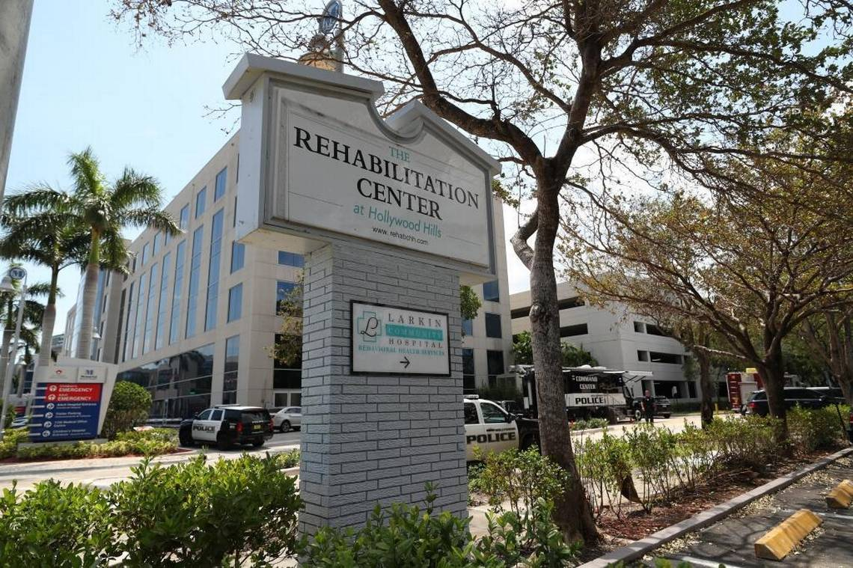
What would this be like for you?

Slide 4
Hollywood hIlls, Hollywood, fl
Circumstances:
  Loss of power leads to “prolonged outage for air conditioning system due to Hurricane Irma” leading to overheated conditions
  Across the street from Memorial Regional Hospital
As of Sept 22, 2017 the 11th resident has died.
  Current criminal investigation.
  All Medicaid funding has been halted and license to operate has been pulled.

Slide 5
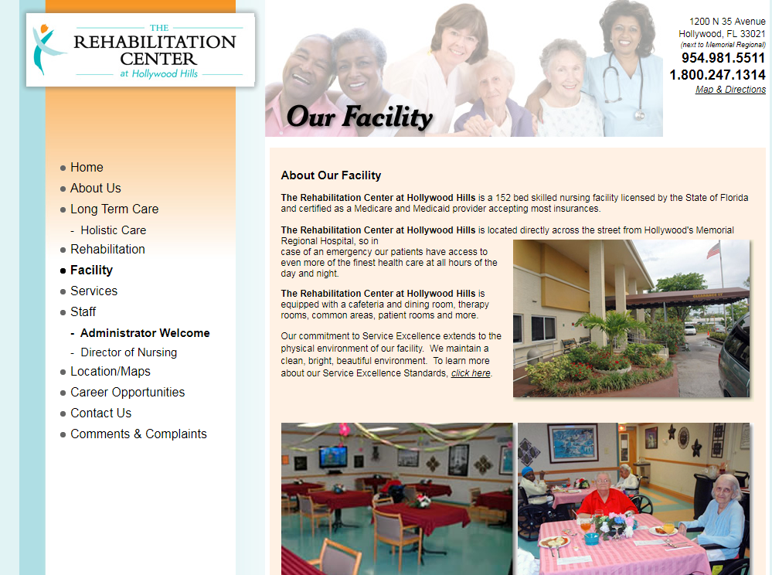


From their website

Slide 6
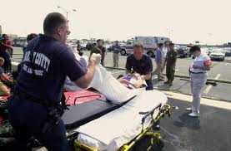
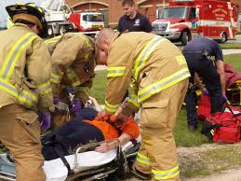
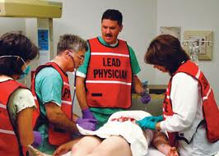
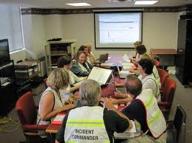
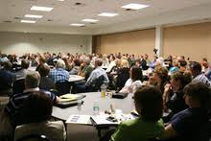

Slide 7
Sectors of Excellence
Prepared to Respond
Emergency
Plan
Policies and Procedures
Communication Plan
Training and Testing

