Slide 1
CMS Policy & Procedures
Chris Breitbach & Lance Ross

Slide 2
Policies & Procedures
Written policies and procedures are critical in the day to day operations of any organization.
They influence and determine all major decisions and actions, and all activities that take place within the facility.
Together, these documents ensure that operational requirements and guiding principles translate into steps that result in successful outcomes

Slide 3
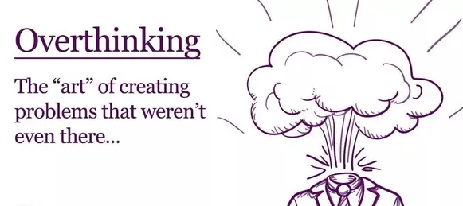

Slide 4
Important to Remember
The requirements do not prescribe or mandate specific technology or tools, nor do they include detailed requirements for how facilities should write their emergency preparedness plans

Slide 5
Important to remember
“We are not requiring a specific format for the manner in which a facility should have their Emergency Plans documented. Upon survey, a facility must be able to provide documentation of the policies and procedures and show surveyors where the policies and procedures are located.”

Slide 6
Purpose of the Rule
The rule addresses the three key essentials necessary for maintaining access to health care services during emergencies:
Safeguarding human resources
Maintaining business continuity
Protecting physical resources

Slide 7
Why?
Past events have identified that the patchwork of laws, guidelines, and standards related to emergency preparedness in health care falls short of the requirements necessary for providers and suppliers to be adequately prepared for a disaster
Because of that, various executive orders and legislative acts helped set the stage for what CMS expects from providers and suppliers with regard to their roles in a more unified emergency preparedness system

Slide 8
Why?
Need for additional health care personnel due to patient surge
Shortages in medical equipment
Challenged accountability of patients
Lack of integrated volunteer response
Lack of clarity regarding authorities
Need for evacuation planning
Challenges with emergency funding and payment mechanisms
Need for functional triage centers and shelters
Challenges in sharing patient information
Overall poor communication
Failure to identify infectious disease
Challenges with isolation setup and triage
EMTALA uncertainty
PPE shortage
Gaps in staff training and education

Slide 9
Policies & Procedures
The general components of the policies and procedures requirement include:
Develop and implement policies and procedures based on the emergency plan & risk assessment
Ensure the policies and procedures address a range of issues including subsistence needs, evacuation plans, procedures for sheltering in place, tracking patients and staff during an emergency
Review and update policies and procedures at least annaually

Slide 10
Do your homework
CMS Conditions of Participation & Accreditation Organizations Crosswalk

Slide 11
Risk Assessment
Hazard vulnerability analysis (HVA) and risk assessment are systematic approaches to identifying hazards or risks that are most likely to have an impact on a healthcare facility and the surrounding community.
From the HVA create policies and procedures based on that risk assessment, so documented emergency plans—like the Emergency Operations Plan (EOP) or Continuity of Operations Plan (COOP)—respond to identified needs.

Slide 12
All Hazards Planning
Facilities are expected to develop an emergency preparedness plan that is based on the facility-based and community-based risk assessment using an “all-hazards” approach.
Facilities must document both risk assessments. An example consideration may include, but is not limited to, natural disasters prevalent in a facility’s geographic region such as wildfires, tornados, flooding, etc.
An all-hazards approach is an integrated approach to emergency preparedness planning that focuses on capacities and capabilities that are critical to preparedness for a full spectrum of emergencies or disasters.
This approach is specific to the location of the facility considering the types of hazards most likely to occur in the area.
Thus, all-hazards planning does not specifically address every possible threat or risk but ensures the facility will have the capacity to address a broad range of related emergencies.

Slide 13
Planning Considerations
Identification of all business functions essential to the facility’s operations that should be continued during an emergency
Identification of all risks or emergencies that the facility may reasonably expect to confront
Identification of all contingencies for which the facility should plan
Consideration of the facility’s location
Assessment of the extent to which natural or man-made emergencies may cause the facility to cease or limit operations
Determination of what arrangements may be necessary with other health care facilities, or other entities that might be needed to ensure that essential services could be provided during an emergency.

Slide 14
When to stay and when to go triggers

Slide 15
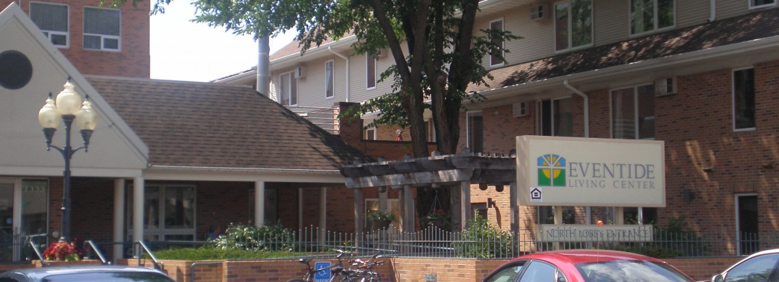
Best Practice

Slide 16
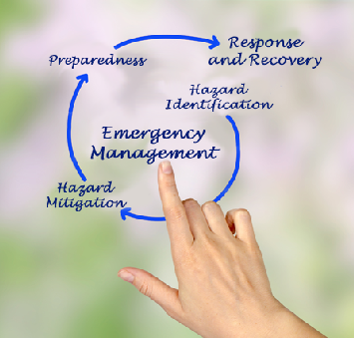

Slide 17
The Final Rule
Increase patient safety during emergencies
Establish consistent emergency preparedness requirements across provider and supplier types
Establish a more coordinated response to natural and man-made disasters

Slide 18
Important to Remember
The requirements do not prescribe or mandate specific technology or tools, nor do they include detailed requirements for how facilities should write their emergency preparedness plans

