Slide 1


Slide 2

Communications Plan – Goal
Ensuring You Have Access to Essential Information
Objectives (Who/What/Why/When/Where/How)
What
  Requirements, Best Practices, Redundancy, Typical Challenges & Gaps
Why & When
  Safety (employees/clients/visitors)
  Business Continuity
  Brand protection
Where & How
  Internal
    Operational Needs
  External
    Local
    Regional
    Clients & Families

Slide 3
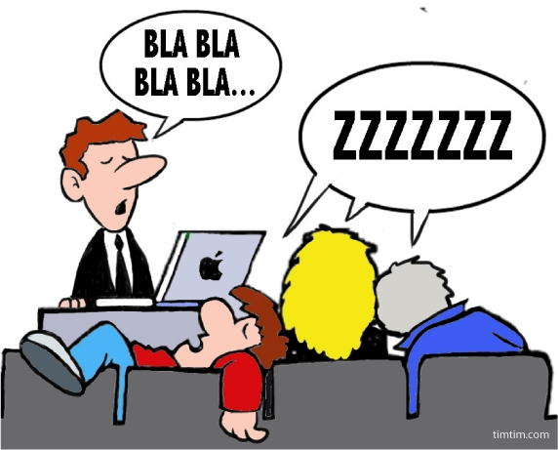
Just to Address any Miscommunication
This is Not the Goal for Today

Slide 4

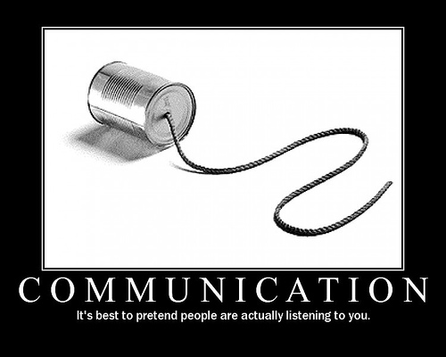
Communication failures have historically plagued organizations in their ability to respond to and minimize the human, operational, and financial impact of critical events and emergency incidents.

Slide 5

Establishing a communication strategy for your operations based on best practices can improve existing crisis communication plans, and help organizations mitigate risk, protect the safety of employees, and prioritize resources where they are needed most.

Slide 6
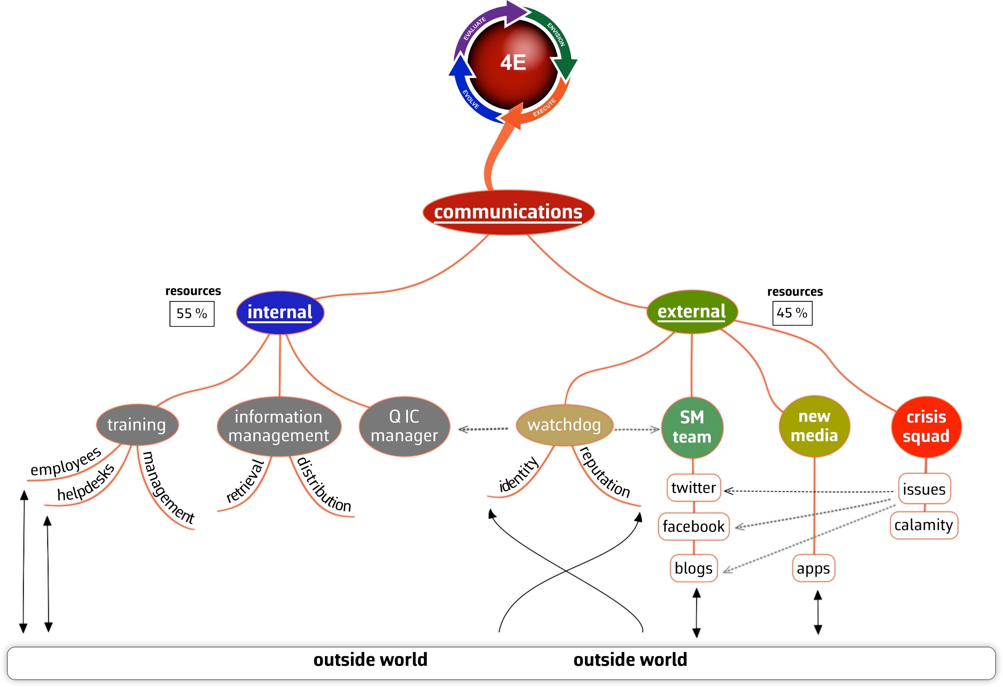
Healthcare
Operations

Slide 7
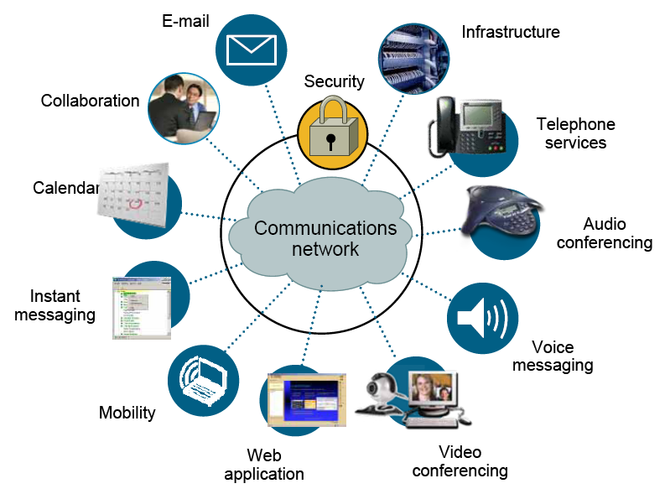

Slide 8


Slide 9
CMS Final Rule Crosswalk
This is an excellent resource and highly recommended
Check out each provider for their details – access through ASPR Tracie
  https://asprtracie.hhs.gov/
  http://files.constantcontact.com/d901e299001/51f80a78-4ff1-4585-8270-f2aea6d39172.pdf

Slide 10
Communication Plan Key Requirements
Develop and maintain an emergency preparedness communication plan that protects patient health and safety in the event of a disaster :
  Complies with federal, state and local laws
  Allows for the coordination of patient care
    within the facility
    across healthcare providers (including EMS)
    with state and local public health departments
    local emergency management
Update the communication plan at least annually

Slide 11
Communication Plan Key Requirements
Have a process for ensuring cooperation and collaboration with local, tribal, regional, state, or Federal emergency preparedness officials’ efforts to maintain an integrated response during a disaster or emergency situation, including documentation of the facility efforts to contact such officials and, when applicable, its participation in collaborative and cooperative planning efforts
As part of its communication plan include in its plan:
  names and contact information for staff
  entities providing services under arrangement, residents’ physicians, other facilities and volunteers

Slide 12
Communication Plan Key Requirements
Include primary and alternate means for communicating with facility staff and Federal, State, tribal, regional, and local emergency management agencies
Include a method for sharing information and medical documentation for residents under the facility's care, as necessary, with other health care providers to maintain continuity of care
Have a means, in the event of an evacuation, to release patient information as permitted under 45 CFR 164.510 (b) (1) (ii).483.73 (C ) 5 6.4.1 12.5.3.3.6.1(4)
Have a means of providing information about the general condition and location of patients under the facility’s care, as permitted under 45 CFR 164.510(b)(4)

Slide 13
Communication Plan Key Requirements
Have a means of providing information about the facility occupancy, needs, and its ability to provide assistance to the authority having jurisdiction or the Incident Command Center, or designee
A method for sharing information from the emergency plan that the facility has determined is appropriate with residents and their families or representatives

Slide 14
HIPAA Privacy Rule Exception
Circumstances that may necessitate the disclosure of PHI during an emergency, the Privacy Rule includes several permissions. Among the most relevant permissions are (short list of examples)
  After an emergency situation has been resolved, a covered entity may need to provide updates to family or other persons involved in an individual’s care. The Privacy Rule, in addition to other potentially applicable provisions, permits the use and disclosure of PHI about an individual to persons that were involved in the individual’s care or payment, as well as to public or private entities authorized to assist in disaster relief efforts.

Slide 15
Metro Region Hospital Compact
Fire
Chemical Spill
Trauma & MCI’s
Medical Emergency
Suspicious or Criminal
Terrorist
Emergency Communication Systems
Interoperable
Integrative
Public Safety Agencies
Metro Region Hospitals

Slide 16
Emergency Communication Management
Alerts/Advisories
Metro Healthcare
Communicated Through
Landline & Cell Phones
Communication System
EMH-CALL
800 MHz Radio
(Hospitals/EMS/LPH/EM)
HAN
Phone & e-mail
MNTRAC
Web-Based
Alerts to Ph./Pager/Email

Slide 17
Complete Comprehensive Assessment of Your Organizations Network and Systems

Slide 18
Phone Networks (landline and cell)
Landline
  Trunk fiber optic phone line systems
  Plain Old Telephone Line
Internet-based VoIP (Voice over IP) system
  VoIP phone system leverages a high-speed broadband or cable connection to route calls as digital data over the Internet. Aside from your Internet connection, all you need to get set up with an offsite-hosted service are compatible handsets.
Call center communication systems (software & hardware)
  Amtelco is one example
Cell phones and or Smart Devices with messaging capbilities

Slide 19
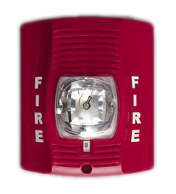
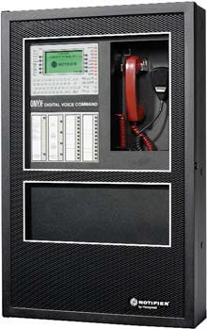
Special Signaling Systems
Fire Alarms (audio, visual or both)
Alertus – messaging to computers & kiosk boards, Cable TV
Overhead paging system
  Fire
  Severe Weather Alert
  Hazardous Material Alert
  Force Protection Threat
  Security Breach
  Bomb Threat
  Natural Disaster Alert
  All Clear

Slide 20


Weather Ready Nation
  Become an Ambassador (no cost)
  Wireless Emergency Alerts
  Daily Weather Forecasts
  Today’s Weather Safety

Slide 21
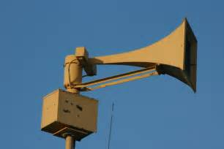
Community Outdoor Warning Sirens
Sirens are used for severe weather warnings, as well as for other situations when people should take shelter and tune to local weather information on radio, television, or NOAA Weather Radio for more information
Weather-related sirens are triggered when the National Weather Service has issued a tornado warning, and/or if there are reports of sustained straight-line winds in excess of 70 mph
Strategically placed throughout the communities
Not intended to alert individuals in buildings (common misunderstanding)

Slide 22

Mass Notification Systems
Numerous Systems with wide variability of capacity and capabilities
Costs vary greatly
Speed and reliability
Ease of use during the situation
Scalability
Few Examples (many choices)
  Everbridge
  Red Alert
  Send Word Now
  Alertus
    https://www.alertus.com/alertusproducts/alertbeacon

Slide 23
Sprint ERT GO-KIT PROGRAM
Sprint developed the Emergency Response Team Go-Kit Program (“ERT Go-Kit Program”) to provide customized short-term communication solutions for those organizations involved in business continuity, disaster relief, recovery operations and pre-planned events.
ERT Go-Kits consist of pre-activated Sprint phones, 3G/4G data cards, other Sprint devices and/or ruggedized Storm Cases™ as ordered by Customer.
Wireless Priority Services:
  You can get access to Wireless Priority Services (WPS) for select device for an additional fee, and if you meet federal eligibility standards, giving your Sprint wireless calls priority queuing into the Sprint network during times of network congestion. For more information about WPS or to submit an application for approval, please visit https://www.dhs.gov/wireless-priorityservice-wps

Slide 24
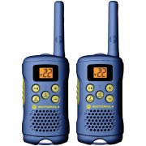
Short Range Radios – Talk About
Normally inexpensive alternative (costs vary – read to reviews)
Range up to 5 miles (depends on structures and barriers)
Set channels in advance to simplify use
Many options for channels (more then you will need)

Slide 25
HAN
Health Alert Network coordinated by MDH & CDC
When a health threat is suspected or identified:
MDH epidemiologists, prevention & control, environmental health, & laboratory system managers with the CDC activate HAN
Health Alerts from MDH have 3 levels of urgency:
- routine (notices)
- time sensitive (most alerts that require action)
- urgent (used rarely urging heightened urgent responses) – eg. Intentional Anthrax Release
Web-Based resources are developed (2 web sites: public & password secured)
- Sent by e-mail and or phone alerts to local public health, public safety, city/county emergency managers, & healthcare agencies (tribal health)
- Recipients are accountable for forwarding the information and taking appropriate action
Updates are made as indicated
- As event evolves
- Event is resolved
- Archived on web site
5. http://www.health.state.mn.us/han/

Slide 26

Minnesota system for Tracking Resources, Alerts, and Communications (MNTrac) is a database-driven web application intended as a statewide solution.
This system has been designed specifically to track bed, pharmaceutical and resource availability from all designated facilities within the state as well as providing for allocation of these resources to support surge capacity needs.
Hospital bed diversion status, emergency event planning, emergency chat, and alert notifications are supported in real time.
Information is aggregated from all facilities and can be transported to other systems and agencies to improve communications and share pertinent information.
Standard and ad hoc reports can also be generated to turn data into useful information.

Slide 27
Internet Based Secure Communication System
Hospital and LTC Bed availability
Alerts and Notifications - real time incidents
Establish “Situation Rooms” to coordinate response
Protracted Incidents (multiple shifts or days)
Command Center – Coordination Room
  Activated by Regional Healthcare Resource Center (RHRC)
  Planning
  Logistics
  Multi Agency Coordination when needed
Recovery

Slide 28
EMH-CALL
800 MHz Radio System
Integrated & Interoperable Communications
Emergency Notification 24/7
  EMH-CALL monitored by all hospitals 24/7
EMH Talk Group Channels 1-4 allow for
  event/incident management
  Coordination of planning/logistics, recovery
TAC Channels
  Ability to cross patch users of 800 Mhz
  Public Safety, Local Public Health

Slide 29
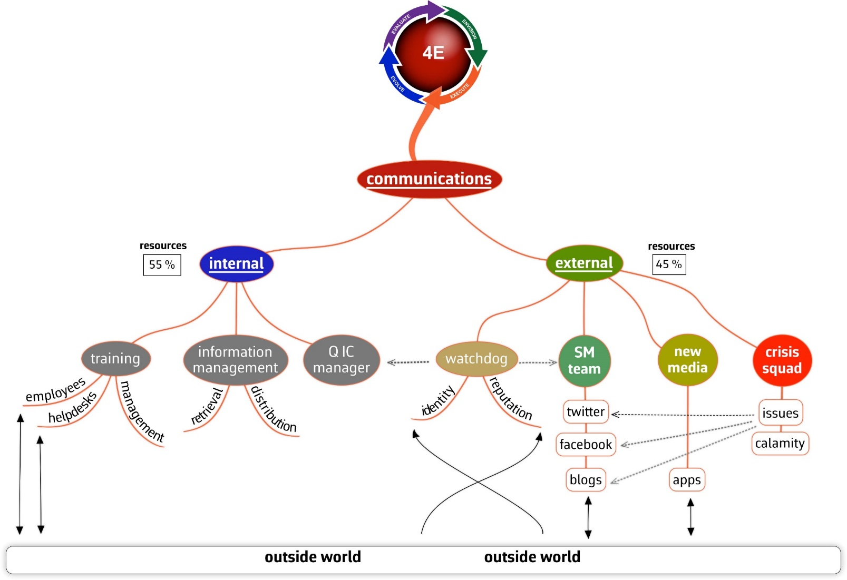
Social Media
Don’t forget to leverage social media as a method for outreach to your clients, families of clients, staff and community
Healthcare Operations

Slide 30
Social Media
During a crisis, social media can be an important input for situational intelligence, helping organizations to create a more complete understanding of an event.
Combined with information gathered via two-way communication, organizations can create an informed response plan that efficiently and effectively uses available resources.
This vast amount of content can be leveraged by organizations that have the tools to filter, analyze, and qualify it.

Slide 31
Key Aspects to Emergency Messaging
Advisory/Notification – be aware & ready to take action
Alert – take action
Mobilization – teams or key individuals respond
Situational updates (establish criteria i.e. every 15-30 minutes)
Pre-scripting messages
  Alert type with brief situation awareness (deliver message in <10 seconds)
    Prescript for all anticipated situations (fire, security incident, medical emergency etc.)
  No more than 3 actions for message receivers to perform
    Some actions will result in more steps or actions

Slide 32

Plain Language Overhead Paging

Slide 33
The Recommendation
The Minnesota Hospital Association recommends hospitals reduce noise by minimizing overhead pages by using other means of communicating; and when possible use plain language with emergency overhead paging to align with its core principles of being transparent with patients and families and increasing patient safety by standardizing safety practices across hospitals throughout Minnesota.
Based on the science of patient safety, variation can be a contributing factor that can lead to adverse events. MHA’s member survey indicated significant variation among Minnesota’s 145 hospitals, such as 22 different codes for patient abduction; 18 different codes for a security alert and code yellow had 5 different meanings. This variation creates confusion for the entire health care team.

Slide 34
Plain Language Principles
This is a voluntary initiative. Each hospital should convene a team to evaluate use of plain language with overhead paging.
Use of plain language will reduce confusion for health care professionals working in more than one hospital, which could otherwise lead to a potential delay in care or patient safety event.
This initiative is not meant to be prescriptive, rather suggested scripting is provided.
Transparency with patients and families is a top priority of MHA and members. Use of plain language for overhead paging is consistent with this priority.

Slide 35
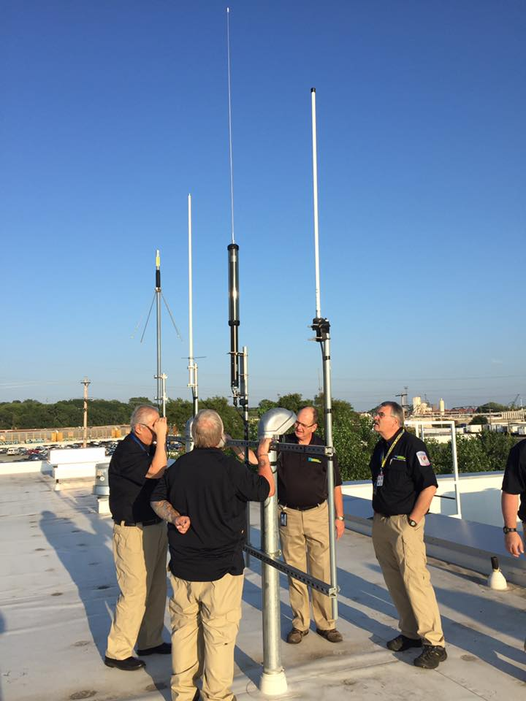
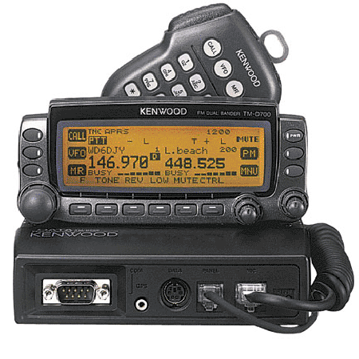
Amateur Radio
Equipment
Radio Club Support
Regional Training to Certify and License operators
Robust Capacity and Capabilities

Slide 36
ICS 213 General Message Form
(When Systems Fail go Old School)
GENERAL MESSAGE
TO: |  |  | POSITION:
FROM: |  |  | POSITION:
SUBJECT: |  |  | DATE: |  | TIME:
MESSAGE:
SIGNATURE: |  |  |  | POSITION:
REPLY:
DATE: | TIME: | SIGNATURE/POSITION:

Slide 37
Summary
Ensure you get the Essential Information to Inform/Involve/Engage
Know your systems capabilities and capacities
Test and Exercise Regularly
  Expect barriers, gaps and failures
  Improve – test frequently

Slide 38

Questions

Slide 39

Mark A. Lappe
Administrative Manager for the Metro Region Healthcare Preparedness Program
Emergency Manager for Hennepin Healthcare Systems Inc. mark.lappe@hcmed.org
Office: 612-873-3869

