Slide 1

Risk Assessment

Slide 2
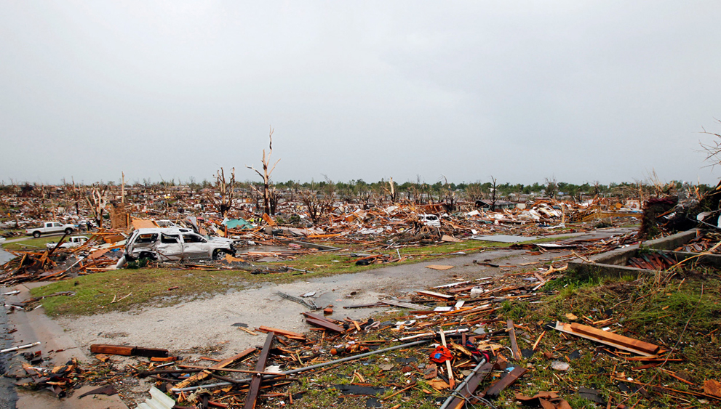
Risk Assessment
Why is Risk Assessment important?
It answers the question, “What would happen if a hazard event occurred in our community?”

Slide 3
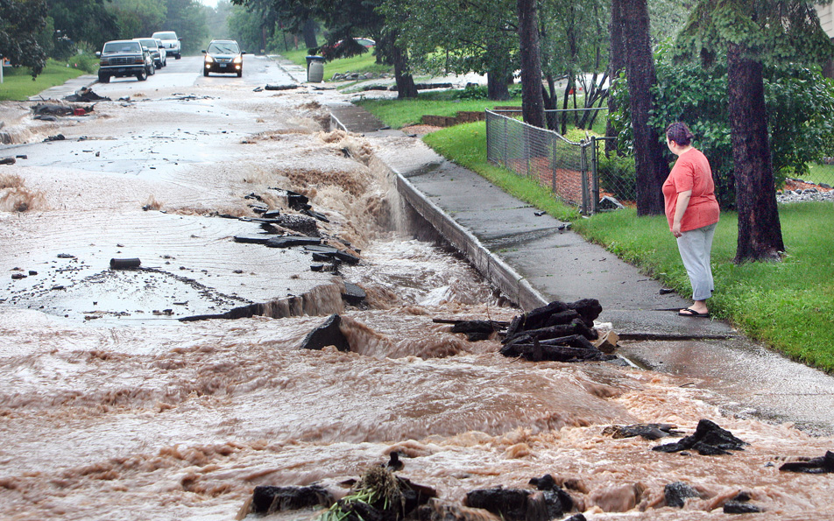
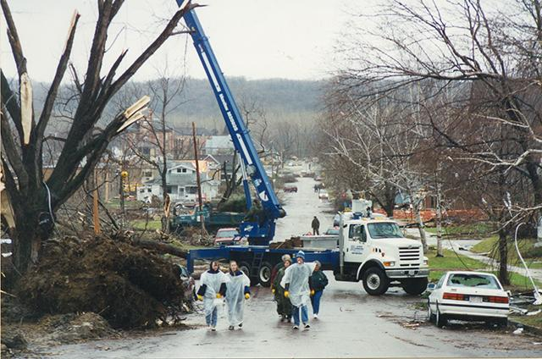
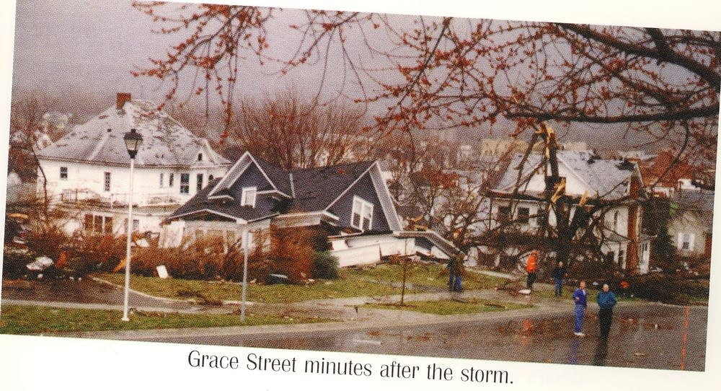
Risk Assessment
What is Risk Assessment?
Risk assessment is the process of measuring the potential loss of life, personal injury, economic injury, and property damage resulting from hazards by assessing the vulnerability of people, buildings, and infrastructure to hazards.

Slide 4
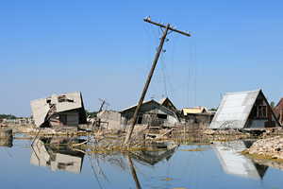
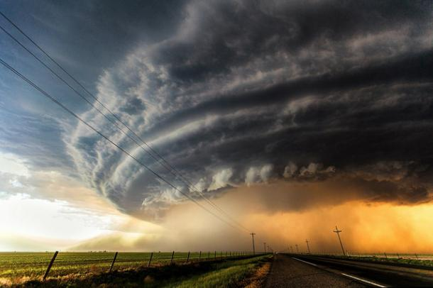
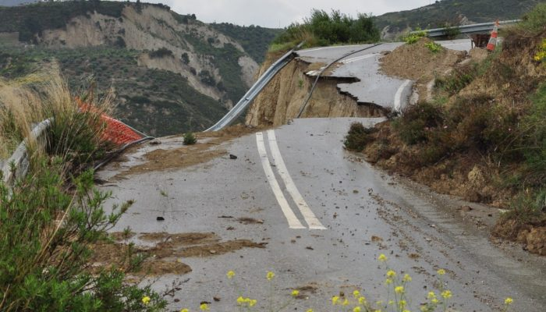
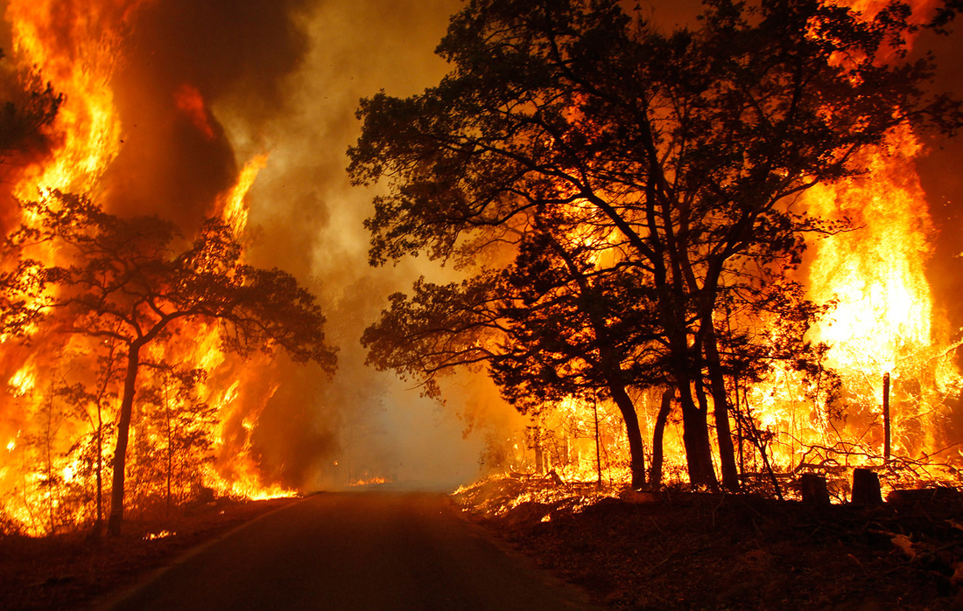
Risk Assessment
Four Basic Components
The four basic components of a risk assessment are:
1) Hazard analysis
2) Profiling of hazard events
3) Inventory of assets
4) Estimation of potential human and economic losses based on the exposure and vulnerability of people, buildings, and infrastructure.

Slide 5
Risk Assessment
1. Hazard Analysis
The process by which hazards that threaten the community are identified, researched, and ranked according to the risks they pose and the areas and infrastructure that are vulnerable to damage from an event involving hazards.

Slide 6
Risk Assessment
History, Characteristics, Trends, Past Damage, Financial, Economic, Human Impacts
2. Hazard Profiling
Definition
Range of Magnitude
Spectrum of Consequences
Potential for Cascading Events
Geographic Scope of Hazard
Chronological Patterns
Historical Data/Previous Occurrence
Future Trends/Likelihood of Occurrence
Indications, Alert & Warning
Critical Values & Thresholds
Prevention
Mitigation
Response
Recovery
HCEM
Hazard
Assessment

Slide 7
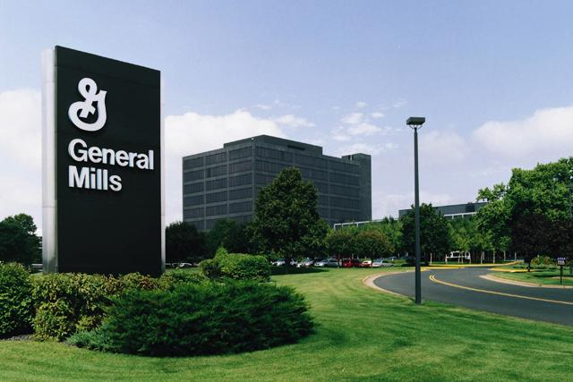
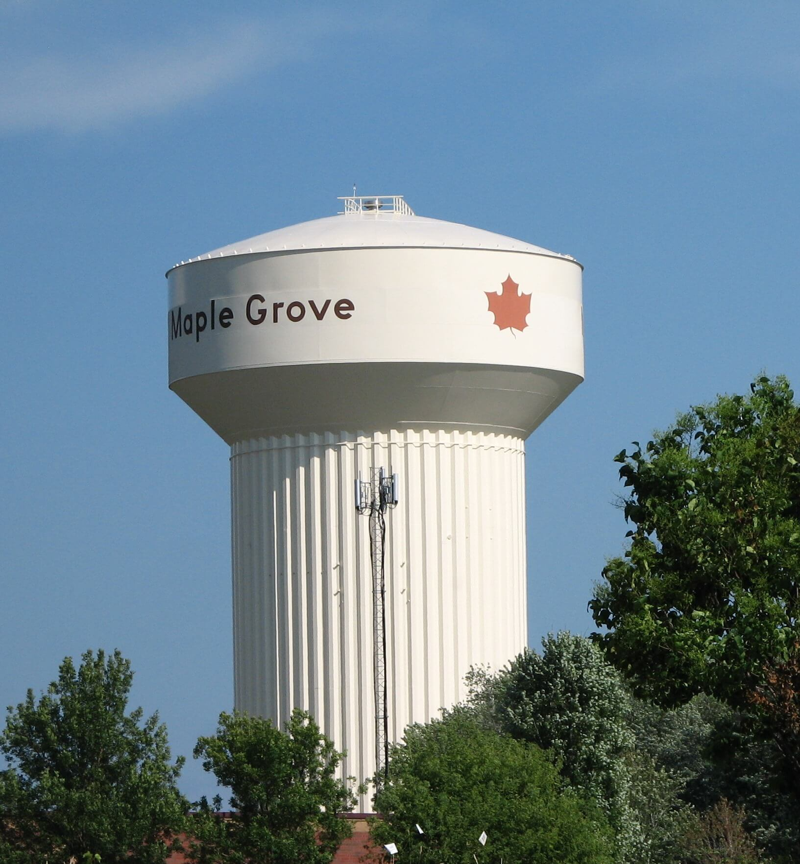
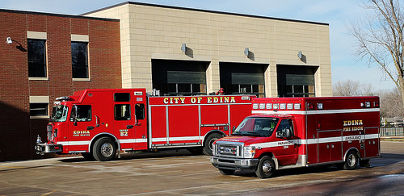
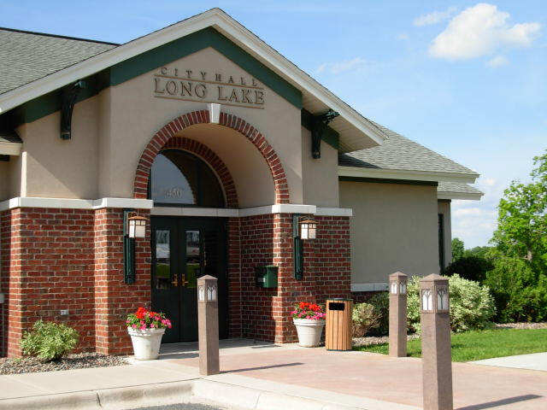
Risk Assessment
3. Inventorying Assets
What assets (Infrastructure) will be affected by the hazard event and why are they important to the community. Know what you have and know what you will need

Slide 8
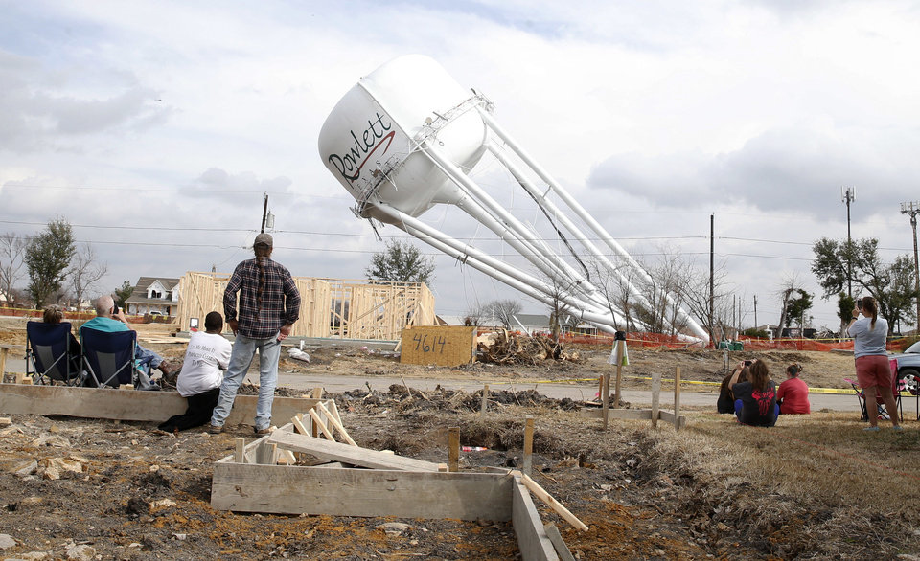
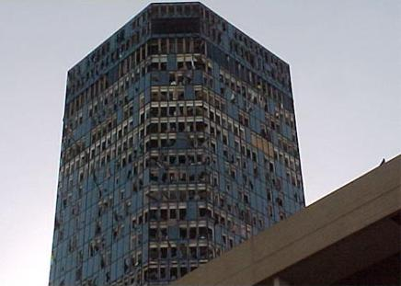
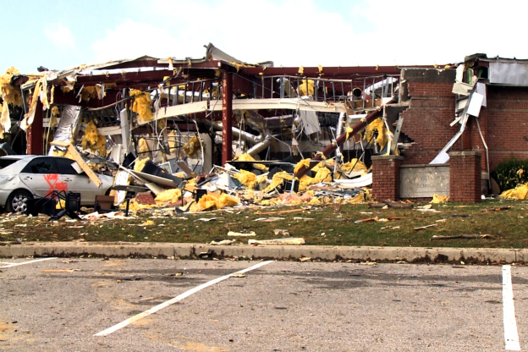
Risk Assessment
4. Estimation of Losses
How will your organizations assets be affected by the hazard event? Economic loss? Facility Cost? Man Hours? Service Provision?

Slide 9
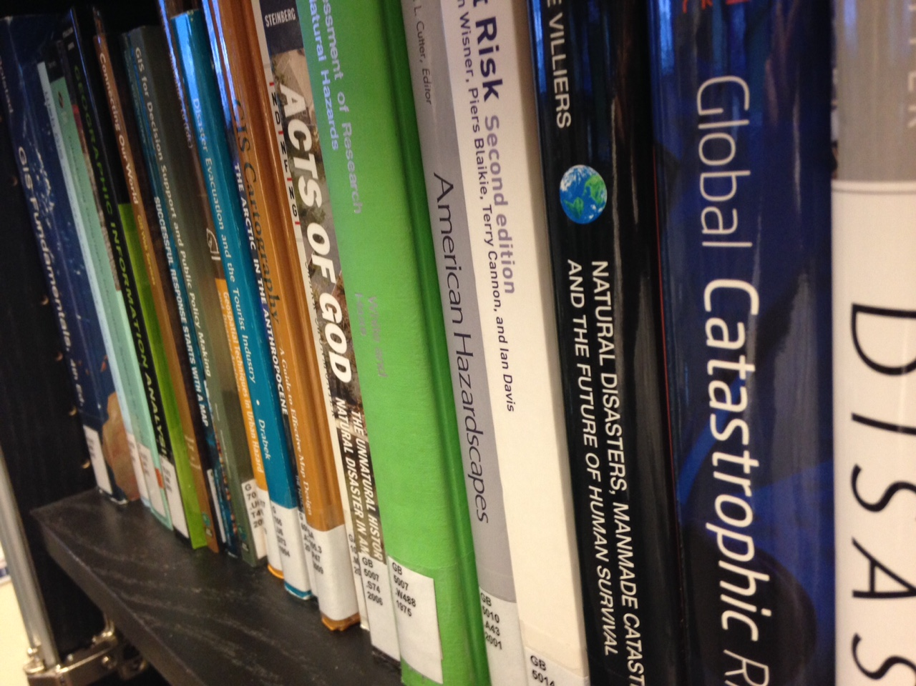

HCEM’s Regional Disaster
Resource Database
Mission
The Regional Research Disaster Database (R2D2) collection supports and serves the information needs of the Hennepin Emergency Management Community, as well as partners in allied emergency fields across the metropolitan Twin Cities and the State of Minnesota. This mission is founded on the central importance of knowledge and information to the planning and practice of emergency management throughout all its phases and activities. Well-informed planning results in improved emergency response.
Notes:
SharePoint site will be available to out side Emergency Management partners and researchers

Slide 10
Bruce Kelii

