Slide 1
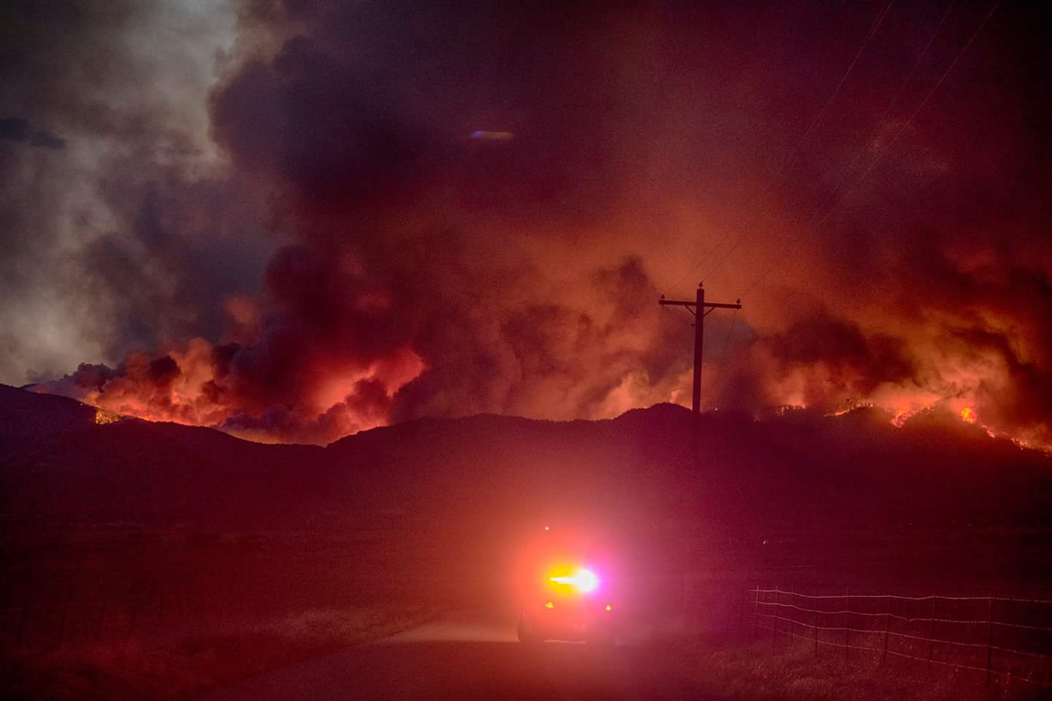
Fire on the mountain
JUNE 27, 2018 thru JULY 16, 2018
The Spring Fire and Evacuation of SPRHC

Slide 2
Notes:
Southern Colorado – Cuchara Valley Region. East Peak fire burn scare in green perimeter from 2013 – 13,500 acres. Spring Fire in yellow perimeter, 108,045 acres. Red oval is approximate starting origin of fire. Walsenburg upper mid-right in green. La Veta in center of map with yellow circle. SPRHC just west of Walsenburg in blue oval.

Slide 3
So It Begins
Fire started on Wednesday June 27th, 2018 at approximately 2:30 pm. Human caused.
Fire location was on the West face of the Sangre de Christo Mountain Range.
Costilla County was responding with multiple agencies and resources.
La Veta Fire Protection District was on stand-by.

Slide 4
June 27, 2018 – 10:30 pm
Notes:
Picture was taken at the Hwy 12 and Hwy 160 junction. Approximately 10 miles from the fire. Night before fire came over the mountain.

Slide 5
SPRHC Incident Command Center Open June 28, 9:00 am
IC briefing and assignments made. Management team briefing at the same time.
Began to monitor situation and make initial preparations for the possibility of evacuation.

Slide 6
Evacuation Stage 1 – June 28, 2:30 pm
Smoke worsening throughout the day.
Operational Period 2 - Decided to evacuate our most sensitive patients and residents.
5 total were evacuated during the afternoon and evening of the 28th.
Notes:
Smoke as fire neared the top of the mountains.

Slide 7
Topping Out - June 28, 5:30 pm
Notes:
Fire jumped the mountain. It looked like lava flowing down the slopes. This fire did things that fires are not supposed to do, like race downhill and move opposite the wind direction.

Slide 8
Over The Top – June 28, 6:00 pm
Began to plan for a possible second stage of evacuation
Preparations concluded at 9:15 pm
Notes:
Began to plan for a possible second stage of evacuation. There is a firenado in the saddle. Fire temp was measured at 4,375 deg F.

Slide 9
IC Stand Down…Or Not
Conducted a final briefing and update. Closed out IC at 9:30 pm.
As we were leaving the facility, things went bad very rapidly.
Residents and staff members were having a very difficult time breathing.

Slide 10
Evacuation Stage 2 June 28
We re-opened IC at 9:45 pm to activate the evacuation of an additional 17 patients and residents. Finished round 2 of evacuation at 3:00 am on June 29th.

Slide 11
2nd Evacuation Picture Tracking for Each Vehicle
Notes:
Every load had a verification photo taken with the vehicle photos, including SPRHC vehicles.

Slide 12
Incident Command Prep for Stage 3 Evacuation
Notes:
Preparing to evacuate the remaining 81 residents.

Slide 13
Nursing Staff Briefing
Notes:
Nursing staff being briefed on evacuation order and sequence.

Slide 14
Ash is Falling
Last bus preparing to leave.
Notes:
Ash began to fall again as the last two buses were preparing to load.

Slide 15
Evacuation Complete
Evacuation of 104 patients and residents was completed at 1:10 pm on June 29th.
Less than 18 hrs, to 8 facilities, 40 to 110 miles.
Command Team briefing held to discuss next steps and updates.
Management Team briefing held at 2:00 pm.
Implemented reduced staffing levels across all depts.

Slide 16
Why We Evacuated – 2:30 pm

Slide 17
Why We Evacuated- 4:00 pm
Notes:
This picture was taken at approximately 4:00 pm on June 28th. This was before the inversion later that night. It was dark enough that our parking lot lites came on. We are in the direct path of the smoke plume. The plume fell at approximately 9:30 pm as we were leaving the building for the night.

Slide 18
Operation “Bring Them Home”
Notes:
Didn’t like name so re-named. This began before evacuation was complete but began in earnest on June 30th.

Slide 19
Operation “Bring Them Home”
Began before the evacuation was completed.
What would be the deciding factor for return?
Same as deciding factor for evacuation.
Air Quality – must be showing consistent trend of good for at least 2 days.
Weather forecast also must support continued good air quality.
Preliminary target date of July 3rd for return.
Notes:
Consulted with the climatologist from the IMT about what to look for as indicators that it would be safe to return.

Slide 20
In the Mean Time…June 30 thru July 4
Air quality monitors were installed, one on SPRHC campus, one in La Veta, and one in Alamosa.
Direct access to reports given to facility for monitoring.
Senior Administrative Staff visited each facility at least once during the duration of our evacuation
Unoccupied areas of facility were secured for badge access only 24/7.
Notes:
One on SPRHC campus did not work for first few days. Was repaired and functioning before return decision was made.

Slide 21
In the Mean Time…cont.
Staffing assignments made to travel to receiving facilities.
Updates given to family members as situation dictated.
EOC was informed daily of facility status.
CMS/VA/Colorado DHS were updated daily.
Environmental services personnel conducted deep cleaning procedures as building was empty. (Began on July 3 and completed July 4)
Notes:
Staff rotated shifts between facilities as needed. Also worked with Logistics to gather supplies and delivered them at shift changes.

Slide 22
In the Mean Time…cont.
July 3rd target date was 1st good air quality day.
2 distinct fire plumes from the Spring Fire south and north
Notes:
Fire broke into two fires South and North. 2nd IMT brought in to manage North Spring Fire so we had the Black and Blue Team(s)

Slide 23
In the Mean Time…cont.
Moved Operation “Bring Them Home” to July 5th.
Began to finalize the sequence of return.
Returns were staged over 3 days to bring facility back into full operation.
Air quality remained in the good category for July 4th. Weather forecast to remain good.
July 5th, the go for operation “Bring Them Home” was initiated.

Slide 24
Homecoming July 5
Before the rain
RAIN!!!!
Notes:
First to return, finished just before the rain. First moister in over 5 months.

Slide 25
Homecoming July 6
Notes:
A celebration welcome home tunnel with high fives and a lot of cheering!

Slide 26
Homecoming July 7
Notes:
Final residents are home! Victory declared!

Slide 27
Incident Command
Incident Command remained open in virtual mode July 7th thru July15th.
Continued to closely monitor fire and air quality.
Held final briefing and hot wash on July 16th.
July 16th – Incident Command Closed for the Spring Fire.

Slide 28
Summary and Conclusion
This event was the 4th live event for SPRHC in 2018. This is the 3rd largest wildfire in Colorado history at 108,045 acres.
The decision to evacuate our facility was a very difficult decision. The financial impact to the facility, employees and the community were all brought to the table for discussion. In the end, the Command Team, without hesitation, believe that this was the only option for the safety and wellbeing of our residents and patients.
It also cannot be overstated that 18 years of exercises and real life events have prepared us to execute this event in a calm and orderly manner. We will continue to exercise different scenarios and events to ensure we are as prepared as we can possibly be.

Slide 29
??? Questions ???

Slide 30
Contact Information
Dave McGraw, Director of Safety and Emergency Preparedness and Response
Spanish Peaks Regional Health Center
23500 U.S. Hwy 160, Walsenburg, CO 81089
E-mail: dmcgraw@sprhc.org
Phone: 719-738-5145

