Slide 1
COVID-19 Entrance Screening
Vern Lougheed, Director of IT/ISO
August 7^{7h}, 2020

Slide 2
Goals
Meet all requirements – regulatory and internal
Contactless
Keep everyone safe
Easy and quick
Auditable
Reportable – Analytics
Process for visitors/vendors and patients

Slide 3
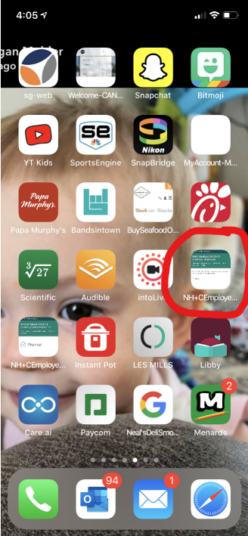
Screening Process Today

Slide 4
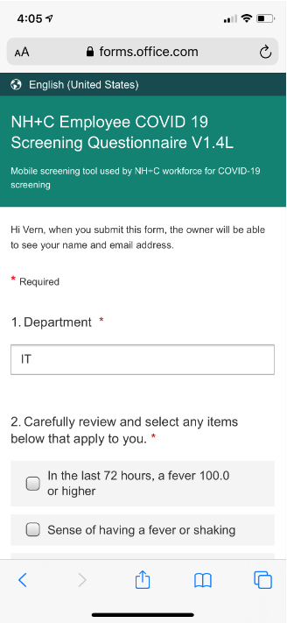
Screening Process Today

Slide 5
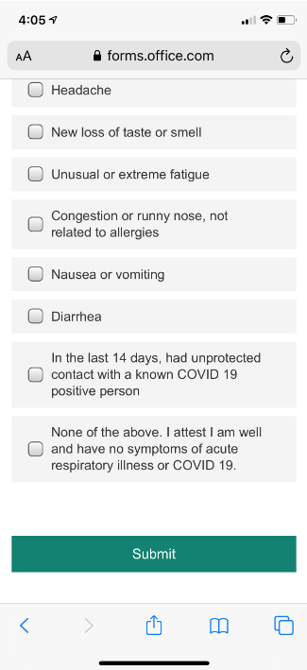
Screening Process Today

Slide 6
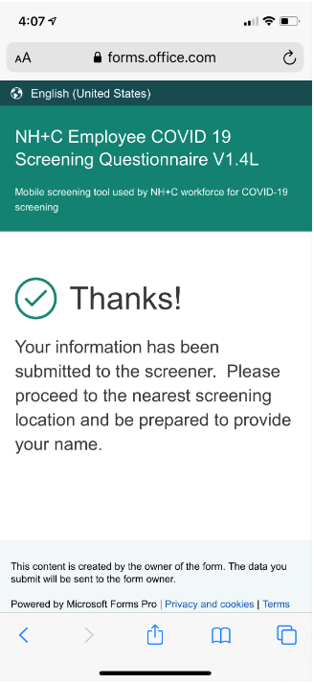
Screening Process Today

Slide 7
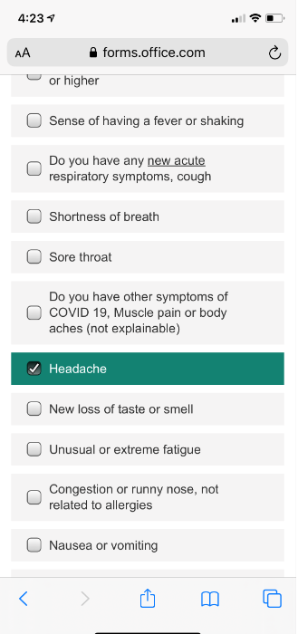
Screening Process Today – Chronic Condition

Slide 8
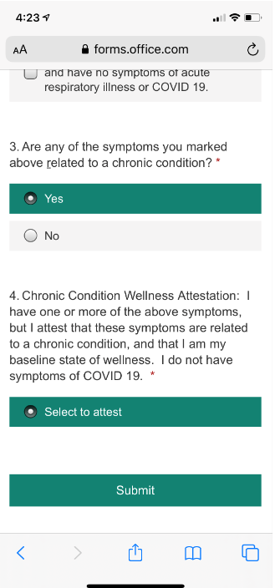
Screening Process Today – Chronic Condition

Slide 9
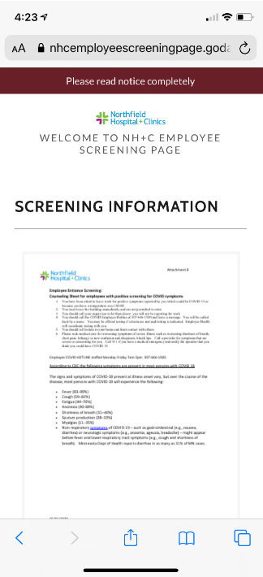
Screening Process Today – Symptomatic

Slide 10
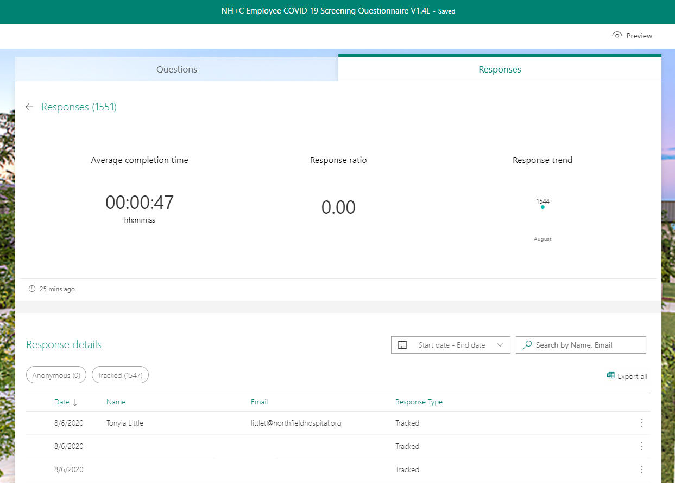

Slide 11
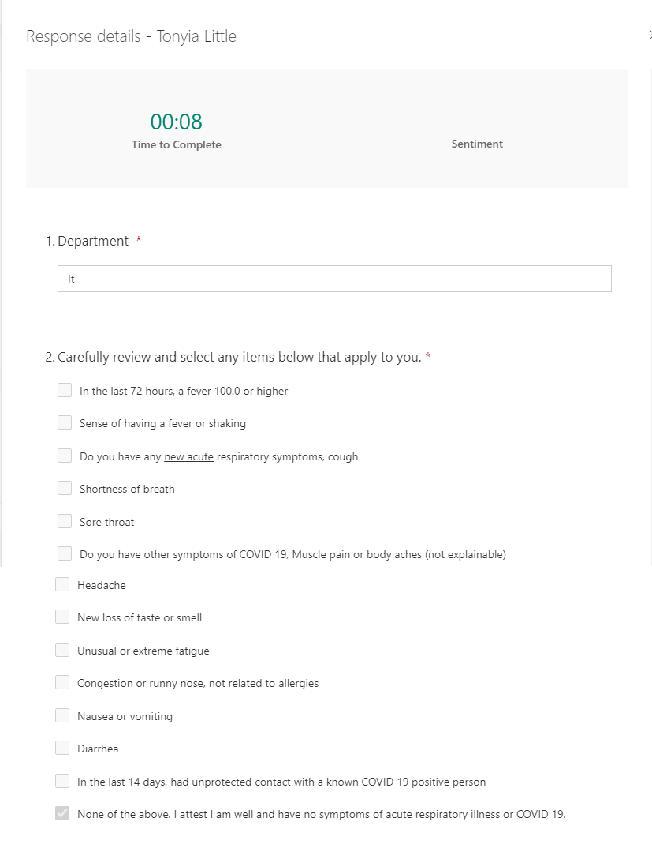

Slide 13
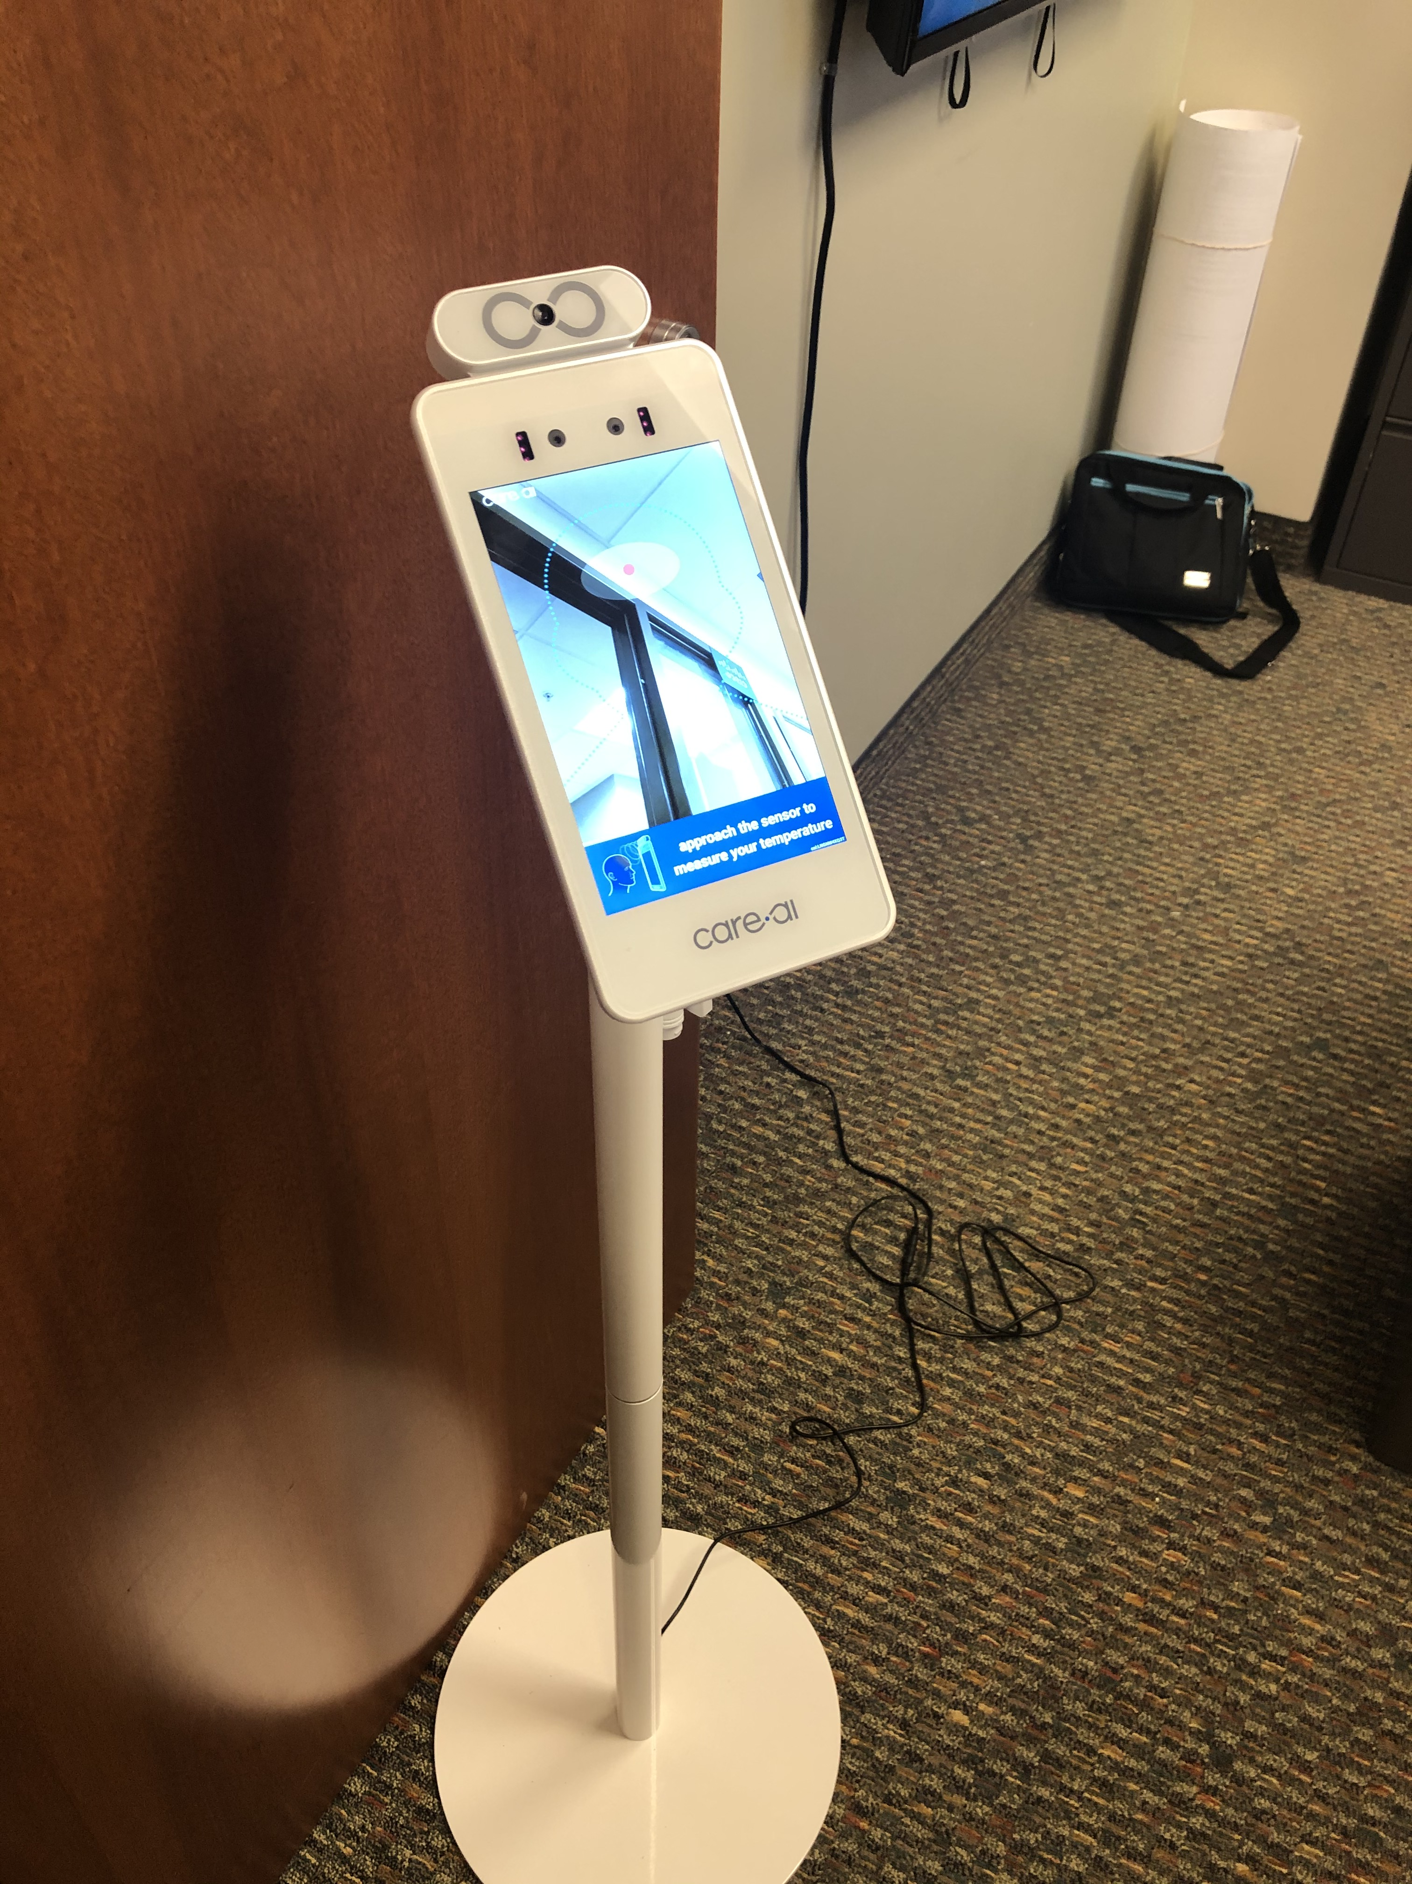

Slide 14
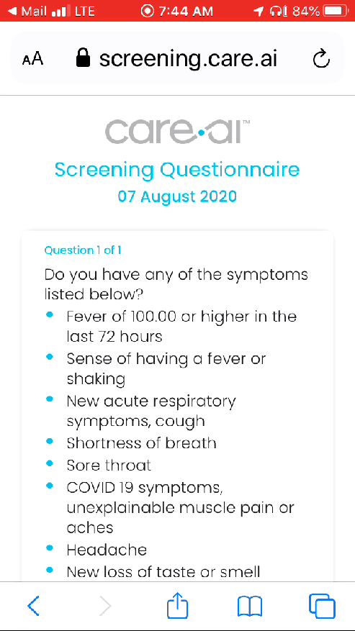
Future Screening Process

Slide 15
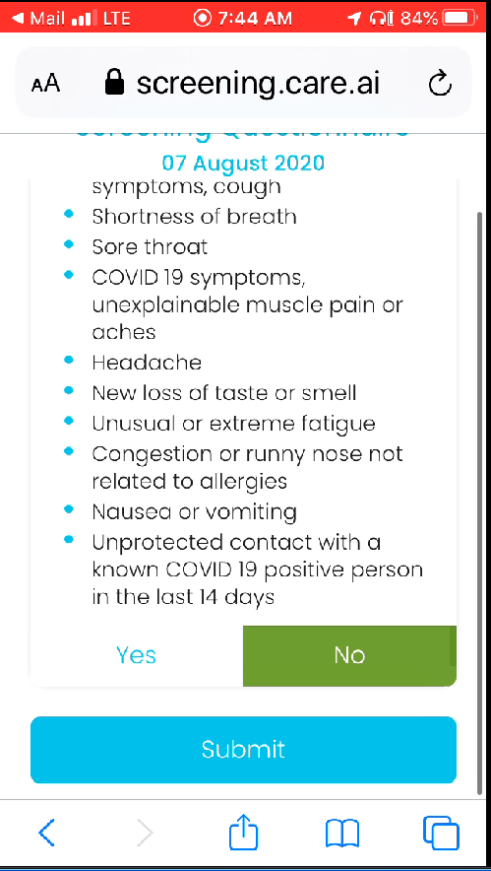
Future Screening Process

Slide 16
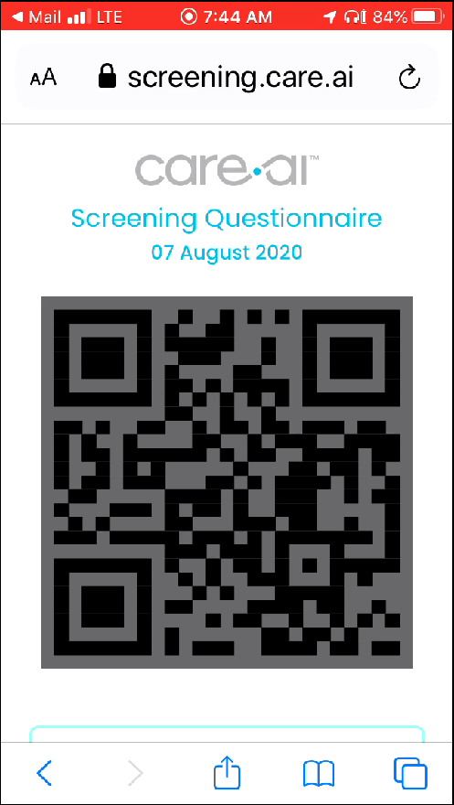
Future Screening Process

Slide 17
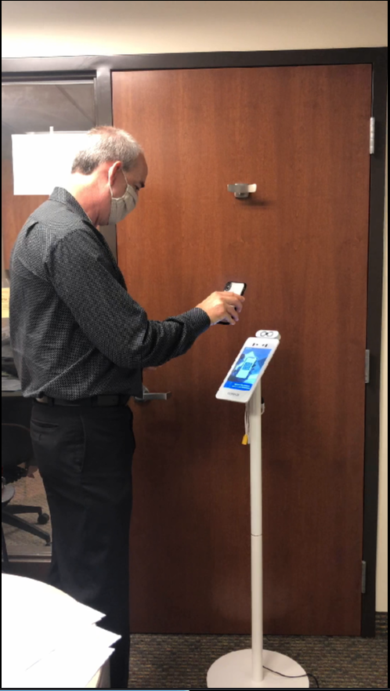
Future Scanning Process

Slide 18
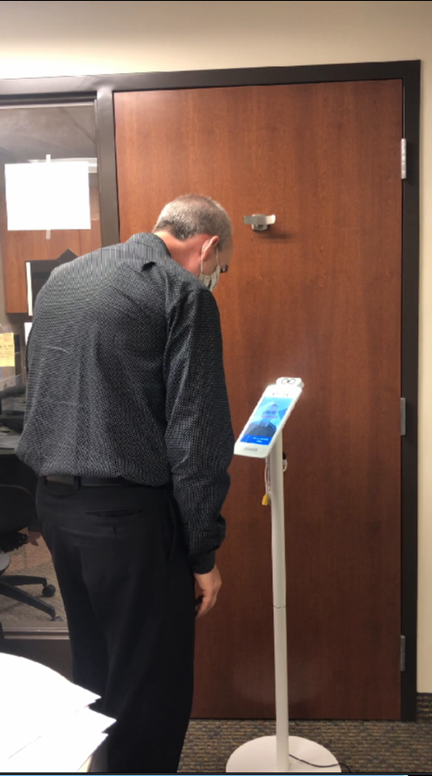
Future Screening Process

Slide 19
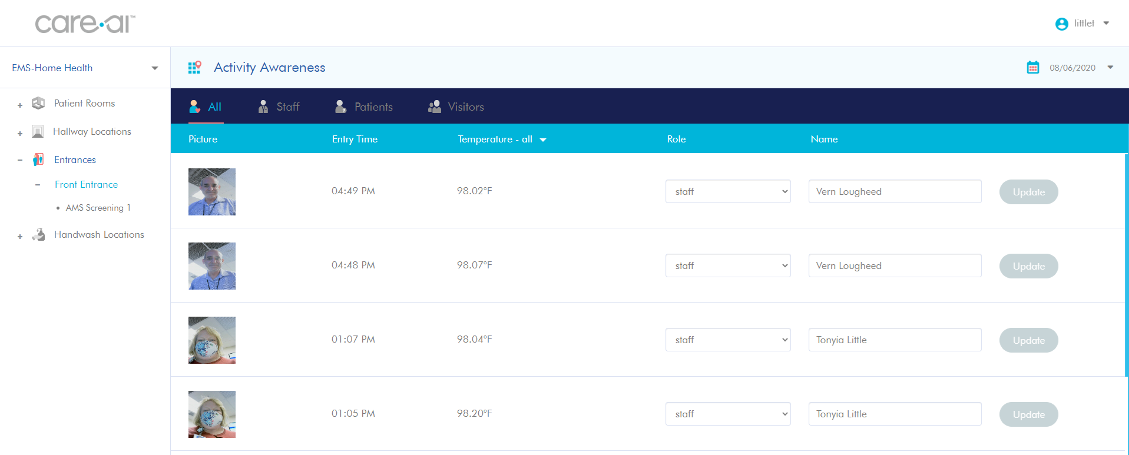

Slide 20
How is this active screening?
Alerts – Realtime text and/or email
QR Code is only generated when no symptoms
Expiring QR Code
With symptoms, staff must be cleared
Condition of employment
Visitors/vendors and patients - same process
What else could we do?

Slide 21
Questions

