Slide 1
Disaster Behavioral Health Update
Nancy Carlson| Disaster Behavioral Health Program Coordinator

Slide 2
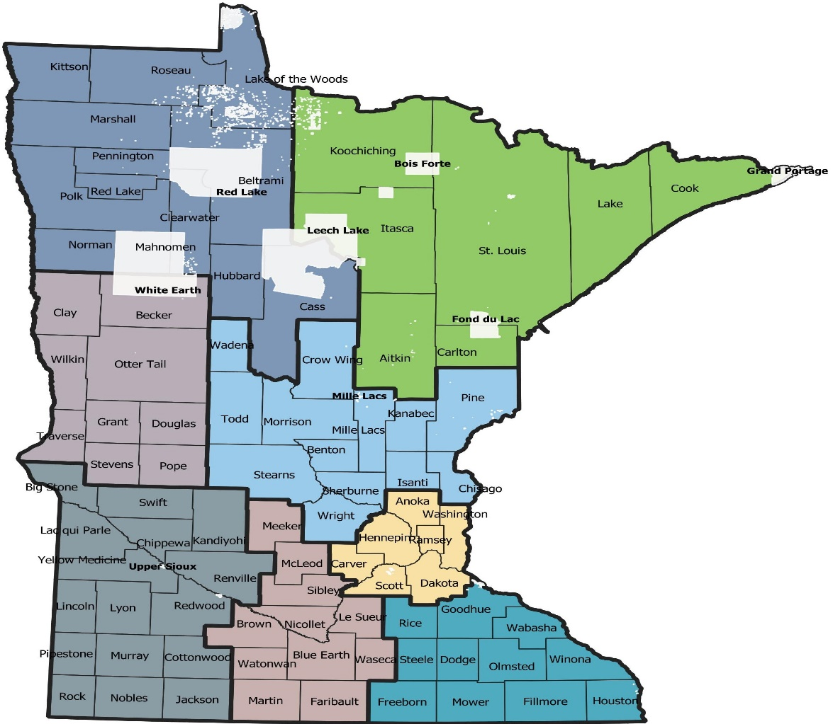
Regional Behavioral Health Coordinators (RBHCs)
Northwest & Northeast Region – Luke Campbell, MA
West Central & Central Region – Kevynn Schumacher, MS
Southwest & South Central Region – Hanna Marzinske, MBA
Metro & Southeast Region - Janet Yeats, MN LMFT
Notes:
We have been fortunate to be able to contract for Regional Behavioral Health Coordinators since December 2021. though the CDC Workforce Grant to focus on COVID-19 Public Health Responder Recovery. While PH is our focus group, we have extended most of our recovery support services to include traditional and nontraditional COVID-19 responders. I will talk more about those services Introduce RBHCs

Slide 3
MN Post-Disaster Stepped Care Intervention Model
Notes:
This graphic displays our standard DBH intervention model.

Slide 4
MN Post-COVID-19 Pandemic Stepped Care Intervention Model
Information & Education
Self-Awareness &
Self-Nurture
Peer Support
PFA
Tx
SPR
Notes:
This graphic displays the post-COVID-19 Pandemic intervention model that we are using. All of these interventions are evidence-informed or evidence-base.

Slide 5
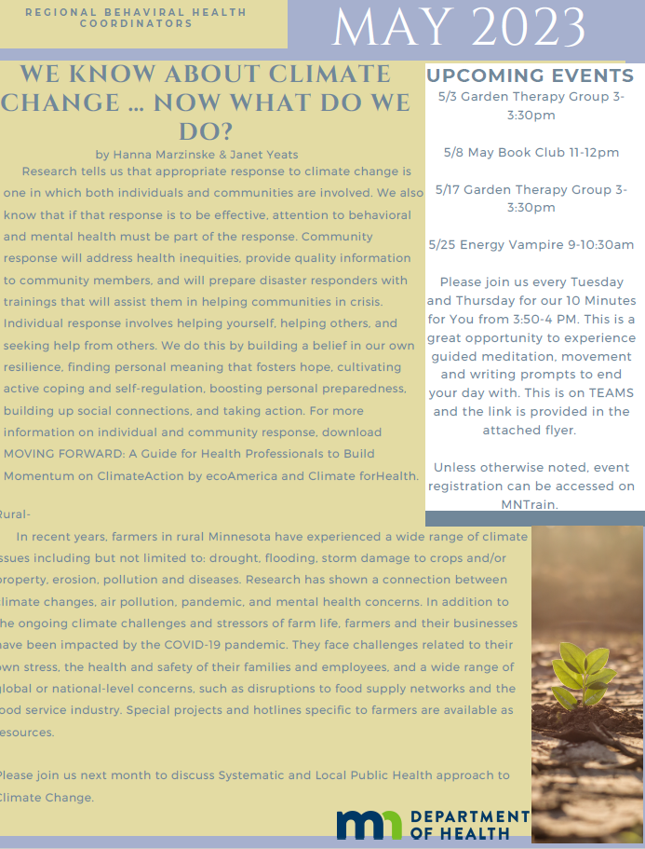
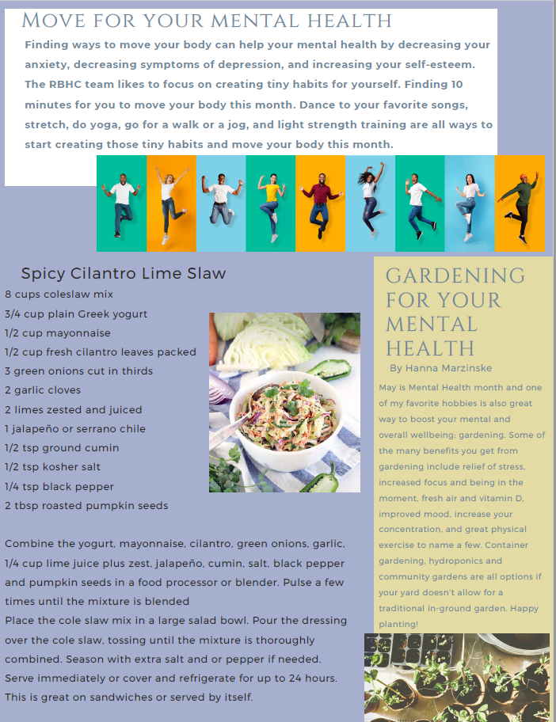
Information & Education
Survivor Guilt
Grieving our losses: Defined and Ambiguous
De-Escalating Emotionally-Charged People and Situations
Understanding What Drives Your Staff: The Science of Organizational Psychology
Climate Change and Behavioral Health Impacts in Minnesota and Beyond
Vanquishing the Energy Vampire
Communication IN and Out of Disaster June 13th from 9-10:30 am - registration: https://www.train.org/mn/ with ID#1109162
Notes:
Information & education

Slide 6
Facilitated Self-Awareness and Self-Nurture Activities

Slide 7
Peer Support

Slide 8
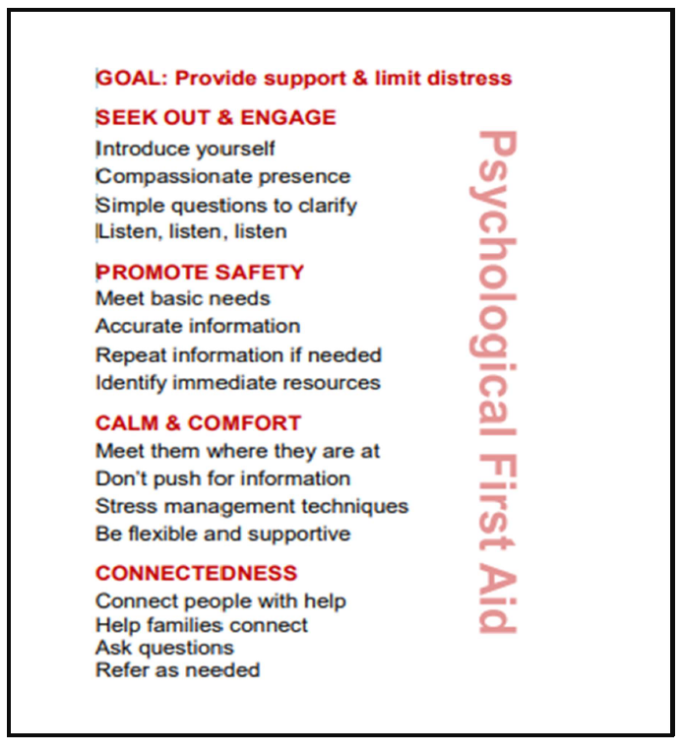
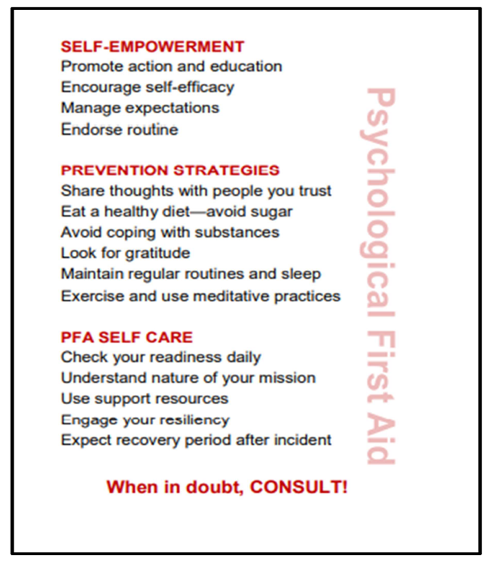
Psychological First Aid (PFA)

Slide 9
New Online Psychological First Aid (PFA)

Slide 10
Skills for Psychological Recovery (SPR)

Slide 11
Coming Soon Online Skills for Psychological Recovery (SPR)

Slide 12
Behavioral Health Medical Reserve Corp (BH MRC)
Mission: Statewide group of volunteer behavioral health specialists, whose task is to support the global resiliency of communities during disasters and public health emergencies.
Vision: To foster resilience and build healthy Minnesota communities.

Slide 13
BH MRC Activities
BH MRC Student Intern, Tessa Jester
Recruiting volunteers.
Updating volunteer manual and intervention materials.
Goal to not only rebuild and strengthen the team, but to also develop a Mental Health Level 1 EMAC team.
August 3 & 4, 2023 -BH MRC volunteer orientation and training camp at Camp Ripley.
Not yet set, but hopefully will be offering another training in fall 2023.

