Slide 1
Leveraging Capacity to Influence Personal Resilience
Kerry P. Appleton, MAN, RN, CCRN-K
HeartMath Certified Trainer
Notes:
Welcome & brief into from each presenter

Slide 2




Identify the emotions & feelings that impact person capacity
Learn & Practice energy self-regulating techniques
Create a choice point that benefits your physiology
What to Expect
Notes:
SAY:
This is what you can expect to get out of today
We will be presenting a portion of HeartMath’s resilience advantage

Slide 3

You FUNCTION
at your best when you are frustrated,
worried, or sad.
Notes:
Read statement and ask people to raise their hand if they AGREE
Most of us do not function at our best, but have you ever thought about why? These emotions are impacting our capacity, and this is what we will spend our time on this afternoon

Slide 4
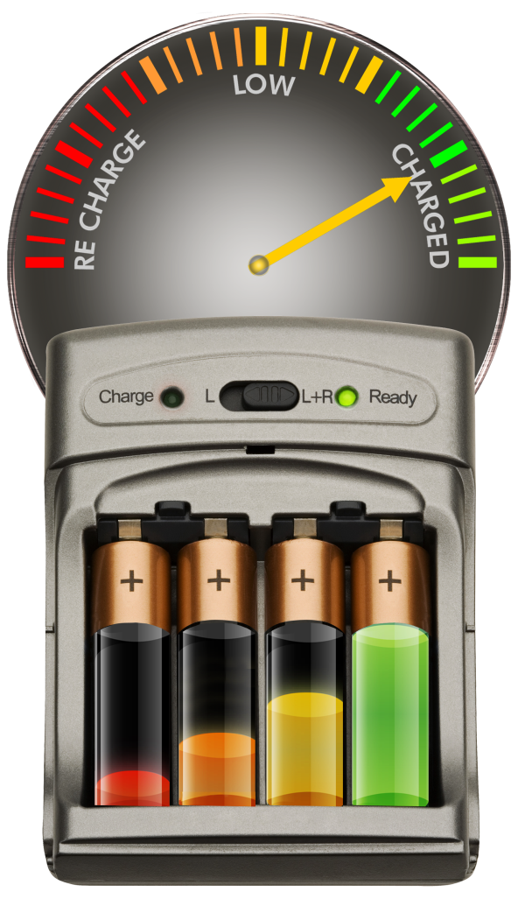

Resilience
The capacity to prepare for, recover from and adapt in the face of stress, challenge or adversity.
You can learn to build your resilience capacity and sustain your energy.
Notes:
Open with cell phone analogy
What's your current battery life?
How do you feel when your cell phone batter is running low?
Would you ever willingly go into situations day after day with your cell phone battery low?
Resilence is much like our cell phone battery & if we wouldn’t let our cell phone batter go low why would we let our resilience run low
read definition
Capacity is the key to this definition!
Think about the difference between your response or reactions with a full tank vs. an empty tank
When you run more effectively, you can naturally expand your capacity.

Slide 5
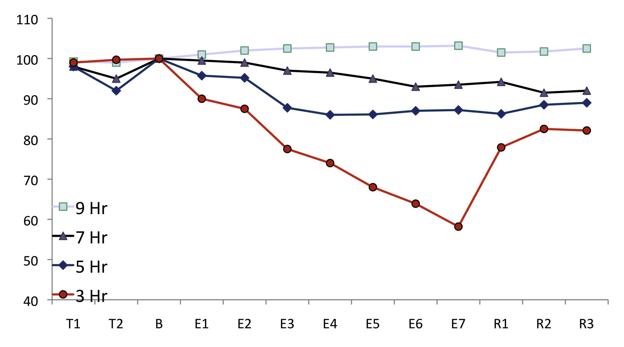
Performance & Sleep
Baseline
Sleep Restriction
Recovery
Mean Speed
(% of Baseline)
Days
Psychomotor Vigilance Task
Belenky & Wesensten , 2003
Notes:
SAY:
This is why we are here today- Walter Reed Army Institute of Research, sleep lab, 4 groups, allotted 9/7/5/3 hrs sleep each night for 1 week, waking hours tested on reaction times at regular intervals
-9 hrs gradually increased in performance ability
-Fewer hours of sleep, bigger drop in performance ability
-Researchers initially thought 3 nights with 8 hrs of sleep would be enough to recover back to baseline performance levels, but performance didn’t recover as expected.
-Does anyone want to guess how many consecutive nights of getting 8 hours of sleep that it took before performance recovered back to baseline? 2 weeks
-Researchers greatest concern, when they asked the test subjects about their perception of their performance, all thought they were performing normally, none were aware of impairment
ASK:
-How many of you consistently get 8 hours of sleep for 2 weeks at a time?
SAY:
-HM tools, shifting into a coherent state for even a few minutes before going to bed, can help align, boost body’s regenerative process, help quiet the mind & shift emotions

Slide 6

Depleting & Renewing Emotions
Notes:
Use depletion/ renewal worksheets
- Emotions are not good or bad but rather drain or renew
-Primary drivers of our physiology, driving activity in nervous and hormonal systems
-1400 different biochemical and hormonal changes tell our energy systems use more energy or conserve/replenish energy

Slide 7

Depleting Emotions
Emotions such as fear, frustration, impatience and anger have a toxic feeling and cause the release of stress hormones.
This often results in:
Reduced muscle mass
Brain-cell death
Impaired memory
Accelerated aging
Impaired mental function
Diminished performance
Notes:
SAY:
How clearly do you think when you are overwhelmed or angry?
Emotions such as impatience, anxiety, frustration & sadness reduce resilience and affect your ability to think clearly and communicate effectively
Cortisol is the hormone that is produced by our body even in brief emotional reactions.
Setting of a cascade of biochemical changes that can last up to 12 hours! This is why emotional upsets during the day can have a disruptive effect on getting a good night’s sleep
Serious health problems occur when we hold onto depleting emotions too long
DO:
Read off list

Slide 8

Husband & Wife Arguing
Wife said something that got under his skin.
Heart Rate (BPM)
Heart rate remains elevated
after argument ends.
Minutes

Slide 9

Renewing Emotions
Emotions and attitudes such as care, courage, tolerance and appreciation create neurochemicals that regenerate your system and offset energy drain, resulting in:
Increased longevity
Increased resilience to adversity
Improved memory
Improved problem-solving
Increased intuition and creativity
Improved job performance and achievement
Notes:
SAY:
Renewing emotions, attitudes and feelings recharge your inner battery.
Research show that the benefits of renewing emotions include: (read list)
Positive emotions also set in motion 1400 biochemical/ hormonal changes.
But these changes are very different then depleting emotions.
The hormone that is released with renewing emotions is DHEA (Dehydroepiandrosterone) = the vitality hormone!
This is good stuff and we can make this ourselves when we are experiencing these emotions.

Slide 10
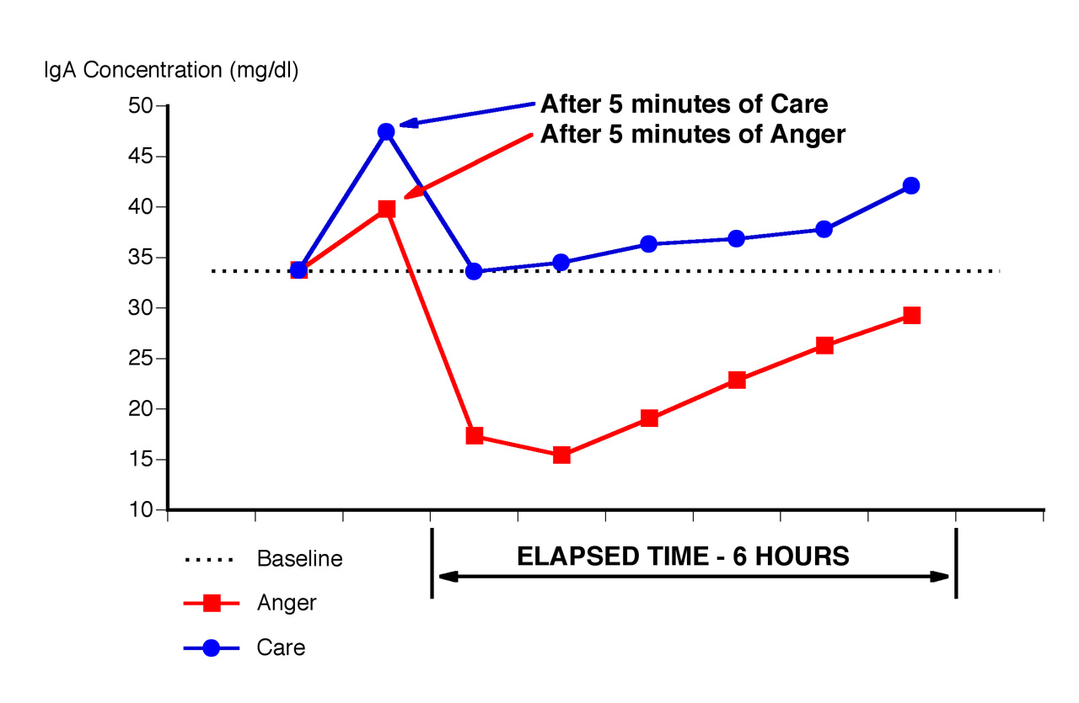
Care & Immunity
Notes:
-IgA (immunoglobulin A) is found in saliva, first line of defense against bacteria/viruses/pathogens. High IgA, more resistance. Low IgA, less resistance, immune system vulnerable
-Baseline, blue graph, feel care, increase, baseline, increased above baseline for 6 hrs, increasing resistance
-Red graph, feel anger, just 5 min, increase, reduced from baseline for 6 hrs, decreasing resistance

Slide 11
Self-Awareness
One of the most important steps in being able to stop energy drains and increase resilience is to expand our awareness and identify unnecessary energy expenditures.
Notes:
SAY:
So the first big step is to identify where you are draining energy.
You need to know where the leaks are, so you can plug them up
Examples:
Worry- COVID/ job/ kids… Does this emotion help the issues?
Frustration- my mother-in-law/ how messy my kids leave our house… Does this emotion help these issues?
No, they just make me tired. I am spending energy on a fruitless effort
I tend to be a worrier by nature.
My worrying doesn’t change those situations.
A better way to deal with it is to not be stuck in the worry.

Slide 12

Heart-Focused Breathing™ Technique
An Intelligent Energy Self-Regulation Technique
Notes:
SAY:
With a greater awareness of how your emotions are impacting your energy level, I’d like to share a HeartMath tech. called HFB

Slide 13
Heart-Focused Breathing™
Heart-Focused Breathing is a powerful and effective tool for self-regulation.
It’s the first step in shifting to a more coherent state – you are alert and calm at the same time.
It can help you maintain your composure in challenging situations.
Notes:
SAY:
When we are feeling a drain here is a technique that will help
This is the first step towards shifting to a more coherent state = alert + calm
Deceptively simple, but can be a powerhouse tool

Slide 14
Heart-Focused Breathing™ Technique
Focus your attention in the area of the heart. Imagine your breath is flowing in and out of your heart or chest area, breathing a little slower and deeper than usual.
Suggestion: Inhale 5 seconds, exhale 5 seconds (or whatever rhythm is comfortable).
Quick Step: Heart-Focused Breathing
Notes:
DO:
Unpack the technique
Let me explain the why:
I’m asking you to slow your breathing down I’m asking you to slow your heart rate down.
During times of stress our heartrate goes up
Second, I’m going to ask you to focus on the attention of your heart
If you are focusing on your heart or your pinky finger, what are you not doing? (Answer: Thinking about everything else)
The goal is to quiet all the other noise in our minds and begin to create an alignment between our heart, mind and emotions.
SAY:
Provide a guide experience with HFB
ASK:
What do you notice about yourself?

Slide 15
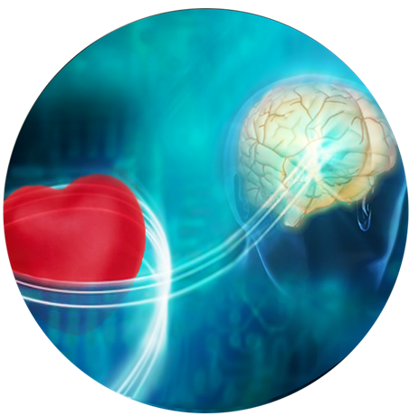
The Physiology
of Coherence &
Optimal Functioning
Notes:
SAY:
Researchers at the institute of HM have been researching the physiology of resilience and optimal functioning for over 20 yrs
This is a very broad topic and I will focus on the highlights
The one word that is fundamental to resilience, optimal function and being our best is…. Coherence.
ASK:
Briefly share what coherence means to you
DO:
Talk through responses, then bridge to next slide

Slide 16
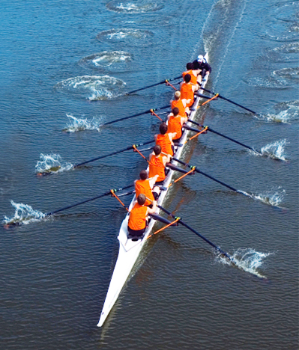
Coherence
An optimal state in which the heart, mind and emotions are aligned and in sync.
Physiologically, the immune, hormonal and nervous systems function in a state of energetic coordination.
Notes:
DO:
Connect previously mentioned definitions to
SAY:
Incoherence came more easily to mind then coherence, as I used the word to describe a patients’ mental condition.
People commonly think about a coherent sentence or coherent speech, you know when words come together to create meaning.
Fun fact, during my 1st years at the U of Iowa I had the privilege of being a member of the rowing team. As a novice crew we leaned quickly about the importance of synchronicity. Each person pushing, swinging, and pulling in a unified motion that resulted in our shell gliding across the water
With HM we are not thinking about a crew but rather an alignment between our hearts, mind and emotions, working toward a state of energetic coordination
When we enter into this coordinated harmonious state we have greater mental And emotional flexibility and composure
To understand coherence and how it effects us, lets look at a key physiological system

Slide 17
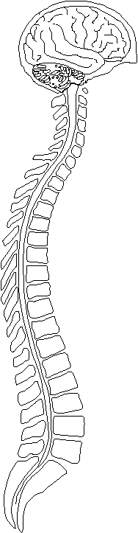
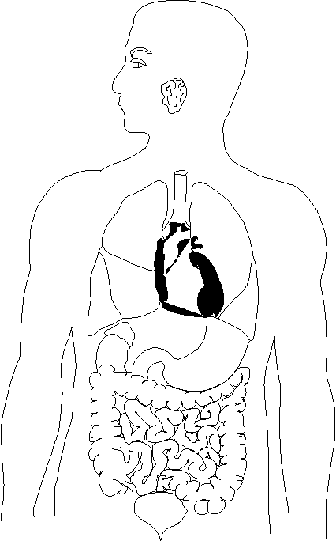
Autonomic Nervous System
Autonomic Nervous System
Sympathetic
Parasympathetic
Dilates
Constricts
Stops secretion
Secretes saliva
Spinal cord
Parasympathetic
Dilates bronchioles
Constricts bronchioles
Sympathetic ganglion chain
Speeds up heartbeat
Slows down heartbeat
Secretes adrenaline
Adrenal gland
Increases secretion
Decreases secretion
Stomach
Increases motility
Decreases motility
Retains colon contents
Empties colon
Delays emptying
Empties bladder
Parasympathetic
Bladder
Notes:
SAY:
No one panic, this is just a quick overview. New for some, but a review for others. This is an opportunity to understand what is happening inside us
Autonomic nervous system = Automatic nervous system (ANS)
This system regulates over 90% of our body’s internal functions. The things that we don’t have to think about; breathing, digestion, immune response, temperature regulation, just to name a few.
The call-out on this slide is that the ANS has 2 branches
#1 Sympathetic NS = has the ability to speed-up our HR. This is where our ability to ramp up, going into fight/ flight or freeze comes from. You could also think of this branch as a gas pedal able to speedup our systems to jump into action
#2 the other side is the parasympathetic NS- this branch can be thought of as the brakes of the system, allowing for rest/ digest/ renewal
ASK:
Are you wondering why I’m talking about this?
SAY:
Because it turns out that both branches are connected to the heart
Any changes with either branch will affect the HR, beat to beat
Now that we understand the connection between the ANS and our heart, lets look at how it impacts mental fxn

Slide 18

Heart-Brain Communication
The heart has its own complex nervous system: the “heart brain.”
The heart sends far more information to the brain than the brain sends to the heart.
Patterns in the neural signals from the heart especially affect the brain centers involved in perception, emotional experience and self-regulation.
Notes:
ASK: (poll question)
How many neuron cells does the heart contain? (a) 40 (b) none (c) 40,000 (d) 400
SAY:
40,000 neuron cells make-up the hearts own complex nervous system, known as the heart-brain
When we are centered and in sync, we create a more coherent field environment and are less affected by others’ incoherence.
ASK:
Have you ever had your brain say one thing while your heart or gut gave a different direction? These mixed emotions don’t feel good and happen when we are out of sync

Slide 19
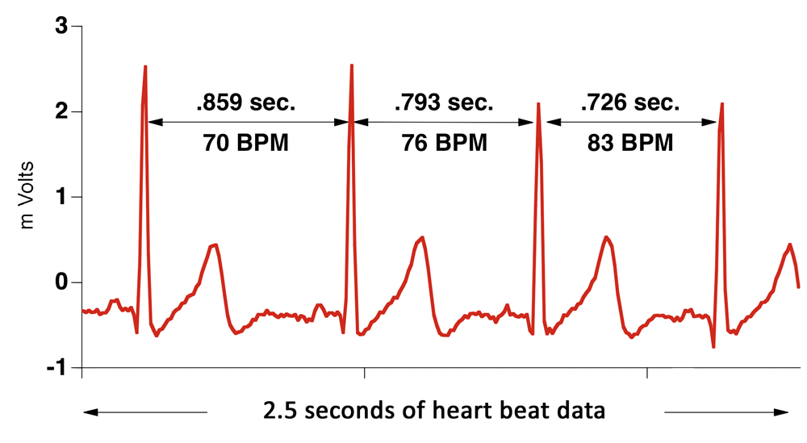
Heart Rate Variability (HRV)
Notes:
SAY:
Our HR is the # of times our heat beats in 1 minute
It use to be thought that the heartbeat at a steady rhythm, but we know now that in healthy, resilient people the amount of time between each beat varies
As a nurse, I have spent countless hours looking at and deciphering types of heartbeats, but never considered the space in-between
TO ID the HRV, we simply need to look to the space between the beats also known as the interval

Slide 20
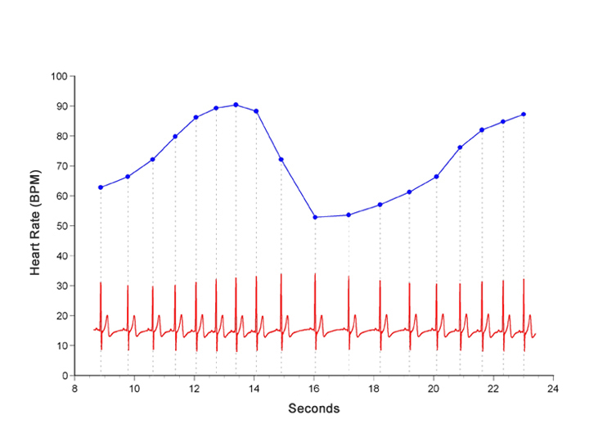
Heart Rhythm Patterns Emerge
Notes:
SAY:
Let’s bring our attention to the redline- this is a longer version of the ECG tracing we just looked at
The blue line is the same data, just recorded in a different way. Each blue dot is the HR recorded in beats per min
Connecting these dots forms a heart rhythm pattern
Upslope= increased HR
Downslope= decrease in HR
Now let’s consider how emotional states impact this type of tracing

Slide 21
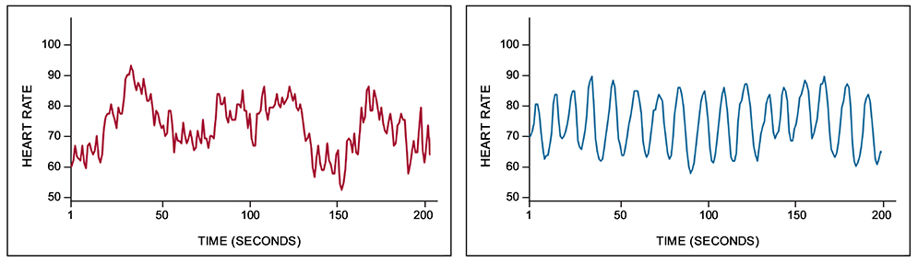
Emotions & Heart Rhythms
Incoherence
frustration, irritation, impatience, worry
Coherence
appreciation, calm, patience, confidence
Inhibits brain function – impairs performance
Facilitates brain function – promotes optimal performance
Notes:
SAY:
Here are 2 illustrations of how different emotional states impact the heart rhythm
Background: 1 person, participating in a study, asked to recall a time…
ASK:
Which example looks as if a person is trying to drive with one foot on the brake while the other is on the gas? (red/ blue)
SAY:
Depleting emotions such as frustration, impatience or anxiety are reflected in an irregular, chaotic HRV pattern. Activity between sympathetic & parasympathetic are out of sync… AKA incoherent HR variability
ASK:
Why is driving a car with 1 foot on each pedal bad for the car?
Competing, increased wear-n-tear, impairs performance and increase energy drains.

Slide 22
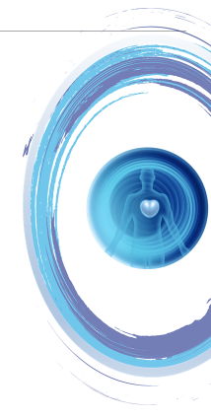
Quick Coherence® Technique
An Intelligent Energy Self-Regulation Technique

Slide 23
Emotions & Feelings that Create Coherence
    Courage, Honor, Dignity
    Care, Love
    Confidence
    Compassion
    Appreciation, Gratitude
    Tolerance, Patience
    Kindness
    Enthusiasm, Joy

Slide 24
Quick Coherence® Technique
Step #1:
Focus your attention in the area of the heart. Imagine your breath is flowing in and out of your heart or chest area, breathing a little slower and deeper than usual.
  Suggestion: Inhale 5 seconds, exhale 5 seconds (or whatever rhythm is comfortable).

Slide 25
Quick Coherence® Technique
Step #2:
Make a sincere attempt to experience a regenerative feeling such as appreciation or care for someone or something in your life.
  Suggestion: Try to re-experience the feeling you have for someone you love, a pet, a special place, an accomplishment, etc., or focus on a feeling of calm or ease.

Slide 26
Quick Coherence® Quick steps
Heart-Focused Breathing
Activate a positive or renewing feeling

Slide 27

Building and Sustaining Resilience
Three Strategies
Prep to set the tone for the day and to be more composed before upcoming stressful events.
Shift and Reset to a more coherent state as soon as possible after a stress reaction to minimize energy drains.
Sustain your resilience throughout the day through regular practice and by remembering to refresh your composure in between activities and events.
Notes:
SAY:
How do we put these techniques into practice? When and where do we insert them into our lives?
Prep, value of prep cannot be overstated. We all probably do some sort of prep work already, work shifts/on the way to calls/for our patients. Why not insert a technique into your prep routines?
On the way to work/on the way home/on the way to a call/before you receive a patient/every morning
Shift and reset bullet, great recovery tool,
On the way home from work/after a call or patient encounter/after a difficult conversation/before bed
Sustain, key to HM is remembering to use the techniques, practicing them regularly. Are there things you already do regularly that you can staple these techniques to?
Wash your hands/at a stoplight or stop sign. Start thinking of different places in your life where these techniques might fit in.

Slide 28
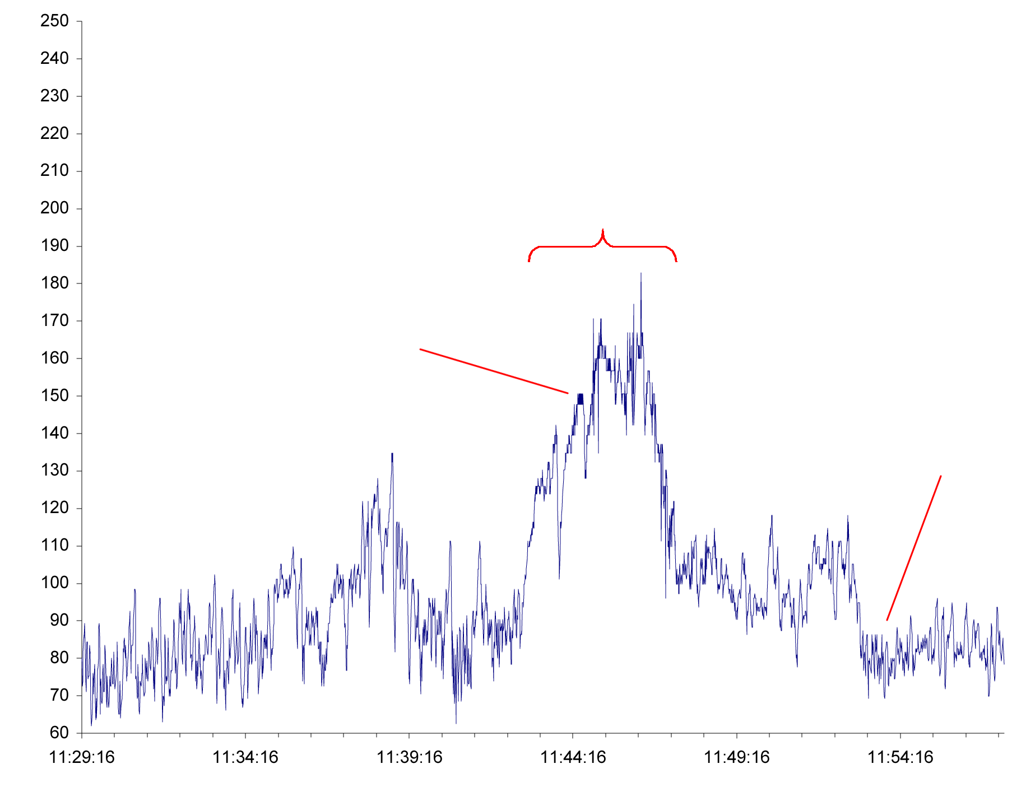
Police Officer Resets After Domestic Violence Scenario
Scenario
Encounters
angry man
HEART RATE (BPM)
Officer Shifts and Resets
Clock Time
Notes:
Say:
Background: Training scenario, practiced HM techniques for 1 month
Overview: Baseline, HR/tones, normal reaction, back to baseline, during scenario, 180 spike. This shows that emotional stress can increase our HR more than exercise, just a simulation, after the scenario, difference is officer recognizes this as a time to do a HM technique, shifts baseline
HR was only elevated for about 10 min. How much energy did this officer save? Is he going to have more energy available to him for his next call?
Scenarios before HM training, average HR recovery time was about 1 hr and 20 min, some officers had HRs that stayed elevated for the rest of their shifts
Energy difference 10 min vs 1 hr 20 min

Slide 29

How to keep growing YOUR HeartMath practice?
Be intentional:
    AWARENESS of your emotions
    IDENTIFY where HeartMath practices fit
    COMMIT to yourself
Check out FREE HeartMath content
  www.heartmath.com
Notes:
ASK:
Where does HM fit for you? (if time allows, ask for ideas)
Encourage participants to use the worksheet in the back of the program to capture learnings and write their plan for how they can weave HM into their day

Slide 30
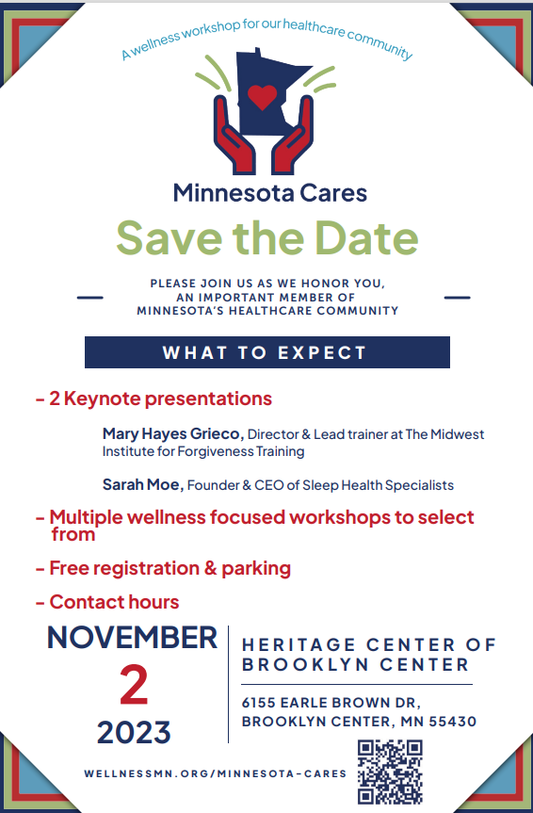
RESERVE some time for YOUR personal care & healing…

Slide 31

For questions, Kerry.Appleton@northmemorial.com
For more information about HeartMath, https://www.heartmath.com

