Slide 1
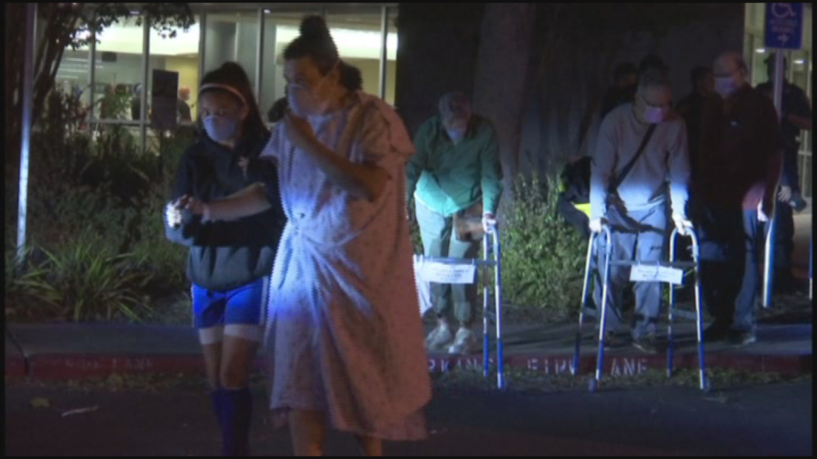
SAFE EVACUATION for LONG TERM CARE
Presented by CAHF’s Disaster Preparedness Program
May 31, 2023 | 12:45 – 14:00 | Brooklyn Center, MN

Slide 2

Today we will learn about...
What to consider for a safe evacuation of residents
What the CMS EP Rule requires for a safe evacuation
The impacts of evacuation on elderly/vulnerable residents
Case Studies on Evacuations – Lessons Learned

Slide 3

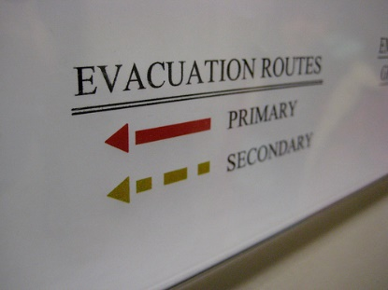
OUR FOCUS TODAY: SAFE EVACUATION
CMS Says this INCLUDES:
Care and treatment of evacuees
Staff responsibilities
Transportation (MOUs)
Tracking residents and staff
Evacuation locations (Pre-Arranged)
Primary and alternate means of communication
with external sources of assistance
Notes:
Based on your risk assessment and specific to your resident/client needs you will need to plan for the needs of the residents/clients during and post evac at least until they are settled into their relocation sites. We wont know how detailed this will have to be in terms of staff responsibilities until IG come out, but I believe it is a good plan to institute the use of incident command which spells out the functions that need need to be preformed and organizes the assignment of staff into that function based on who is available and trained for the tasks. NHICS is imbedded into the EOP template that I have mentioned before and the complete system is available on the CAHF website. NHICS resources include an incident specific guide for evacuation and many relevant forms.

Slide 4
Acronyms Used Today
EOP – Emergency Operations Plan
HVA – Hazard Vulnerability Assessment
CMS – Center for Medicaid/Medicare Services
NHICS – Nursing Home Incident Command System
JAS – Job Action Sheets
IAP – Incident Action Planning
SitRep – Situational Report
HPP – Hospital Preparedness Program
HCC – Health Care Coalition

Slide 5
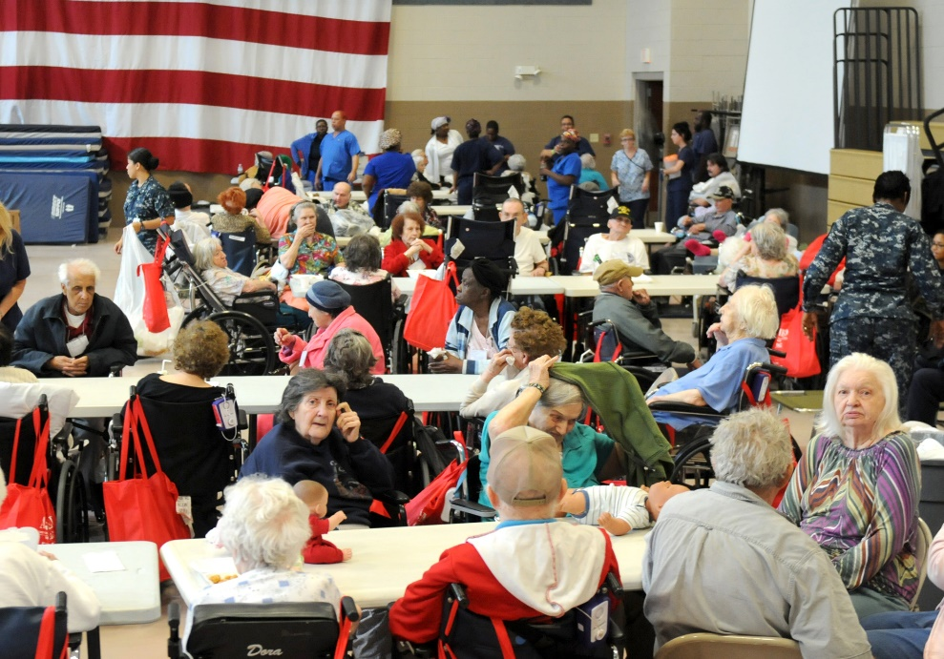
Emergency Preparedness Requirements for Medicare and Medicaid Participating Providers and Suppliers
“We believe that, currently, in the event of a disaster, healthcare facilities across the nation will not have the necessary emergency planning and preparation in place to adequately protect the health and safety of their patients.”
Federal Register – Published 9/16/16. Effective 11/15/16. Implementation 11/15/17
Notes:
This final rule establishes national emergency preparedness requirements for Medicare- and Medicaid-participating providers and suppliers to plan adequately for both natural and man-made disasters, and coordinate with federal, state, tribal, regional, and local emergency preparedness systems.
17 Medicare/Medicaid beneficiaries
An estimated 75,000 providers
Hospitals, Dialysis, Transplant centers, hospice, home health and yes ….SNFs and IID centers

Slide 6
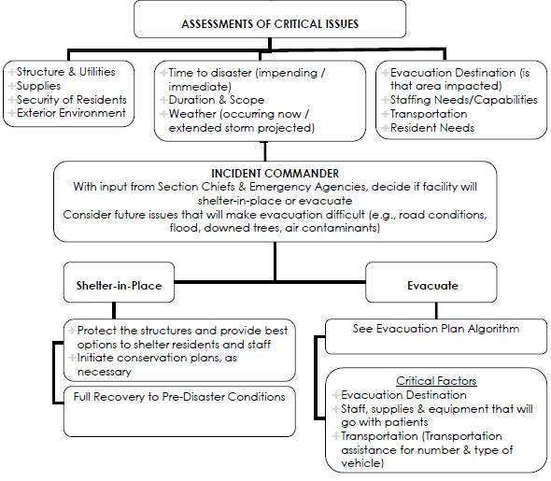
You need more than evacuation plans to be ready for evacuation.
You need a comprehensive Emergency Preparedness Program to be ready for all the variables that will arise.
Translation:

Slide 7
Part 483.73 (a) – the Emergency Operations Plan (EOP)
Your EOP must…
Reference and use an all-hazards approach
Address facility population at risk because of their residents’ unique needs
Be based on the facility‘s and community‘s Hazard Vulnerability Assessment
Identify services that must be provided in the emergency
Consider continuity of operations
Cooperate with community & emergency responders
Notes:
Reviewed and updated annually
Reference an all-hazards approach

Slide 8
E-0020: Policies and Procedures including Safe Evacuation
Safe evacuation from the LTC facility, which includes:
  consideration of the care and treatment needs of evacuees;
  staff responsibilities;
  transportation;
  identification of evacuation locations(s); and
  primary and alternate means of communication with external sources of assistance.

Slide 9
SURVEY PROCEDURES:
Review the facility’s EOP to verify it has all the required P&PS
Ask staff to describe and/or demonstrate the tracking systems to document location of residents and staff
Verify that tracking system is part of the EOP
Ask to see P&Ps that preserve and make readily available critical medical info
Ask to see copies of agreements with other facilities to receive residents
Ask facility leadership to explain arrangements in place for transportation in event of evacuation

Slide 10

QUESTION – WHAT TRIGGERS COULD MAKE YOU EVACUATE YOUR FACILITY?

Slide 11
EVACUATION VS. SHELTER IN PLACE
IS EVACUATION ALWAYS THE BEST CHOICE?
…preliminary data suggests that evacuation has
unintended consequences in terms of mortality,
hospitalization, and functional decline.
Vincent Mor, PhD
Center for Gerontology and Healthcare Research, Brown University, Providence, RI, USA

Slide 12
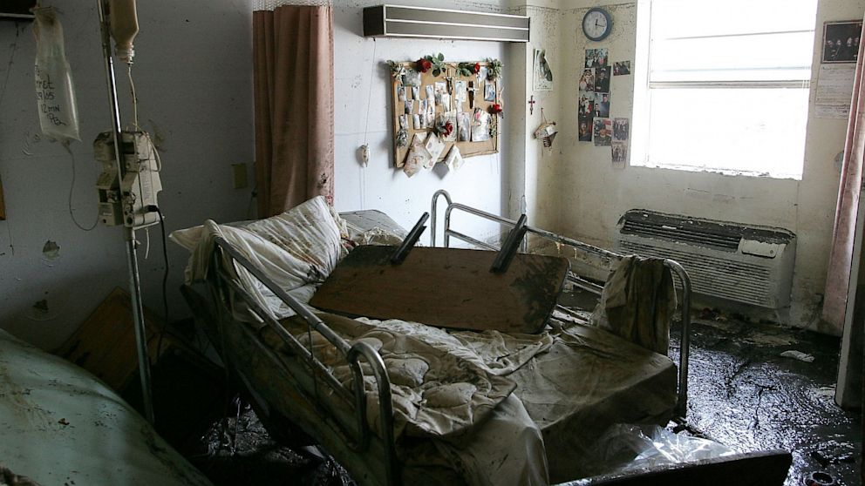
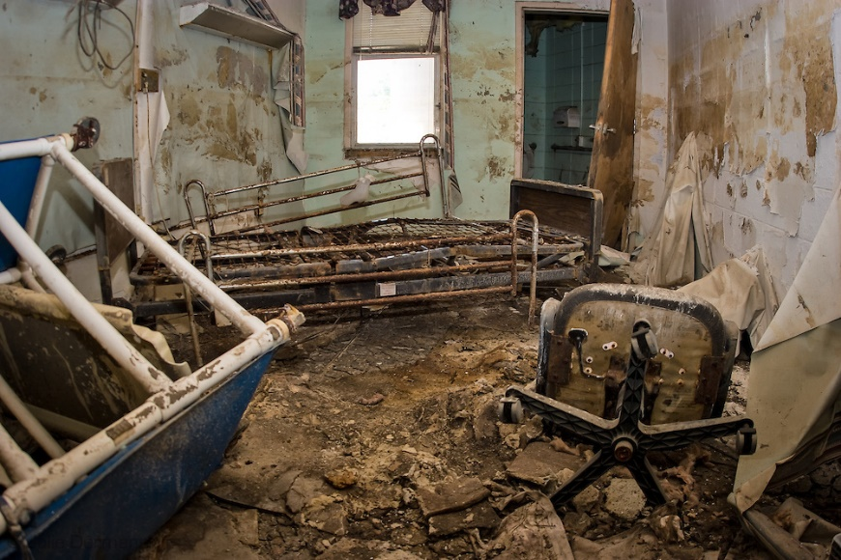
Effects of Hurricane Katrina on Nursing Facility Resident Mortality, Hospitalization, and Functional Decline
David Dosa, MD, MPH, Zhanlian Feng, PhD, Kathy Hyer, PhD, MPP, Lisa M. Brown, PhD, Kali Thomas, MA, and Vincent Mor, PhD
Disaster Med Public Health Prep. Sep 2010; 4(0 1): S28–S32

Slide 13
Results - Katrina
Excess Mortality and hospitalizations at 30 and 90 days
additional 148 deaths at 30 days and 230 deaths at 90 days.
The 30-day hospitalization rate was 9.87% compared with 7.21% and 7.53%, respectively.
The 90-day hospitalization rate was 20.39% compared with 18.61% and 17.82%, respectively.
Conclusions:
SNF residents experienced a significant increase in mortality, hospitalization, and functional decline during Hurricane Katrina
Notes:
Lower numbers are 2003 and 2004 for same cohort (pre storm)

Slide 14
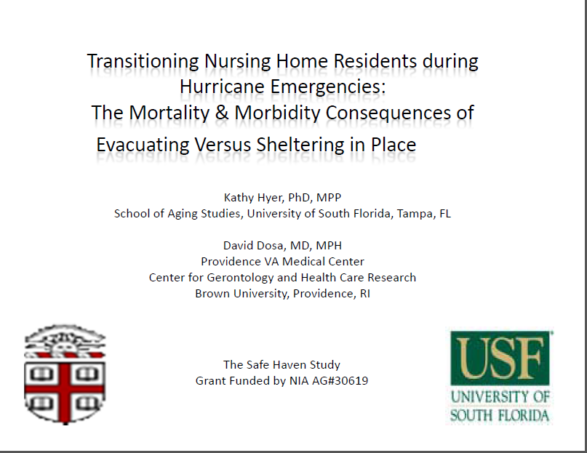
Notes:
This first-of-its-kind study evaluates the effects of Hurricane Katrina on long-stay NF residents living in facilities located in highly affected areas of Louisiana and Mississippi. In all of the cases, the 30- and 90-day mortality and hospitalization rates for residents living in NFs exposed to the storm were considerably higher than for residents living at the same facilities during the same period of time in 2003 and 2004. Even among survivors, there was also a statistically significant decline in functional status.
Perhaps most striking in the data are the significant increase in loss of life at 30 and 90 days. The data for 2005 suggest that 148 additional residents died in the exposed area compared with the mean number of deaths at the same facilities in the 2 preceding years. This translates to a rate of nearly 16 extra deaths per 1000 residents. At 90 days, a total of 230 additional lives (an additional 25 deaths per 1000 residents) had been lost. This excess in the death rate is statistically significant and suggests that greater attention needs to be paid to this high-risk population by emergency preparedness officials to prevent future repetition of this calamity. Among the survivors, the rates of additional hospitalizations were also significant, with 204 extra hospitalizations (22 additional hospitalizations per 1000 residents) at 30 days and 132 extra hospitalizations (14/1000 residents) at 90 days. In addition, 86 extra residents experienced significant functional decline (10/1000 residents) as a result of the storm.

Slide 15
Fraction of “excess” deaths/hospitalizations “attributable” to evacuation before storm:
 | Hospital 30 Days | Death 30 Days | Hospital 90 Days | Death 90 Days
Katrina (%) | 14% | 5% | 15% | 10%
Rita(%) | 92% | x | 95% | 21%
Gustav(%) | 95% | x | 95% | 31%
Ike(%) | x | x | x | x
Notes: All fractions are significant at the 10 percent level. [x] cells are those where the “excess” deaths in storm year were not significantly different from zero.

Slide 16
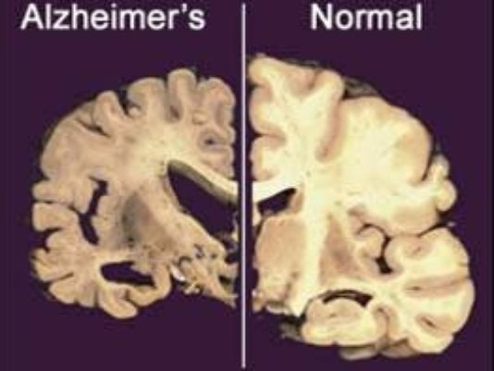
The Effects of Evacuation on Nursing Home Residents With Dementia
AM J ALZHEIMERS DIS OTHER DEMEN September 2012 vol. 27 no. 6 406-412
Included 21,255 residents living in 119 at risk nursing homes over three years of observation.
Compared to the 2 years before the storm, there was:
  2.8 percent increase in death at 30 days
  3.9 percent increase in death at 90 days for residents with severe dementia who evacuated for Hurricane Gustav

Slide 17
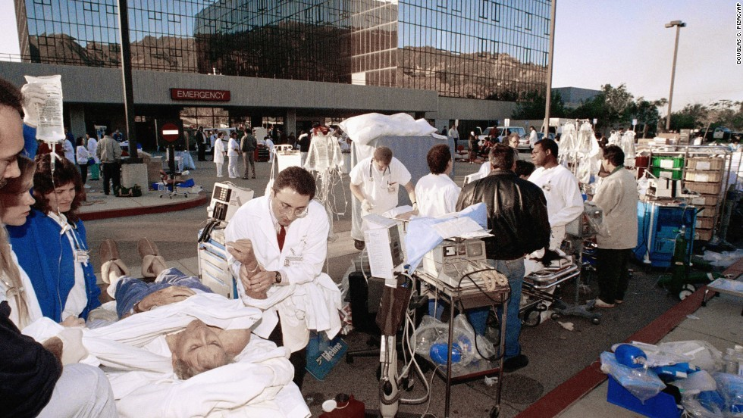
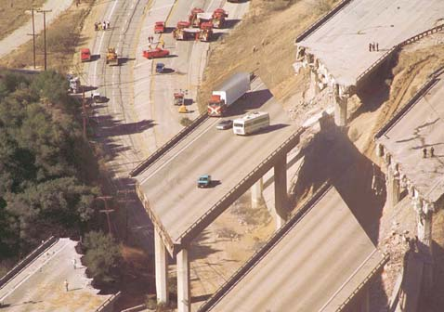
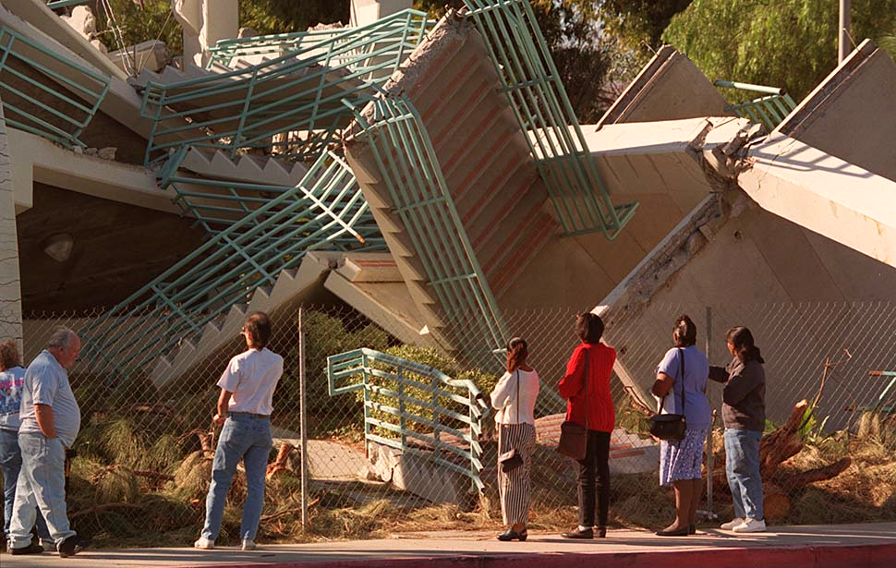
Northridge Earthquake
January 19th, 1994
6.7 magnitude
57 people died, an additional 15 people died from cardiac arrests
9,000 people injured

Slide 18
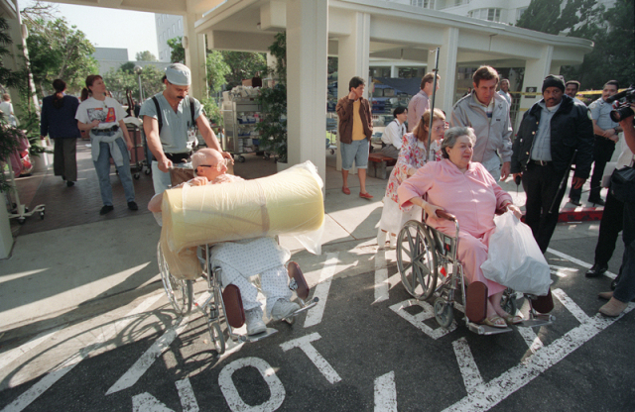
Post Northridge Nursing Homes Study
Northridge, 1994
113 widely dispersed nursing facilities interviewed after the Los Angeles Northridge earthquake. (11 365 beds),
23 sustained severe damage,
5 closed (625 beds), and
72 lost vital services.
52% reported disaster-related admissions from hospitals, nursing facilities, and community residences.
Saliba D., J.B. Buchanan, and R.S. Kington. 2004. Function and response of nursing facilities
during community disaster. American Journal of Public Health 94 (8): 1436-41.

Slide 19
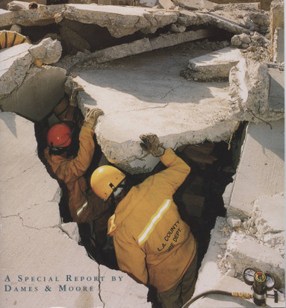
Lessons Learned from Northridge
All nursing facilities received limited post disaster assistance.
56/87 nursing facilities implementing disaster plans cited problems:
plans did not adequately address
  absent staff,
  communication problems, and
  insufficient water and generator fuel.
Northridge, 1994

Slide 20
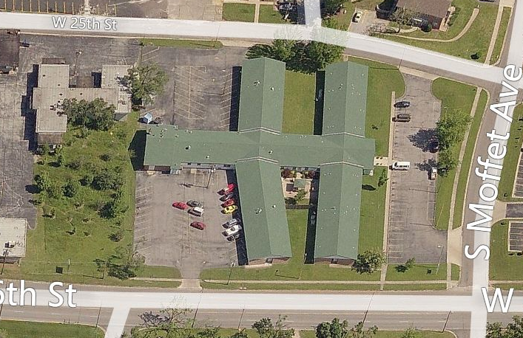
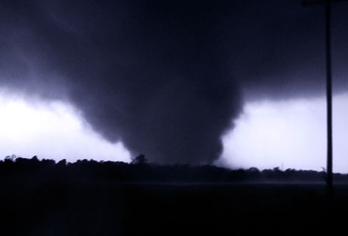
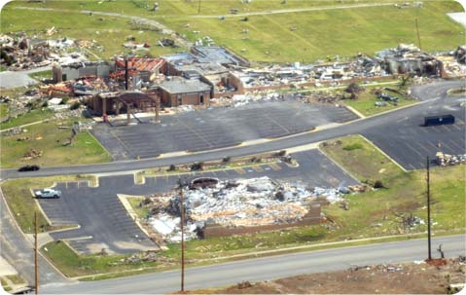
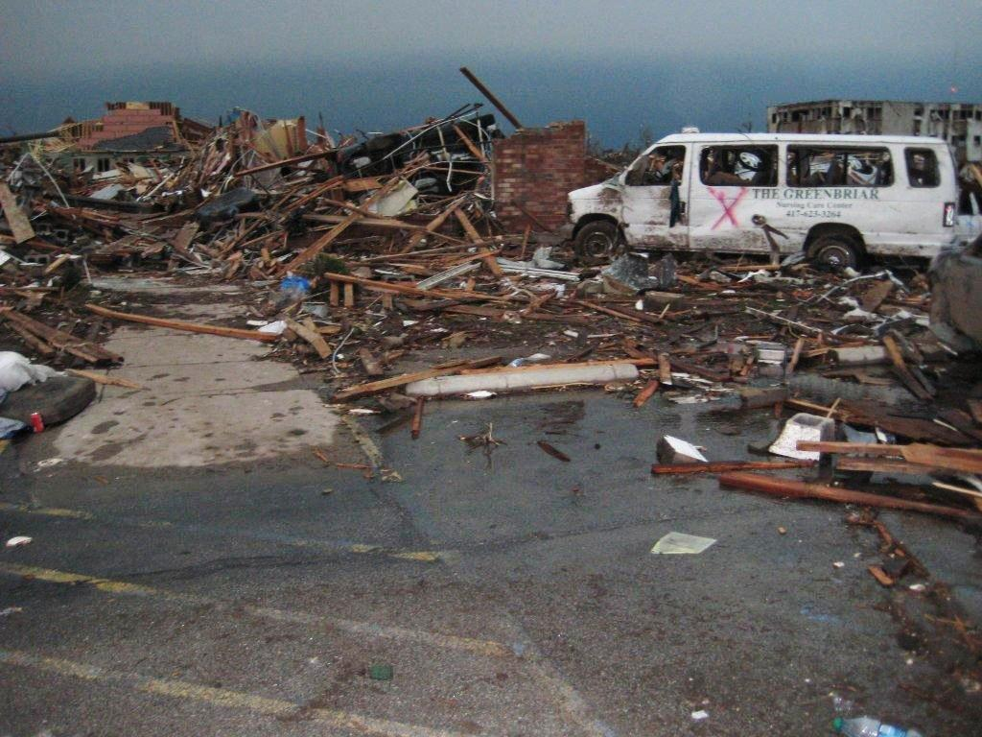
Lessons Learned from Joplin…
Disaster planning and exercises are the key to survival - not the written plan
Phone service will go down – text may not
96 hours of supplies are not enough
EHRs helpful in long run – in short term have paper kits
The desperate public will show up
It could be hours to days before help arrives
You and your staff will be profoundly impacted
Notes:
What you practice you will do. Drill until you fail
Not only were landlines down and cell service disrupted – internal systems non functional due to structure damage, power outage. No paging
Supply demands were intense. First aide, dry clothing, medications, food water, equipment. These needed to be in multiple locations
Checklists, logs for resident tracking, logs for injury, communication. Place in various locations. Charts began to mold within days.
Injured showed up, even to facilities that were impacted. Looters showed up. Tried to take cars from parking lots, E kit disappeared first night.
6 hours after the it hit, the first rescue EMS arrived at one of the nursing homes waiting to be evacuated. In the meantime, their sprinklers were continually going. No one was able to shut off.
7000 homes were lost. Many of the staff lost everything. ALMOST ALL STAYED. Those that needed to check on families came back. Many tried to get back to facility but were most only able to with facility ID. One lesson learned from St John’s Medical Shelter is that staff need wallet cards, not just the ID their wear because they may not have that with them.
The need to have staff personally prepared is tantamount. The need to spell them, feed them, and support them psychologically must be part of the plan

Slide 21
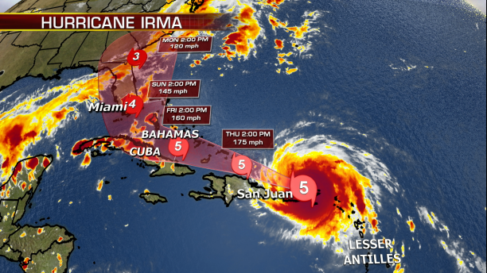
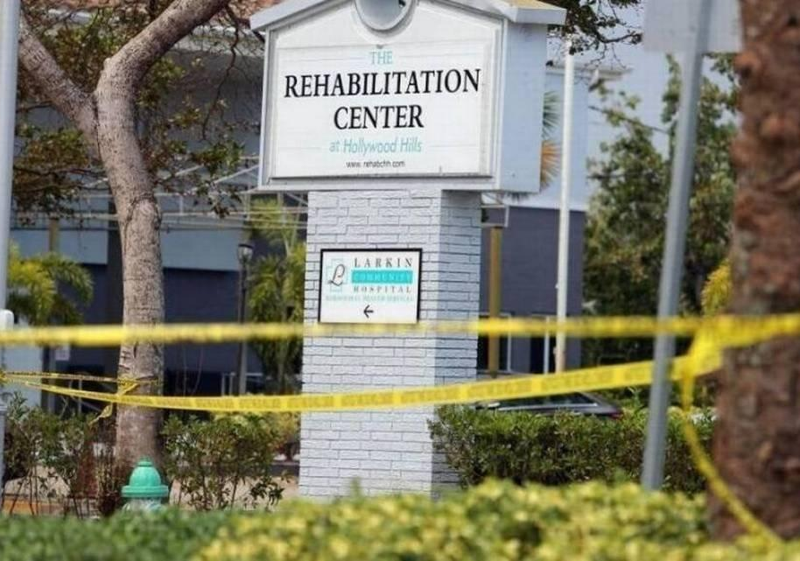
The Rehabilitation Center at Hollywood Hills, FL
Hurricane Irma: The strongest Atlantic basin hurricane ever recorded outside the Gulf of Mexico and the Caribbean Sea.
Two-story skilled nursing facility, licensed for 152.
Decision of the facility to shelter in place due to the frail condition of the residents and the stress of moving them out of the projected path of storm impact.
Power knocked out on Sunday. AC not on generator.
Multiple calls to request power restoration, but no request for evacuation assistance. Portable AC brought in.
On the following Weds concerns led rescuers to facility and they found 40 residents suffering critical heat –related illness.
A total of 12 heat-related deaths. Homicide charges being considered.

Slide 22
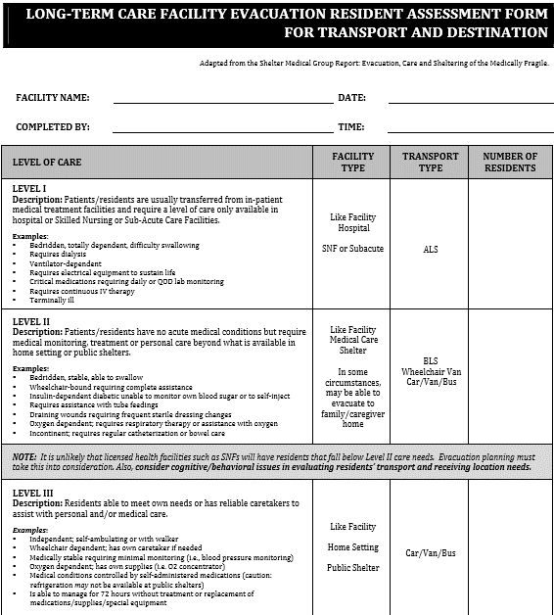
Long-term Care Evacuation
Resident Assessment Form For
Transport And Destination

Slide 23
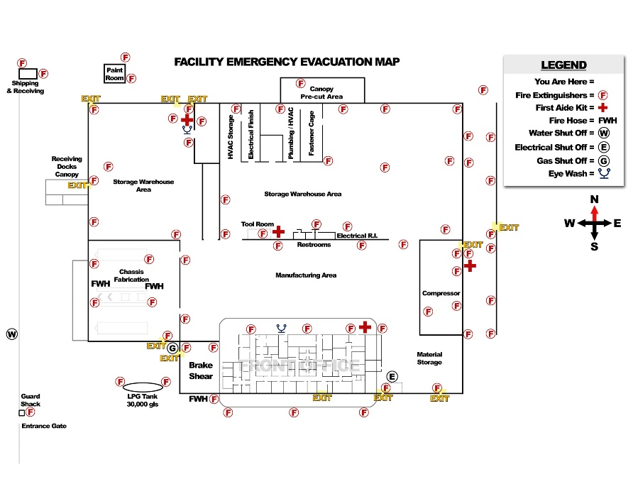
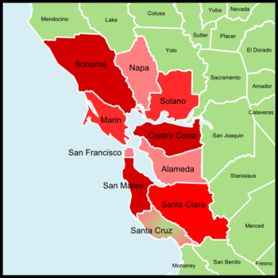
FACILITY EVACUATION AND MAPS
Definitions
Agreements for Relocations Sites
Logistics
  Transportation
  What to send
  Resident ID
  Tracking
  Routes

Slide 24
ALTERNATE CARE SITES
Residents’ Unique Needs for Safe Transfer
In your EOP, do not list hospitals as your alternate care sites, instead pre-determine other “like” facilities.
Find “like” facilities that can provide the same services as your resident would receive at the home facility – continuity of care.
“Alternate care site” can also be a specified area in your facility, e.g. when you need to cool your residents in the dining room during a power outage.
Identify the unique needs (including transportation) of your residents using a resident profile – assign a staff member to keep this resident profile updated periodically.
E-0026: The role of the facility under a waiver declared by the Secretary, in accordance with section 1135 of the Act, in the provision of care and treatment at an alternate care site identified by emergency management officials.

Slide 25
ALTERNATE CARE SITES
Memorandums of Understanding / Patient Transfer Agreements
What are the names of the alternate facilities that have agreed to an MOU or patient transfer agreement?
Can your alternate care site also serve as your alternate Command Center?
What will the alternate care site need, listed by essential function, in order to provide continuity of care (sending along staff, DME, meds, etc)?
If you have to move residents outside of your immediate area to a facility you can still arrange MOU after the fact for billing and reimbursement purposes.
CAHF’s MOU template: www.cahfdisasterprep.com/mou
E-0025: The development of arrangements with other facilities and other providers to receive patients in the event of limitations or cessation of operations to maintain the continuity of services to facility patients.

Slide 26
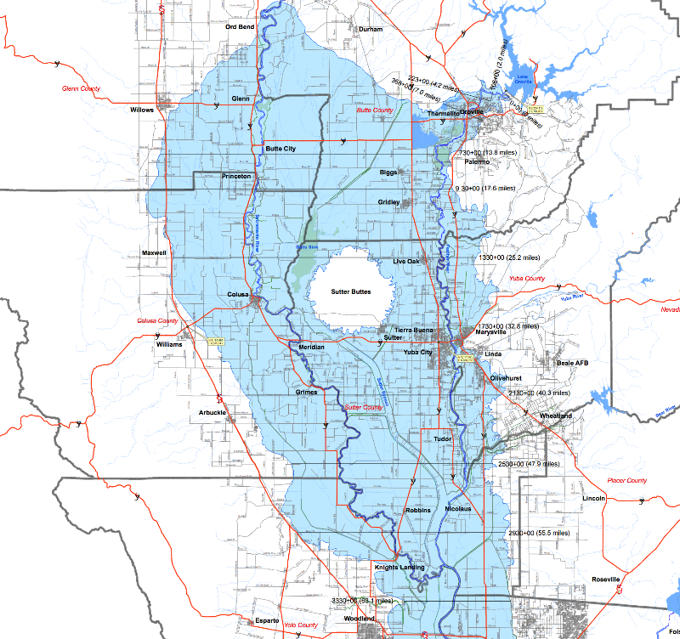

Lesson Learned: Oroville Dam Overflow, 2017
Administrator of one Oroville facility was told that a 12 foot wall of water could hit his facility in a couple hours and to get out ASAP.
Took him several hours to find transportation for his 99 residents, Butte County did not have enough.
After repopulation, facility was faced with a $70,000 bill for transport from various ambulance companies.
Administrator said his number one lesson was knowing the ambulation status of all residents and updating it regularly so that the staff could order the right transport more efficiently.
He now updates ambulation status of all residents once a week.
Know the unique needs of your residents!!

Slide 27
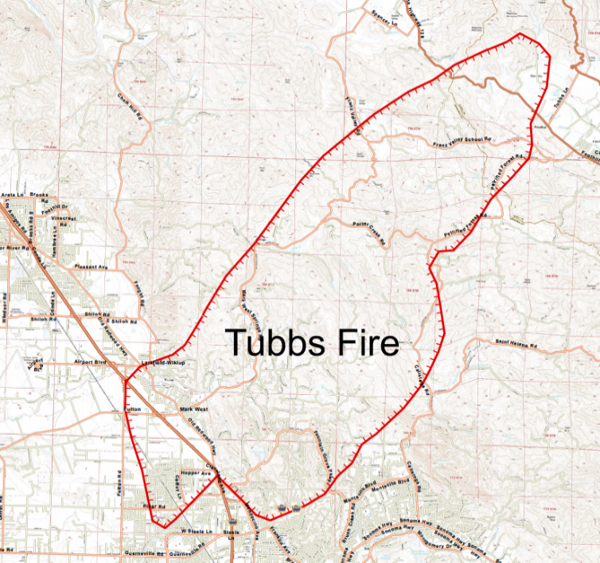
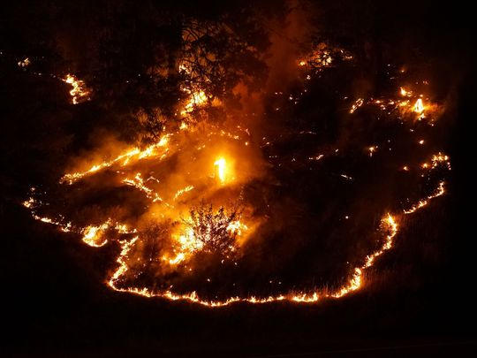
Lesson Learned: Tubbs Fire (2017)
Veterans Home in Yountville (Sonoma County) was threatened by the Tubbs Fire, at the time the most destructive wildfire in CA. Residents evacuated without medical records to multiple receiving facilities.
The VA used paper charting, no way to remotely access records after the area was closed off due to wildfire.
If you paper chart, prioritize taking all your paper charts with you in an evacuation! You do not know when you will be able to return, or if your building will be damaged.

Slide 28
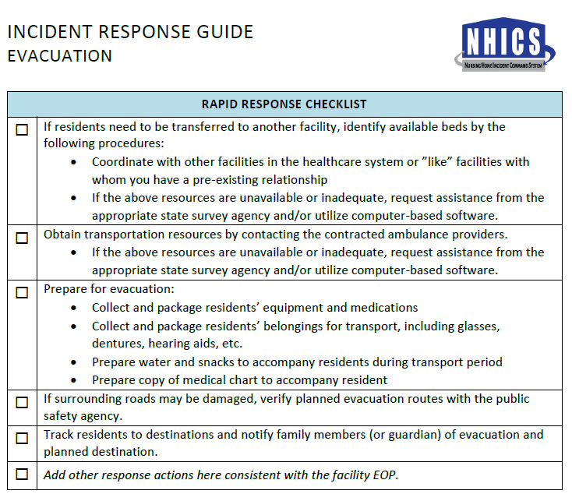
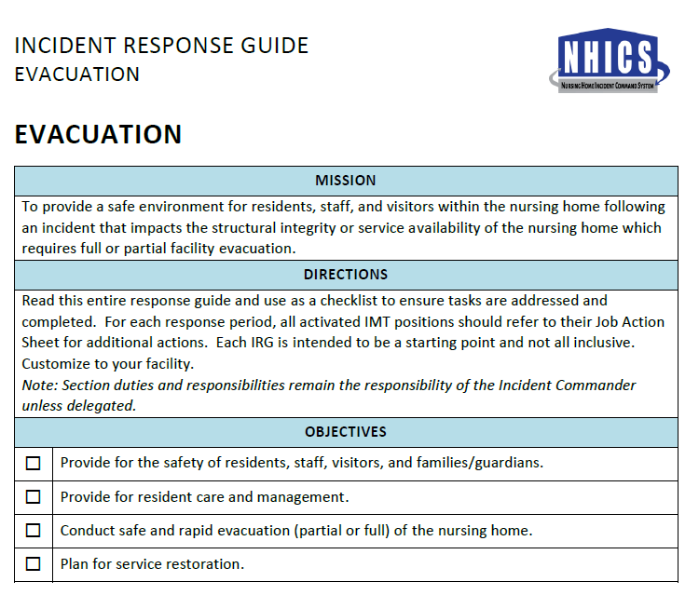

Slide 29
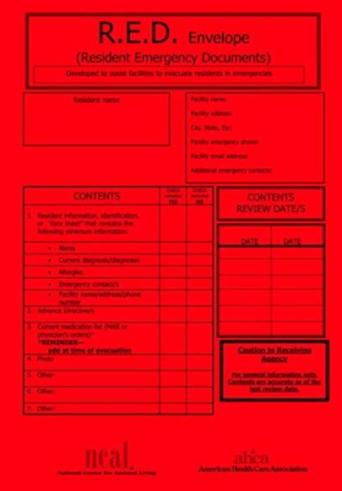
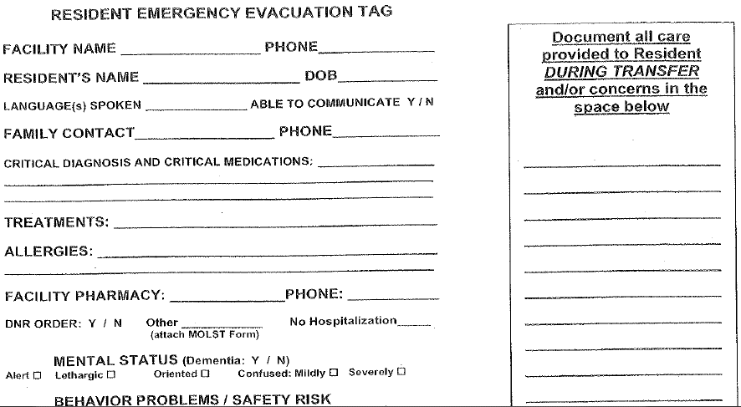

Observing HIPAA during Emergencies
E-0023: A system of medical documentation that preserves patient information, protects confidentiality of patient information, and secures and maintains availability of records.

Slide 30
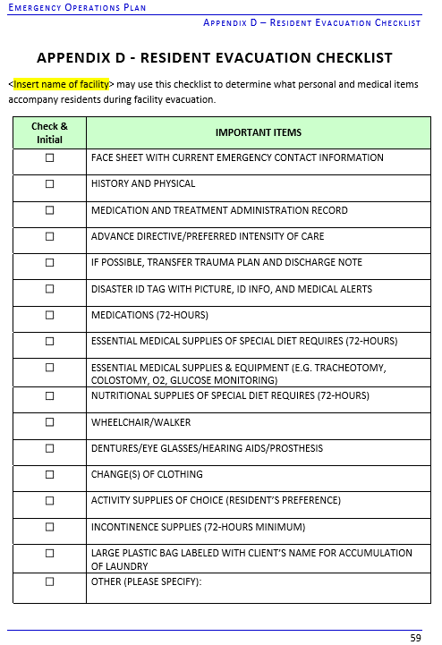
Resident Evacuation
Checklist

Slide 31
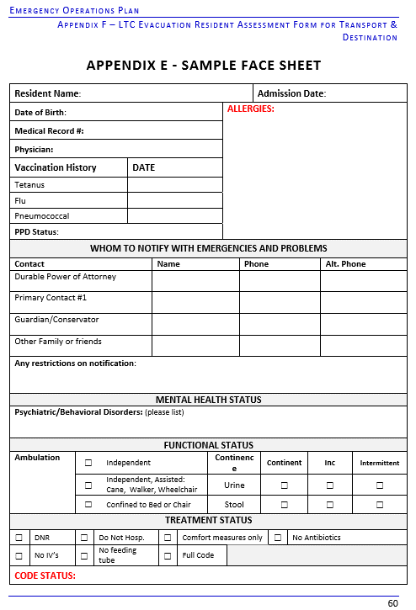
Sample Face Sheet

Slide 32
Systems to Track Residents/Clients and On-duty Staff
www.cahfdisasterprep.com
Notes:
we would expect facilities to track
their on-duty staff and sheltered patients during an emergency and document the specific
location and name of where a patient is relocated to during an emergency (that is, to another
facility, home, or alternate means of shelter, etc.). We would
expect that the information would be readily available, accurate, and shareable among officials
within and across the emergency response system, as needed, in the interest of the patient.

Slide 33
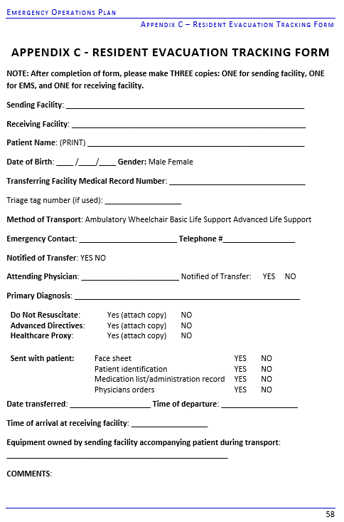
RESIDENT EVACUATION
TRACKING FORM

Slide 34
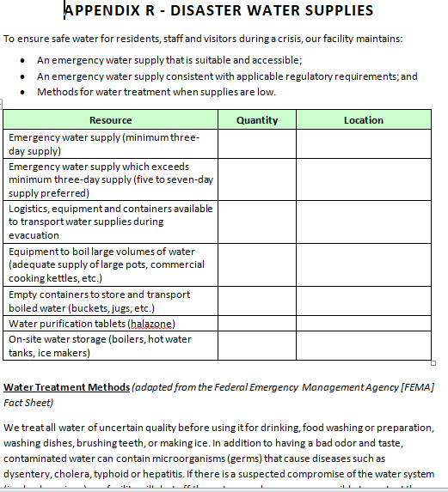
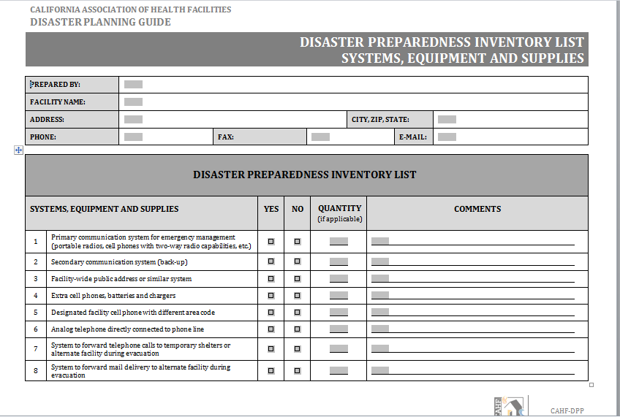
Systems for Tracking Needed Provisions

Slide 35
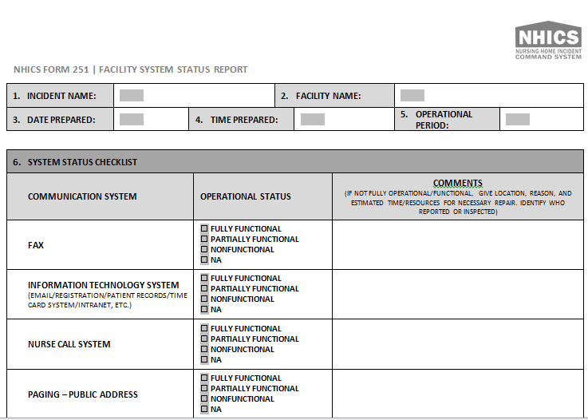
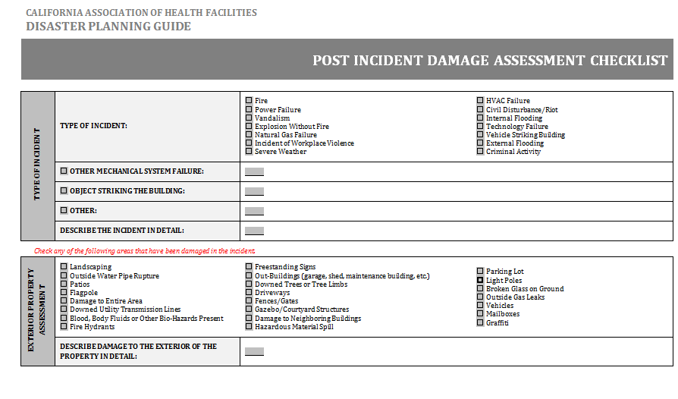
Damage Assessment Tools

Slide 36
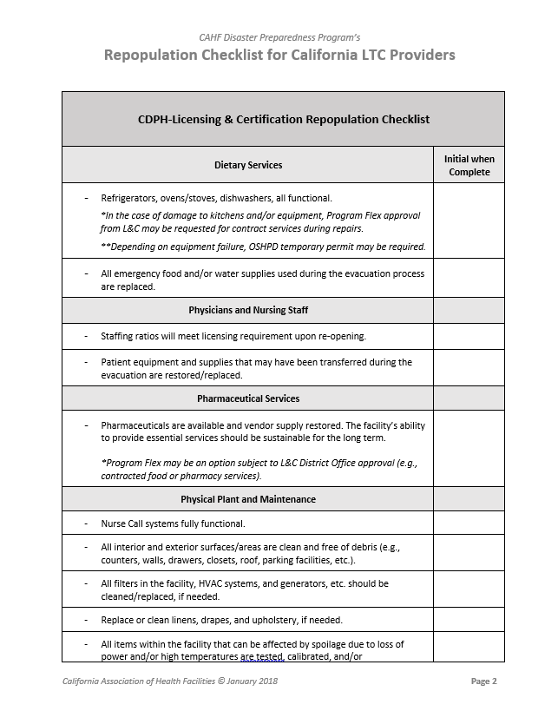
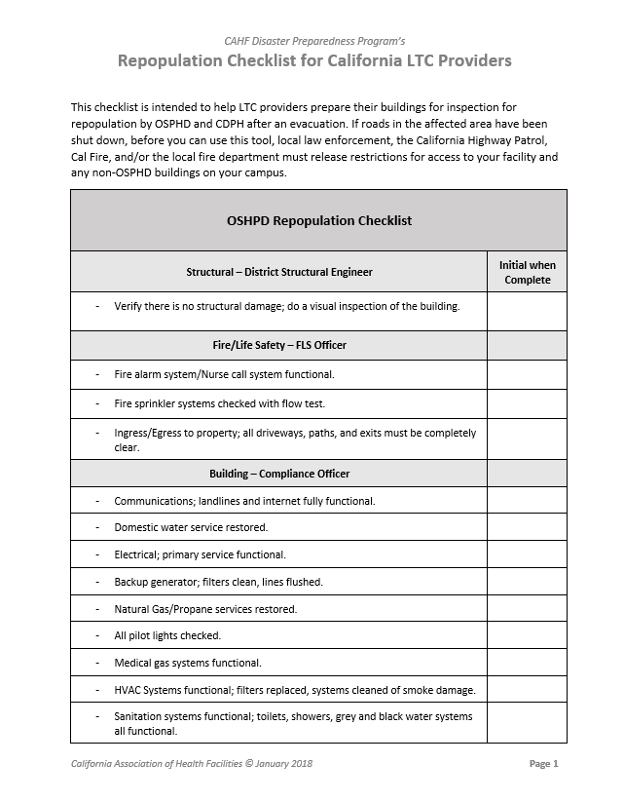
Repopulation after Evacuation

Slide 37
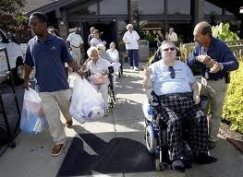

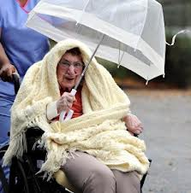
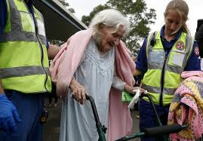
We have to be ready to be their “first responders”…
WE ARE THE EXPERTS ON OUR RESIDENTS

Slide 38

Planning Resources
CALIFORNIA ASSOCIATION OF HEALTH FACILITIES
DISASTER PREPAREDNESS PROGRAM
www.cahfdisasterprep.com
JASON BELDEN
DIRECTOR OF EMERGENCY PREPAREDNESS
PHONE: 916-432-5194 | JBELDEN@CAHF.ORG
MARY STORY MD
DISASTER PREPAREDNESS PROGRAM COORDINATOR
MSTORY@CAHF.ORG

