Slide 1
Emergency Preparedness Citation Trends
Pete Cole | Regional Operations Supervisor
May 31, 2023

Slide 2
Objectives
Demonstrate knowledge of the most frequently cited emergency preparedness citations
Understand the fundamental reasons why the citations are being cited
Demonstrate recommended actions to maintain compliance
Understand sources for updated infection control guidance

Slide 3
Citation Overview

Slide 4
Top Ten Deficiencies
LTC Emergency Power
EP training program
Review and update annually
EP Testing Requirements
EP Program patient population
Sharing plan with residents/family
Primary & Alternate means for communication
Arrangements with other facilities
Information on occupancy/needs
Policies/procedures for volunteers and staffing
Notes:
I usually hide the footers. They’re great if you need them, but I find they add visual clutter

Slide 5
E0041 - LTC Emergency Power
Currently the most commonly cited EP citation.
CMS requires LTC facilities to comply with the 2012 edition of the National Fire Protection Association (NFPA) 101 – Life Safety Code (LSC) and the 2012 edition of the NFPA 99 – Health Care Facilities Code in accordance with the Final Rule (CMS–3277–F).
Most common concerns
Missing weekly visual inspections
Missing monthly run tests
Not achieving 30% of capacity on every monthly run test or supplementing with an annual 1.5-hour load bank for diesel generators
Missing 36-month four-hour load bank test

Slide 6
E037 - EP Training Program
Regulation Summary
Training must be specific to the facility and plan
Training is required initially and annually
Documentation of training must be maintained
Expectations
Staff must demonstrate knowledge of training
Be able to show training for volunteers and contracted staff
Be prepared for review of staff education files to show training

Slide 7
E037 Training -What
Specific to facility
Initial and annual
training to all staff
Maintain documentation of training
Demonstrate staff knowledge

Slide 8
E037 Training -Who
Volunteers
Contracted
Staff
Regular Staff

Slide 9
E004 - Review and Update Annually
The plan must be reviewed and updated at least annually.
The annual review must be documented to include the date of the review and any updates made to the emergency plan based on the review.
The format of the emergency preparedness plan updates is at the facility’s discretion.

Slide 10
E0039 - EP Plan Testing Requirements
Documentation of testing is required in the last year.
Needs to be…
Two community-based exercises
One community based & one tabletop exercise
Have actually activated their plan.
Must be documented
Must have an after-action analysis
Must include a plan revision based on the after-action analysis

Slide 11
E007 - EP Program – Patient Population
The emergency plan must specify the population served within the facility, including their unique vulnerabilities in the event of an emergency or disaster.
The emergency plan must also address the types of services that the facility would be able to provide in an emergency.
Resident populations unique to the facility that are most at risk should be identified and the EPP should document how continuity of operations will be provided for these residents.

Slide 12
E0035 - Sharing EPP with Resident and Families
LTC facilities and are required to share emergency preparedness plans and policies with family members and resident representative.
Facilities have flexibility in deciding what information from the emergency plan should be shared.
Options include providing instructions on how to contact the facility in the event of an emergency on the public website or to include the information as part of the facility’s admission procedures.

Slide 13
E0032 - Primary & Alternate Means of Communication
Facilities are required to have primary and alternate means of communicating with staff, Federal, State, tribal, regional, and local emergency management agencies.
Facilities have the discretion to utilize alternate communication systems that best meets their needs.
The communication plan should include procedures regarding when and how alternate communication methods are used, and who uses them.

Slide 14
E0025 - Arrangements with other Facilities
Facilities are required to have policies and procedures which include prearranged transfer agreements, which may include written agreements or contracted arrangements with other facilities and other providers to receive patients during and emergency.
The facility agreements should include pre-arranged agreements for transportation between the facilities.
The arrangements should be in writing, such as Memorandums of Understanding (MOUs) and Transfer Agreements, in order to demonstrate compliance.

Slide 15
E0034 - Information on Occupancy/Needs
Facilities must have a means of providing information about the facility’s needs and its ability to provide assistance to the authority having jurisdiction local and State emergency management agencies, local and state public health departments, the Incident Command Center, the Emergency Operations Center, or designee.
Regulations don’t prescribe the means that facilities must use in disseminating the required information. However, facilities should include in its communication plan, a process to communicate the required information.

Slide 16
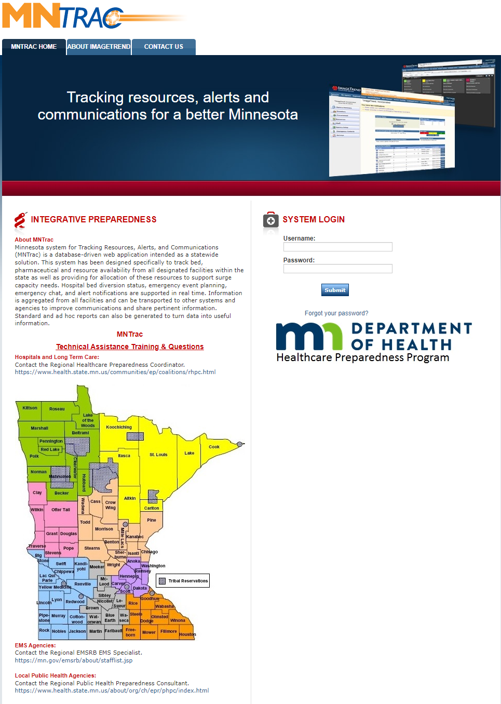
E0034 - MNTrac

Slide 17
E0024 - Policies and Procedures for Volunteers
Policies and procedures must address the use of volunteers in an emergency and other emergency staffing strategies to address surge needs during an emergency.
These may also include federally designated health care professionals, such as Public Health Service (PHS) staff, National Disaster Medical System (NDMS) medical teams, Department of Defense (DOD) Nurse Corps or Medical Reserve Corps (MRC).

Slide 18
Updated Infection Control Guidance
Staff and resident vaccination requirements continue in effect
Information related to impending changes to vaccination requirement is found here: https://www.cms.gov/files/document/qso-23-13-all.pdf

Slide 19
Updated Infection Control Guidance
Source control is recommended more broadly as described in CDC’s Core IPC Practices in the following circumstances: By those residing or working on a unit or area of the facility experiencing a SARS-CoV-2 or other outbreak of respiratory infection; universal use of source control could be discontinued as a mitigation measure once the outbreak is over (e.g., no new cases of SARS-CoV-2 infection have been identified for 14 days); or
Facility-wide or, based on a facility risk assessment, targeted toward higher risk areas (e.g., emergency departments, urgent care) or patient populations (e.g., when caring for patients with moderate to severe immunocompromise) during periods of higher levels of community SARS-CoV-2 or other respiratory virus transmission
5/10/

Slide 20
References
State Operations Manual
Appendix Z- Emergency Preparedness for All Provider and Certified Supplier Types
Interpretive Guidance
(Rev. 204, Issued: 04-16-21)
MDH Monthly LTC COVID-19 Call
5/10/23
MDH Monthly LTC COVID-19 Cal
5/10/2023

Slide 21
Questions?

Slide 22
Thank You!
Pete Cole
Peter.cole@state.mn.us
651-249-1724

