Slide 1
Communication In and Out of Disaster
Disaster Behavioral Health Conference – June 6, 2023
The Regional Behavioral Health Coordinator Team

Slide 2
Objectives
Define what is meant by "good" communication.
Learn how to apply principles of disaster response communication to non-disaster situations.
Understand how personal challenges can impact professional interactions.
Discuss the importance of good communication between leaders and teams.
Engage in case study application of these principles.

Slide 3
Some Facts for You – The Workforce Institute at UKG – Study of 3,400 people across 10 countries
For almost 70% of people surveyed, their manager has more impact on mental health than therapist or doctor.
43% of employees reported they are exhausted.
71% say stress at work negatively impinges on their home life, 64% on their wellbeing, 62% on their relationships.
69% of people surveyed, stated their manager had the greatest impact on their mental health.
78% say stress negatively impacts their work performance.

Slide 4
What Is Communication?
The process or act of exchanging, expressing, or conveying information and ideas through writing, speaking and gesturing.
Notes:
(Maybe we should ask the audience what communication means to them before we go into our presentation?)
communication is The process or act of exchanging, expressing, or conveying information and ideas through writing, speaking and gesturing.
The definition of communication is important because it helps us build relationships by allowing us to share our experiences, and needs, and helps us connect to others. Allowing us to express our feelings, pass on information and share out thoughts. Basically, we all need to communicate.

Slide 5
Types of Communication
Verbal
Uses a strong speaking voice.
Uses active listening. Avoids filter words and industry verbiage when appropriate.
Non-Verbal
Recognizes how emotions feel physically.
Uses intentionality of nonverbals and how they can affect others. Mirrors the other person's affect.
Visual
Considers audience before adding visuals to communication.
Uses visuals only when they add value to communication: clean, clear, easy so others who are not experts can understand.
Written
Understands that tone may not communicate well in written materials.
Takes time to review what has been written before sending to others.
Notes:
Verbal- Use of a speaking voice (strong or soft). Use of active listening. Avoid filter words and industry verbiage when appropriate.
Nonverbal- recognizing how your emotions feel physically. Be intentional about your nonverbals and how they can effect others. Attempt to mimic nonverbal communications that you fine effective in situations. (List examples).
Visual- Consider your audience before you add visuals to your communication style. Use visuals only when they add value to communication and what you are attempting to convey. Make them clean, clear and easy for others who aren't experts to understand.
Written- Simplicity. Do not rely on tone when reading and writing communications to others. Take time to review what you have written before sending it out to others. If helpful, keep a folder of writings that you have found to be effective and well received by others.

Slide 6
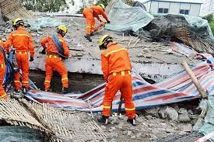
Throughout this presentation ...
… you will hear us use examples and terms that seem interchangeable. We mean to challenge you with the idea that these concepts do not work on their own – they work together to create effective communication.

Slide 7
ELEMENTS OF GOOD COMMUNICATION
COMMUNICATOR
Trust
Integrity
Consistent Messages
Transparency
Intentionality
Intentionality
Consistent Messages
Transparency
Integrity
Trust
LISTENER

Slide 8
No two people ever communicate perfectly. However, the more clearly we communicate, the greater is our ability to TRUST.
NDSU; Effective Communication

Slide 9
Why Do We Start With Trust? (Fahkrudden, 2020)
For the public (or your team) to act on warnings and follow guidance, it is essential that people perceive the source as trustworthy. (p. 4)
Communicating uncertainty is challenging. Uncertainty exists in most, if not all, scientific information, especially information associated with natural hazards. (p.1)
To communicate effectively, it is necessary to know what people think, feel and do about risk, and what makes it easy or difficult for them to take certain actions. (p.3)
Understanding people's demographics, values and beliefs as well as their media consumption patterns and who they trust is also important. (p.3)

Slide 10
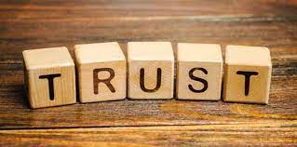
(Gladieux, p.130)
How managers build trust with their teams. They lead by example by:
Creating and supporting truthful, positive relationships – real feedback delivered with kindness, approaching and resolving conflict together.
Using good judgment - from subject-matter expertise
Being consistent – do what they say they will and do more than expected.
Practicing appropriate self-disclosure - communicate clear intentions, hopes, goals with their teams.
Speaking, thinking and writing from the "we" perspective rather than "I" and "you."
Apologizing when they make a mistake or let their team down.
Tending to their "self " so they can respond to their teams in helpful, healthy ways.

Slide 11
Transparency
The quality or state of being exposed to the possibility of being attacked or harmed, either physically or emotionally.
Transparency = to say what you CAN say.
Doesn’t mean that you are outing others.
Being vulnerable, yet professional.
Giving others the opportunity to be heard.
Example: Work team was told decisions have been made to no longer do parts of their job anymore. Nothing else was said. Leaving all kinds of questions and unknowns.

Slide 12
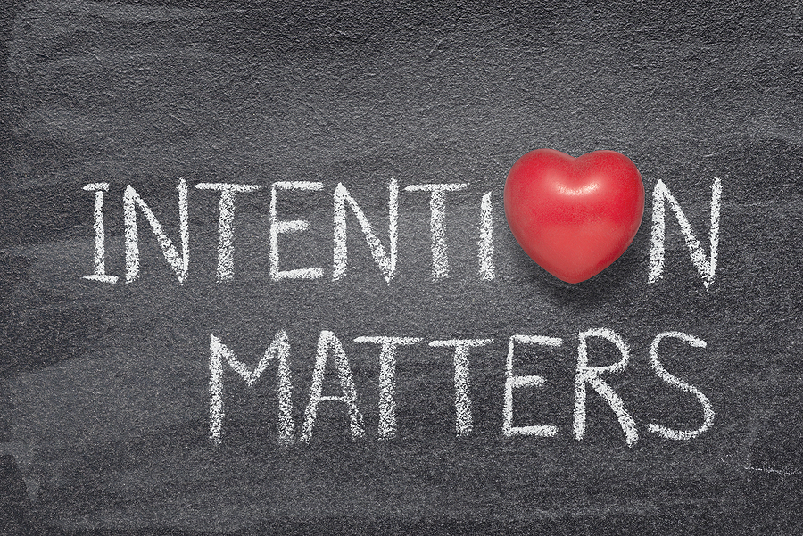
Intentionality
The fact of being deliberate or purposive.
6 ways to be intentional every day (LucemiConsulting.co.uk):
Be deliberate with your day.
Be clear on the result you want.
Be purposeful with your time
Be considered with your focus.
Be focused on your goals (e.g., SPR Skills).
Be mindful of your most important relationships.

Slide 13
The Basics of Intentional Communication
Think before you speak.
Commit to develop your self-awareness.
Develop skill around your body language habits, especially tone of voice.
Watch your words.
Notice what you are feeling in all your communications.

Slide 14
Consistent Messages
Consistent Messages build TRUST because of the consistency, not the changing content of the messages.
In and out of disaster the content is going to change due to the situations.
Disaster response example: "We will give you updated information every hour on the hour." If we do that people are more likely to stay with us because we did what we said we were going to do (trust).
Non-disaster response example: Manager to staff, "When I get updates, I will give them to you." When that is done, even if there isn't an update just yet, the staff will feel confident that they have as much information as possible (trust).

Slide 15
Consistent logo

Slide 16
You are the Logo

Slide 17
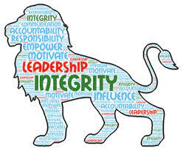
Integrity
Although integrity is at the top of the pyramid, it is assumed not to be foundational, but it is. We cannot assume that because people address the other elements of communication they will communicate with integrity.
What do we mean by speaking with integrity = the quality of being honest and having strong moral principles; the state of being whole and undivided.
4 values of integrity:
Sound judgment
Honesty
Dependability
Loyalty

Slide 18
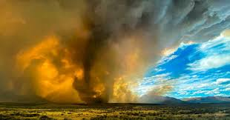
Principles of Disaster/Emergency Risk Communication (AL Dept of Public Health)
This is a two-way process with speaker and listener.
Stop trying to allay panic.
Emphasize that there is a response process in place.
Avoid over-reassurance.
Acknowledge uncertainty.
Give people things to do.
Express wishes.

Slide 19
Tips for the Effective Communicator (AL Dept of Public Health)
Do no harm.
Words have consequences – choose them carefully.
Manage your frustration.
Plan what you want to say.
Don't speculate, guess, or assume. If you don't know something, say so.
Use simple, consistent, and accurate messages. (CERC)
Focus on informing people rather than impressing them.
Use everyday language.
Don't make promises you can't keep.
Never lie – you won't get away with it!

Slide 20
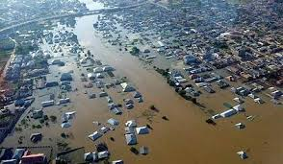
What Gets in The Way of Effective Communication?
Lack of trust and credibility. (Glik, p.3)
People's responses to events that threaten their health and safety evoke a diverse array of emotional, cognitive, and behavioral responses. (Glik, p.4)
Mental states in a crisis. People may feel:
Uncertainty – acknowledge it.
Fear, anxiety, dread – provide accurate information.
Hopelessness and helplessness – advise people to take constructive actions related to the crisis which can restore a sense of some control.
Denial – offer consistent message from multiple trusted sources.
Panic – continue to offer consistent message – appeal to sense of community to help each other. (CERC, p.5-7)

Slide 21
Communication is a Two-Way Street. An Effective Speaker Needs an Effective Listener. What Makes a Good Listener?
Mental Noise Theory – Listeners have difficulty processing information when they are:
upset,
angry,
fearful,
outraged,
under high stress,
involved in conflict,
feel high concern.
Lack of trust impacts people's willingness to believe authority. Negative information is more believed than positive. (Glik, p.4)
Listeners (team members) need to pay attention to our internal and external responses.
Manage your emotions.
Ask questions.
Develop trust.
When possible, support the leader.
When not possible, make your concerns known one-on-one.
Follow the chain of command.

Slide 22
Final Warning
Remember to use this for yourself and to challenge your communication skills.

Slide 23
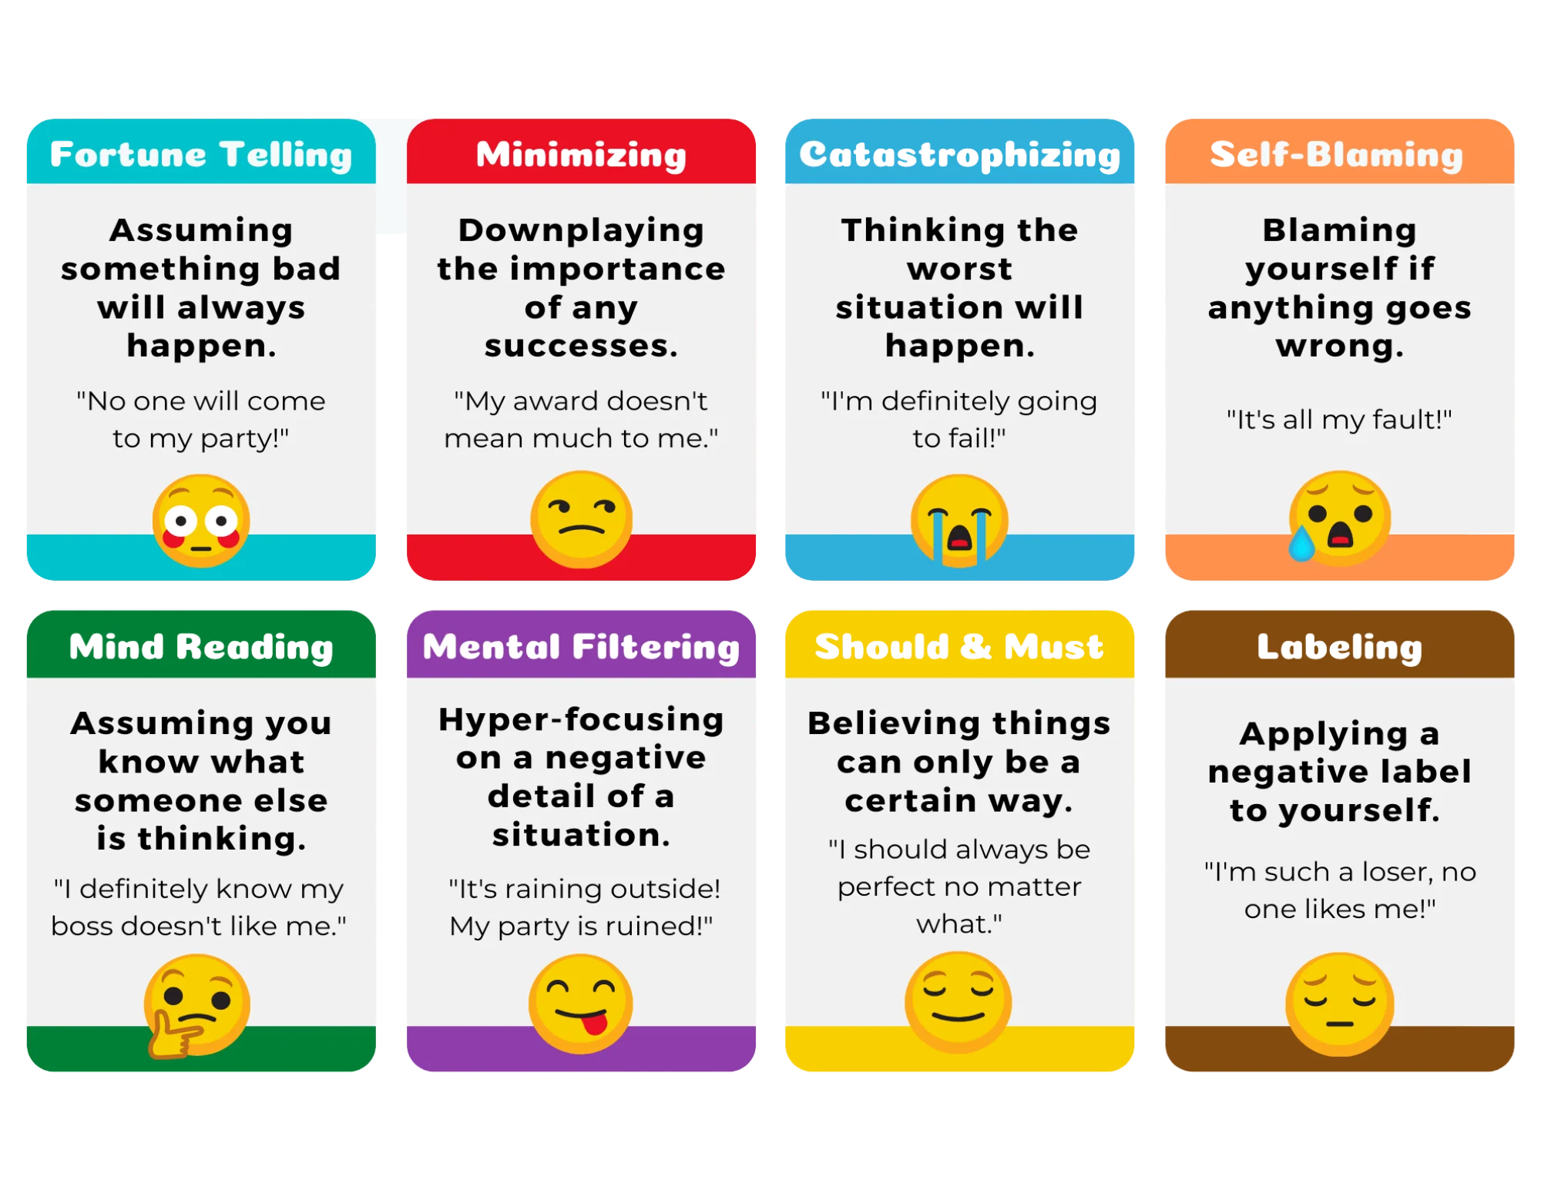
Cognitive Distortions
CognicHealth

Slide 24
Case Study

Slide 25
Questions

Slide 26
Would you like this presentation for your group?
This presentation is available for a 90-minute interactive training. We will be offering this training on June 13th from 9-10:30 am. Register on MNTrain.org.
All our trainings are available for presentation to your team/county/region. Please contact your RBHC if you have questions or would like to schedule a training.

Slide 27
RBHC Contact Information
Nancy Carlson, MPhil (MDH Disaster Behavioral Health Contacts) Nancy.j.carlson@state.mn.us
Luke Campbell, MA (NE/NW Regions) Luke.Campbell.Contractor@state.mn.us
Hanna Marzinske, MBA (SW/SC Regions) Hanna.Marzinske.Contractor@state.mn.us
Kevynn Schumacher, MS (WE/C Regions) Kevynn.Schumacher.Contractor@state.mn.us
Janet Yeats, MA LMFT (Metro/SE Regions) Janet.R.Yeats.Contractor@state.mn.us

Slide 28
Resources
AL Dept of Public Health Satellite Conference (November 15, 2005), Facing Fear: Crisis Communication and Disaster Behavioral Health.
CERC (Crisis + Emergency Risk Communication). (2019 Update). Psychology of a crisis. US Department of Health and Human Services: CDC.
Fakhruddin, B., Clark, H., Robinson, L. & Hieber-Girardet, L. (2020). Should I stay or should I go now? Why risk communication is the critical component in disaster risk reduction. Progress in Disaster Science (8), 1-4.
Gladieux, M. (2022) Communicate with courage: Taking risks to overcome the four hidden challenges. Berrett-Koehler Publishers.
Glik, D. (2007) Risk communication for public health emergencies. Annual Review of Public Health, 28, 33-54.
Mayhorn, C. & McLaughlin, A. (2012) Warning the world of extreme events: A global perspective on risk communication for natural and technological disaster. Safety Science.

Slide 29
Thank You!
The RBHC Team

