Slide 1
The Changing Landscape of Long Term Care Post Covid-19
Panel Member Pamela Hayle, ACC, SFPT
Director of Safety and Quality Support ~ Cassia Care

Slide 2
The Changing Landscape of Long Term Care Post Covid-19
What are some of the Lasting impacts of Covid-19 on Long Term Care?
Staffing, Staffing, Staffing
Losing our Leaders
Supporting/Encouraging “Intentional Recovery”
Professional / Personal Recovery
Industry Recovery

Slide 3
The Changing Landscape of Long Term Care Post Covid-19
How did Long Term Care adapt during Covid-19 and what continues?
Lessons Learned must be recognized
Technology Savvy
Infection Control Experts
Constant System Flexibility…Mandatory System Reboot

Slide 4
The Changing the Landscape of Long Term Care Post Covid-19

Slide 5
The Changing Landscape of Long Term Care Post Covid-19
What Does our New Normal Look Like?
Reflective and New
Process orientated
System Reboot

Slide 6
The Changing Landscape of Long Term Care Post Covid-19
What kind of support does long term care need?
Regulatory Oversite that matches the current system needs
Simplified Processes
Intentional System wide Recovery
A few Quick Tools

Slide 7
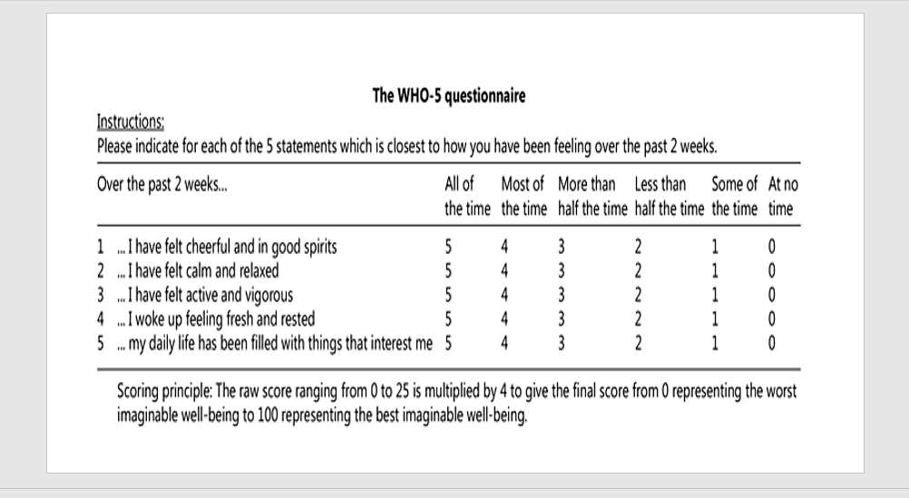

Slide 9
The Changing Landscape of Long Term Care Post Covid-19
Intentional Recovery Tools
Alicia Keys - Good Job | Cover by One Voice Children’s Choir | A Tribute to Covid-19 Heroes - YouTube
Building Your House – System Reboot by Henry Cloud
Signs of Hope – New Beginnings

Slide 10
