Slide 1
Why Social Ties and Social Infrastructure Are Critical in Shocks and Disasters
Daniel P. Aldrich
daniel.aldrich@gmail.com
Twitter/X @danielpaldrich

Slide 2
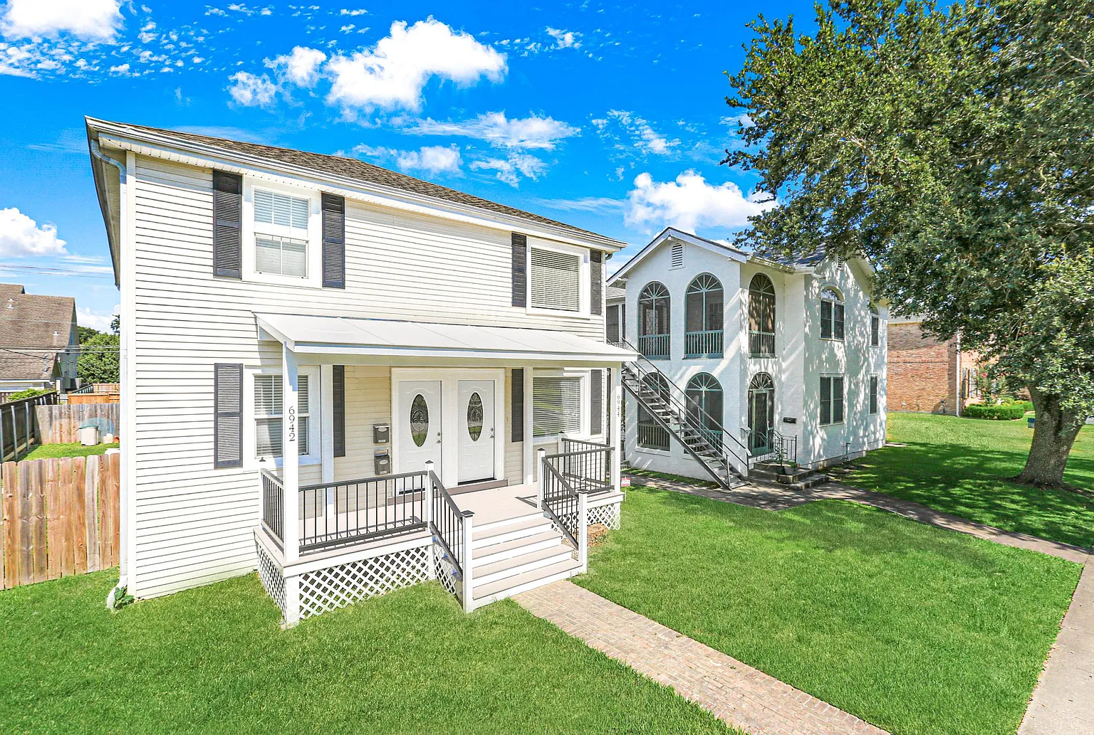

Slide 3
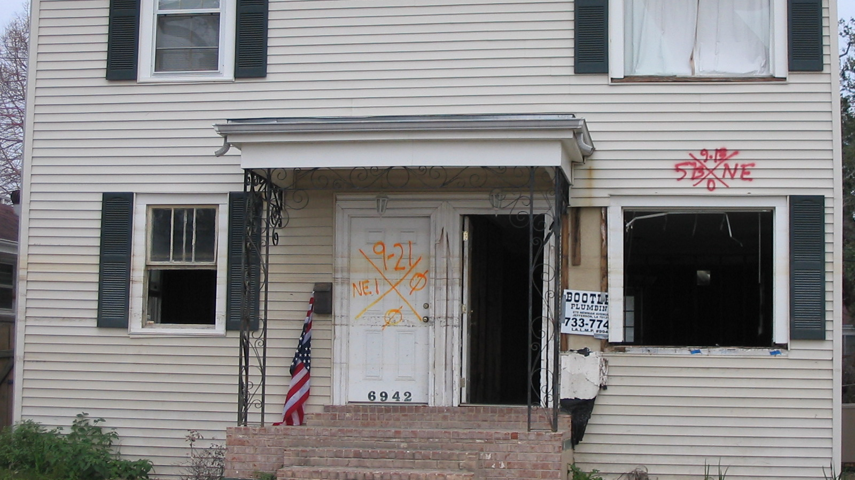

Slide 4


Slide 5
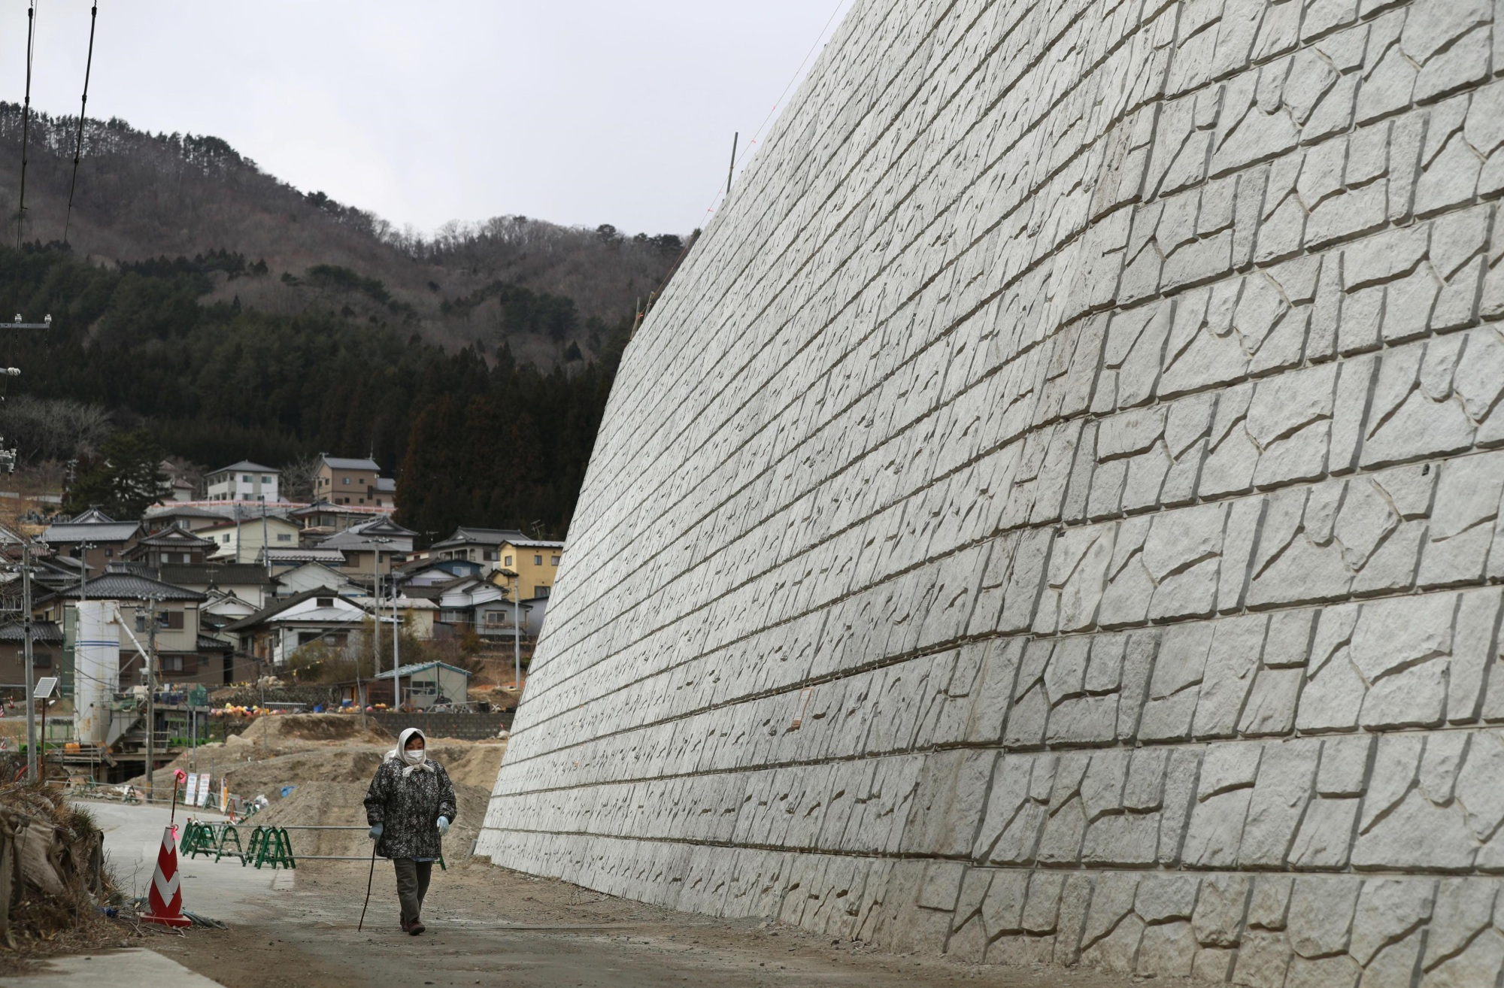

Slide 6
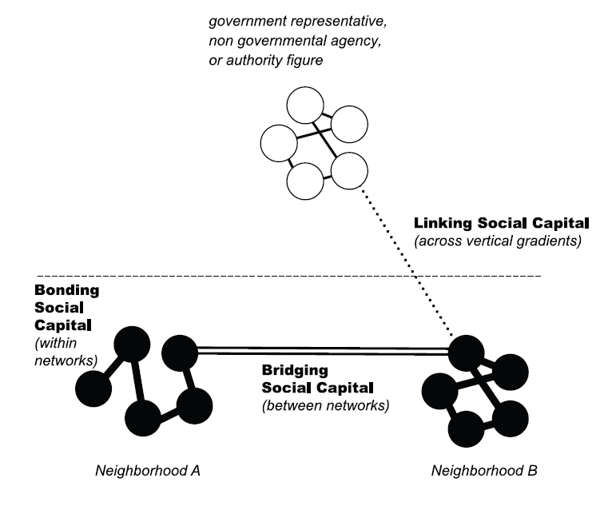
Trust, neighbors, networks

Slide 7


Exit vs. Voice

Slide 8
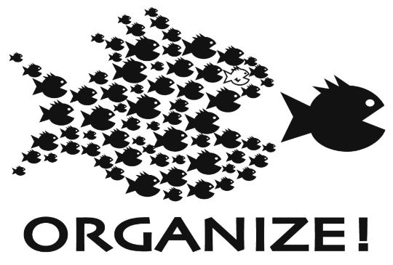
Collective Action

Slide 9
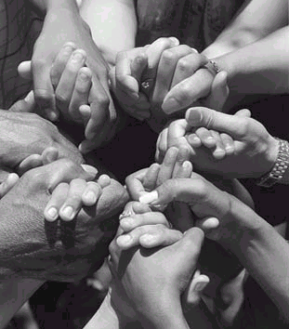
Informal Insurance

Slide 10
Evacuation

Slide 12
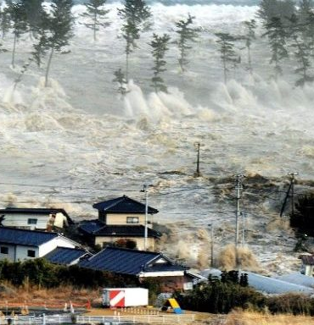
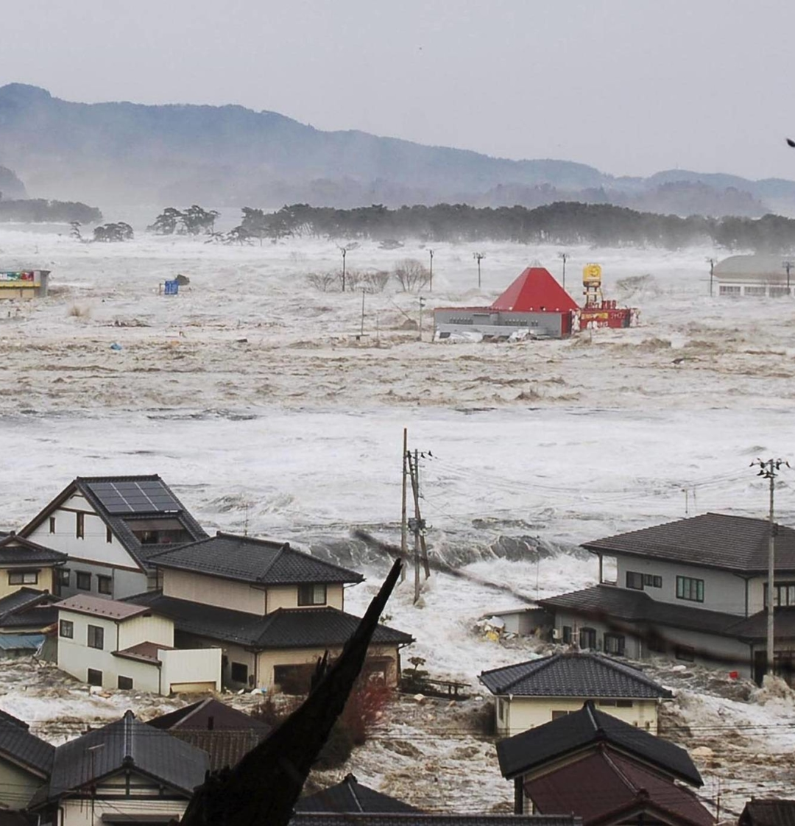

Slide 13
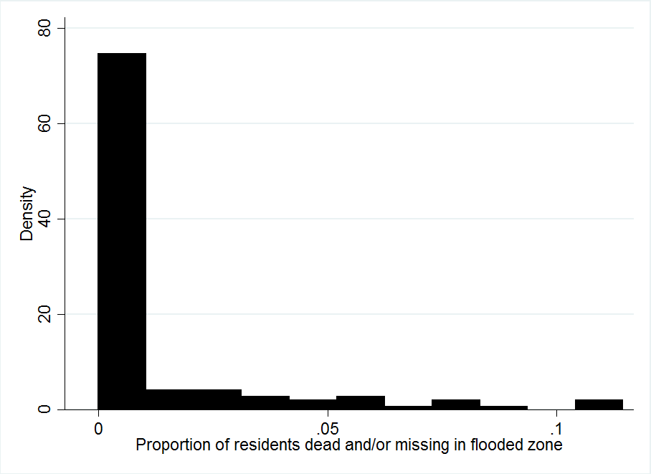
Survival

Slide 14
Survival not well correlated with height

Slide 15
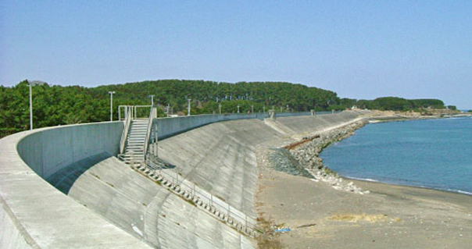
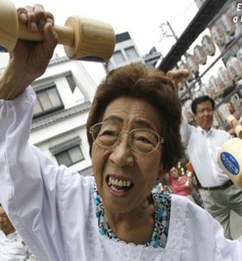
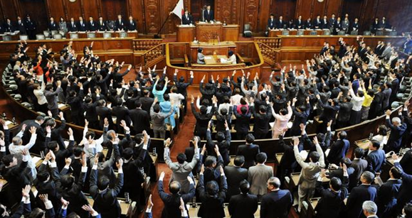
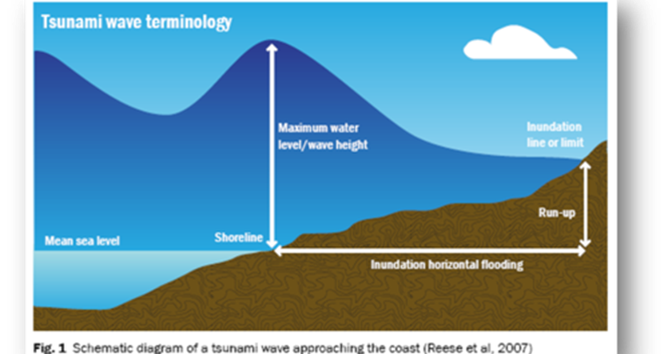
Theories of Survival

Slide 16
Social Networks Critical in Survival
.03
.02
Predicted mortality during the tsunami
.01
0
-.01
0
5
10
15
Weakness of bonding ties

Slide 17
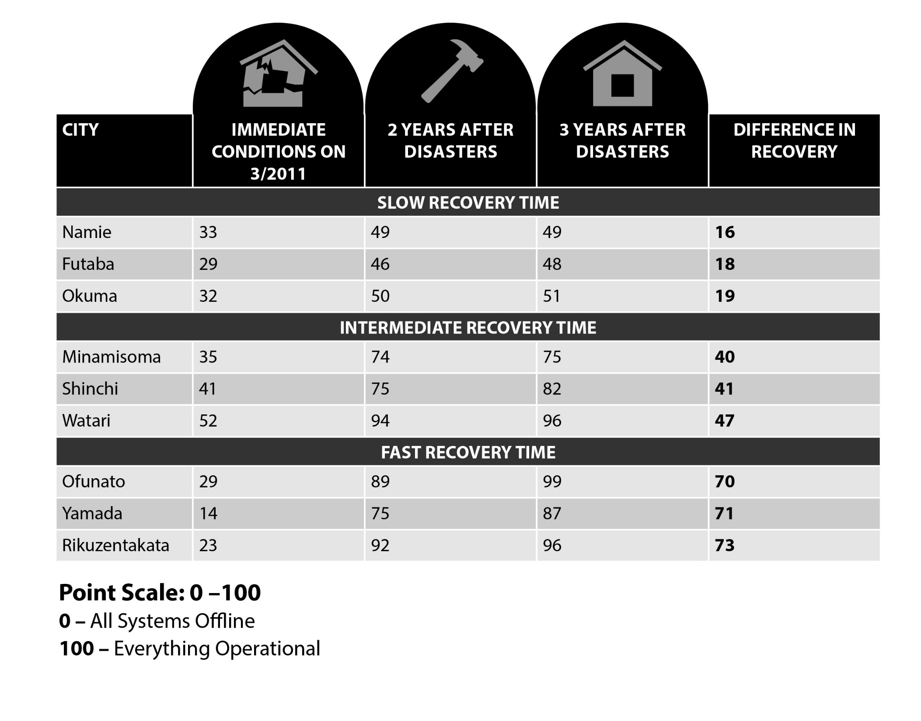

Slide 18
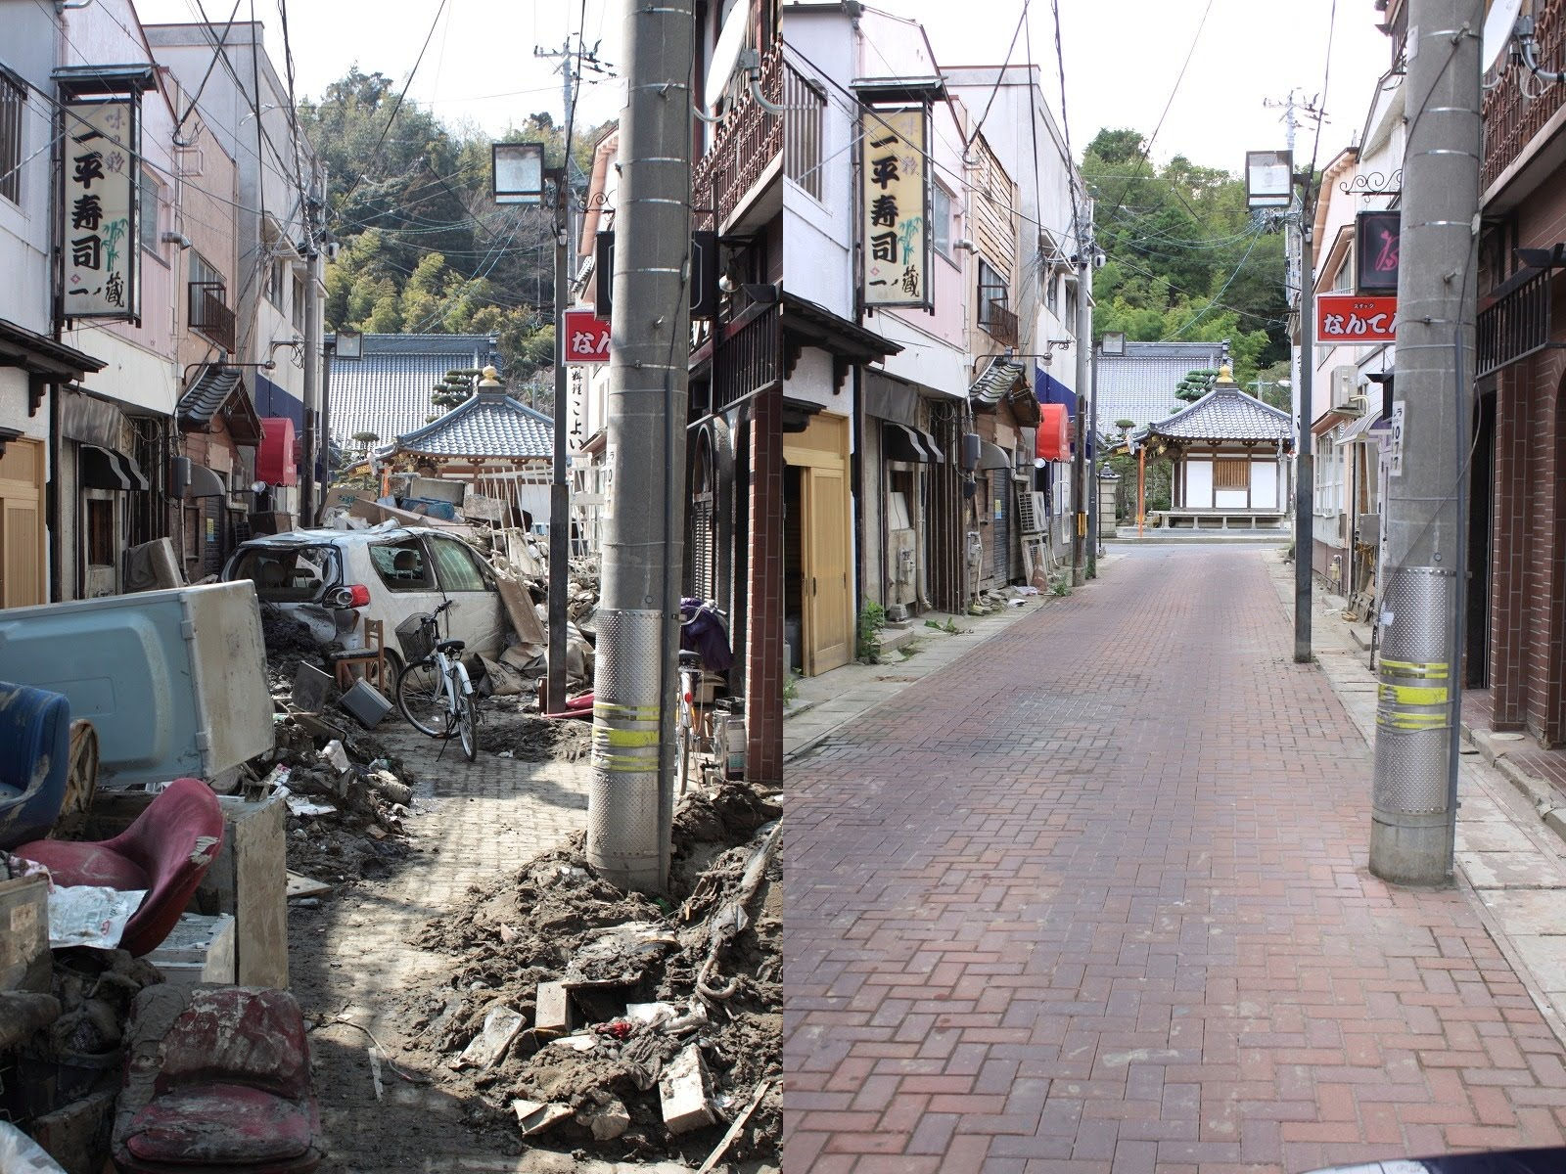
Recovery: Rebuilding Ishinomaki

Slide 19
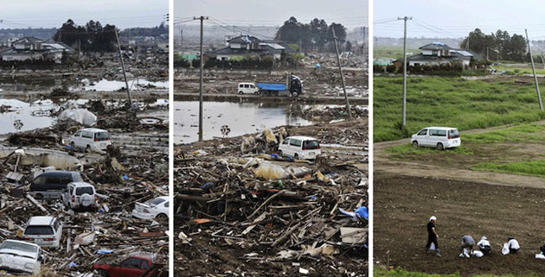
Recovery: Clean up in Sendai

Slide 20
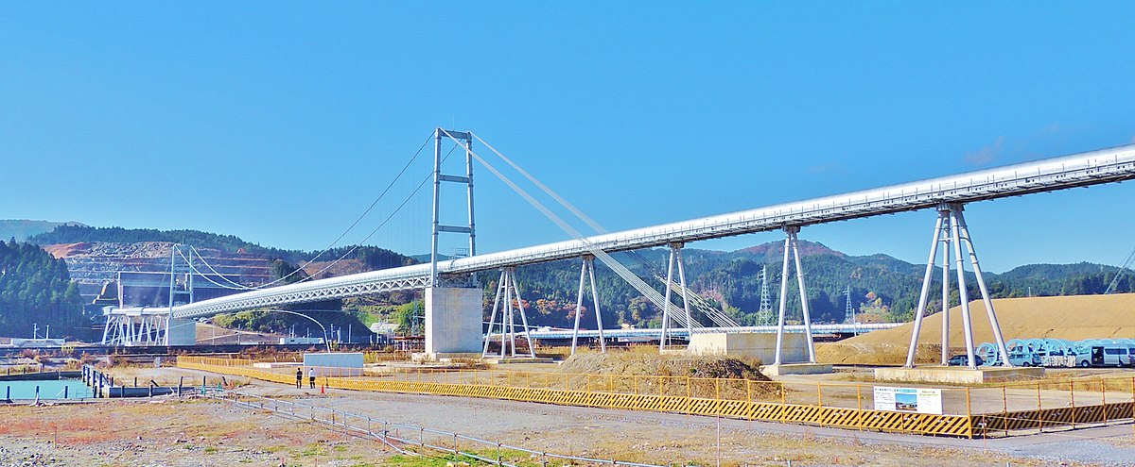
Coastal City

Slide 21
Linking social capital critical in recovery

Slide 22
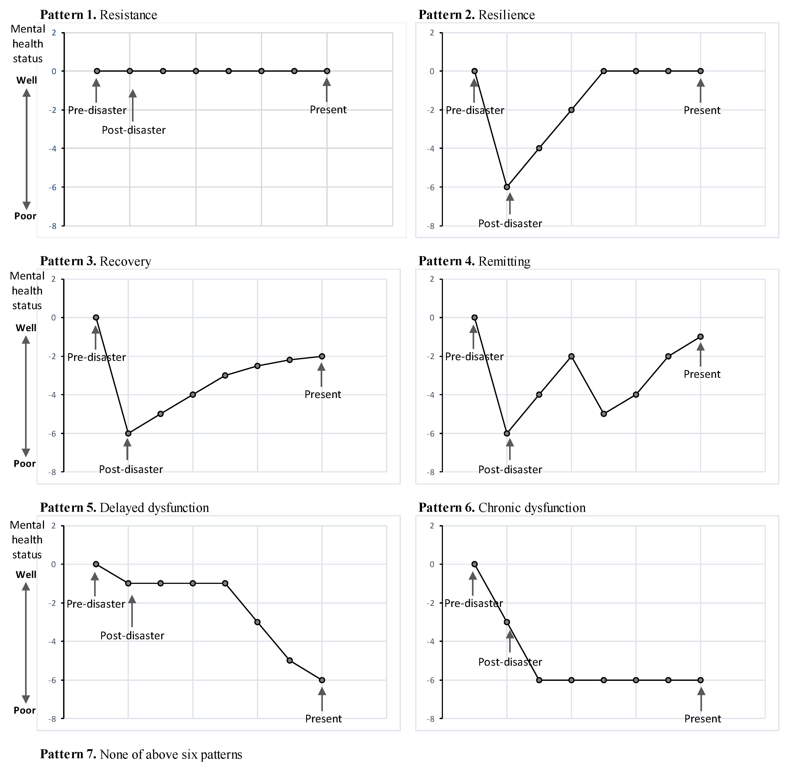

Slide 23
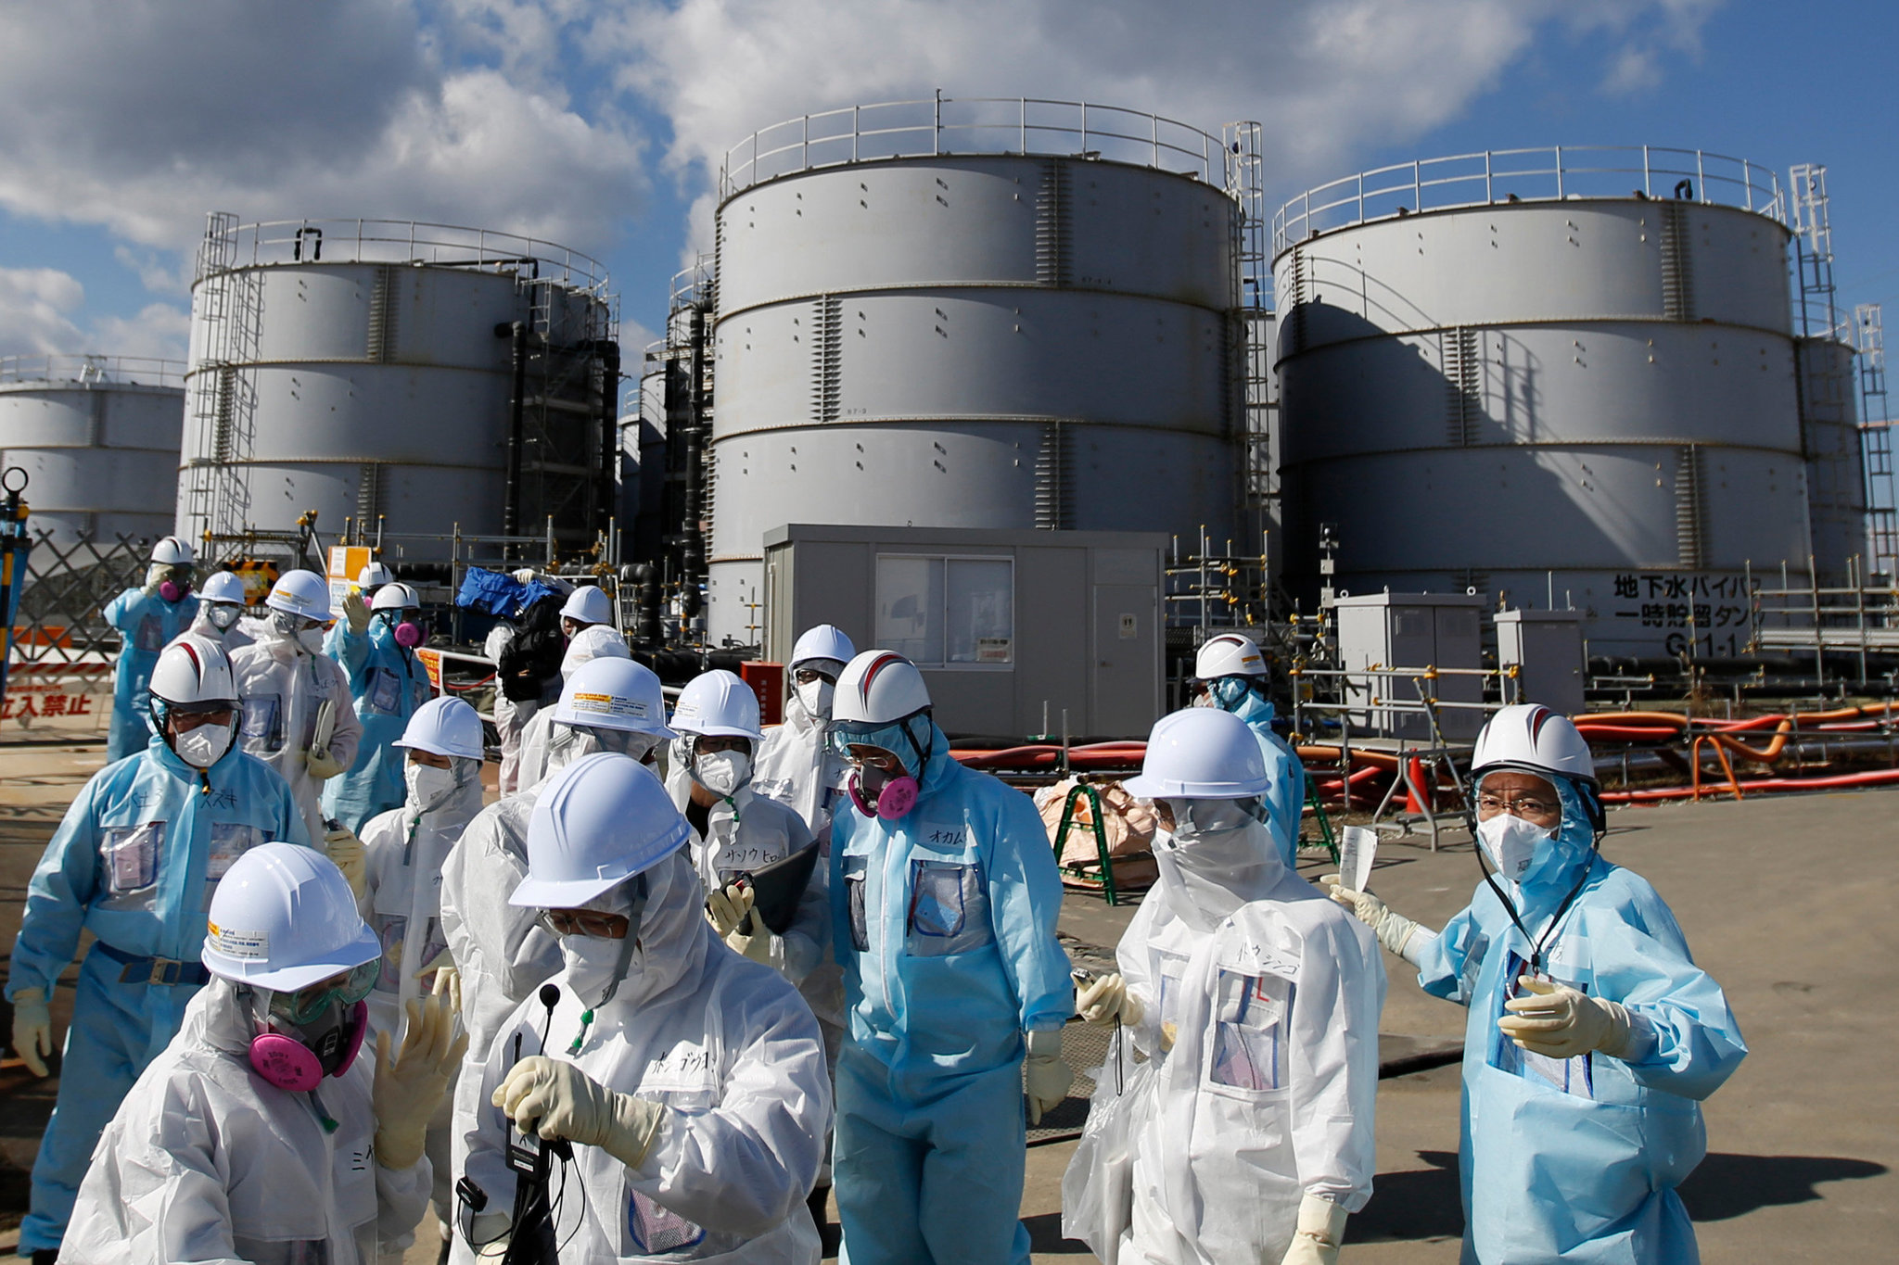
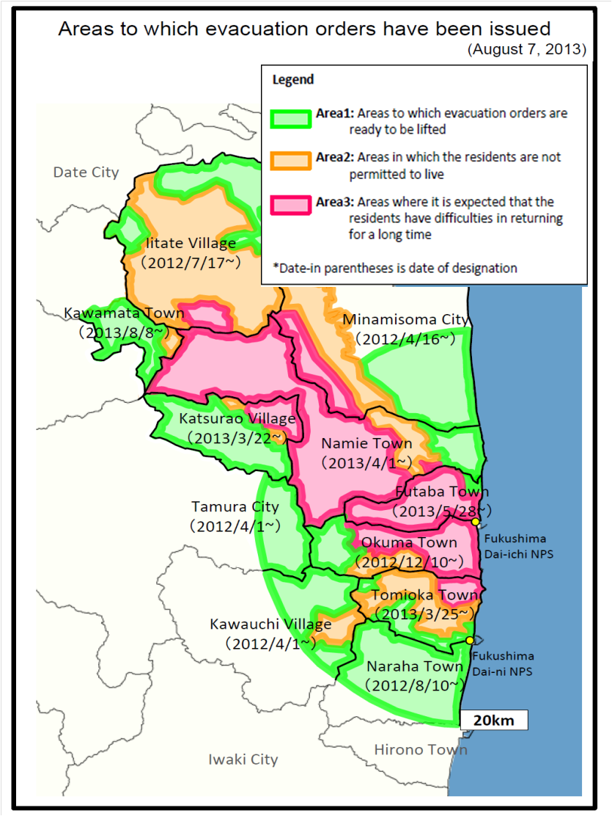
Futaba town and Evacuation Orders

Slide 24
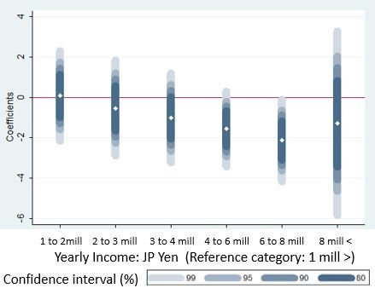
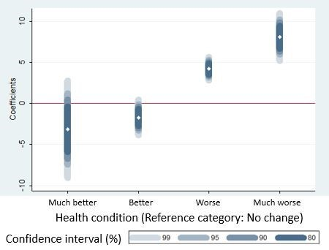
Income and health do not affect K6 scores

Slide 25
Social capital serves as a shield against mental illness
Futaba unknown neighbor
Futaba known neighbor

Slide 26
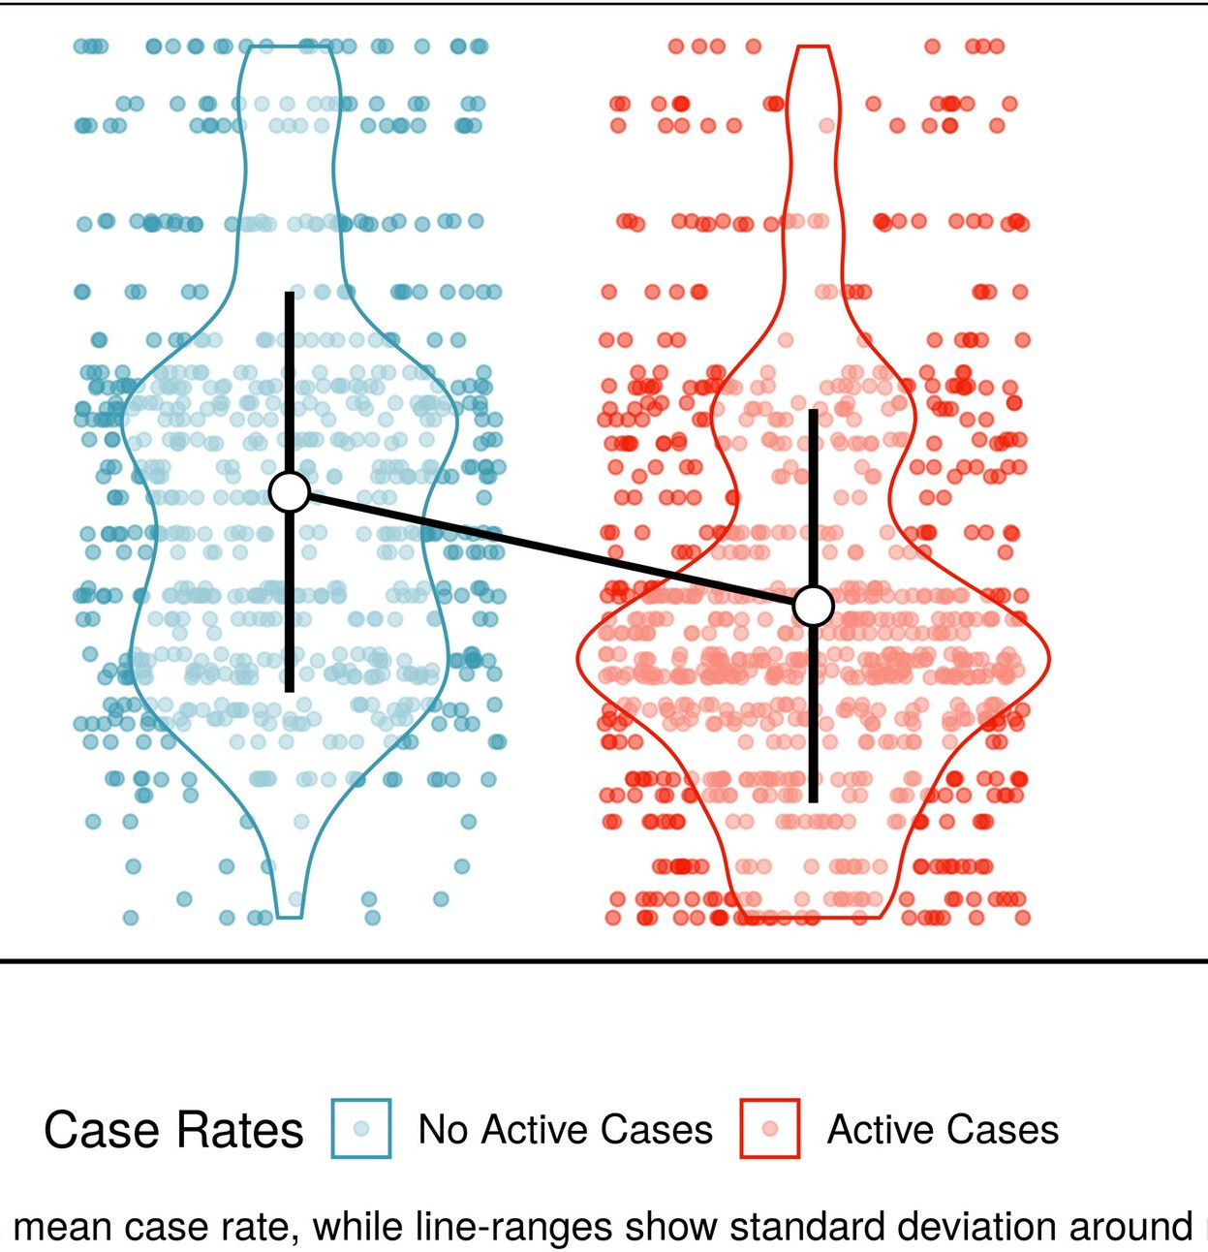
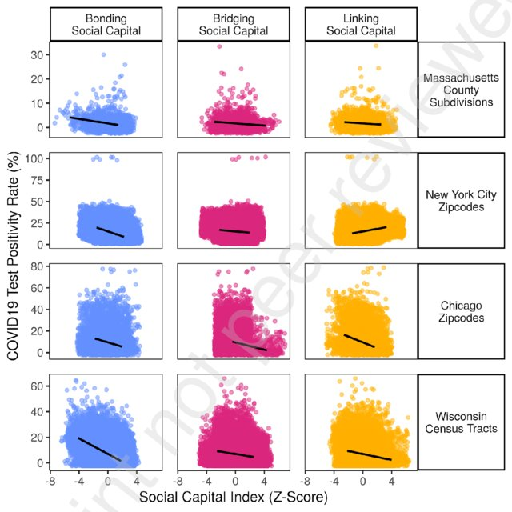

Slide 27
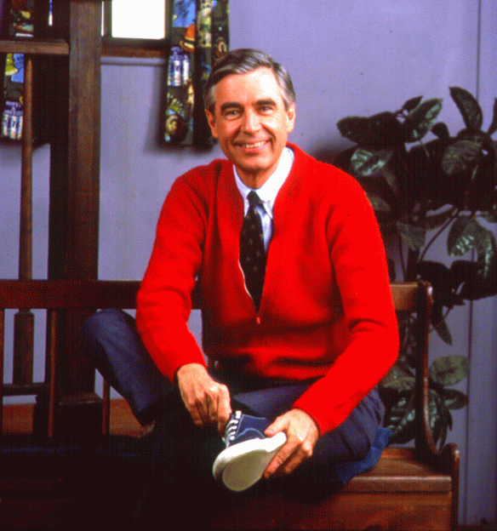
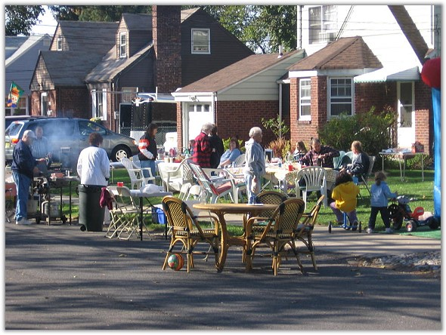
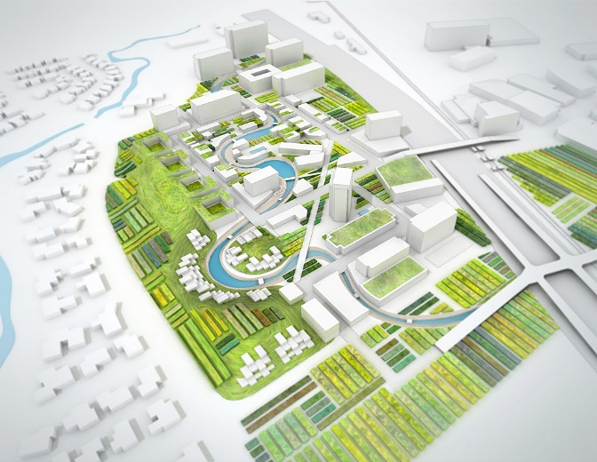
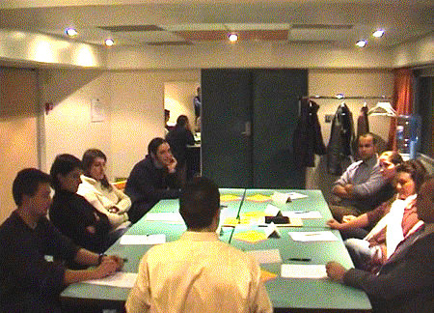

Tools for Building Resilience

Slide 28
How to Survive and Thrive Before, During, and After a Crisis?
Horizontal ties critical in survival and mental health recovery
Vertical ties important during evacuation and rebuilding
These ties can be buit

Slide 29
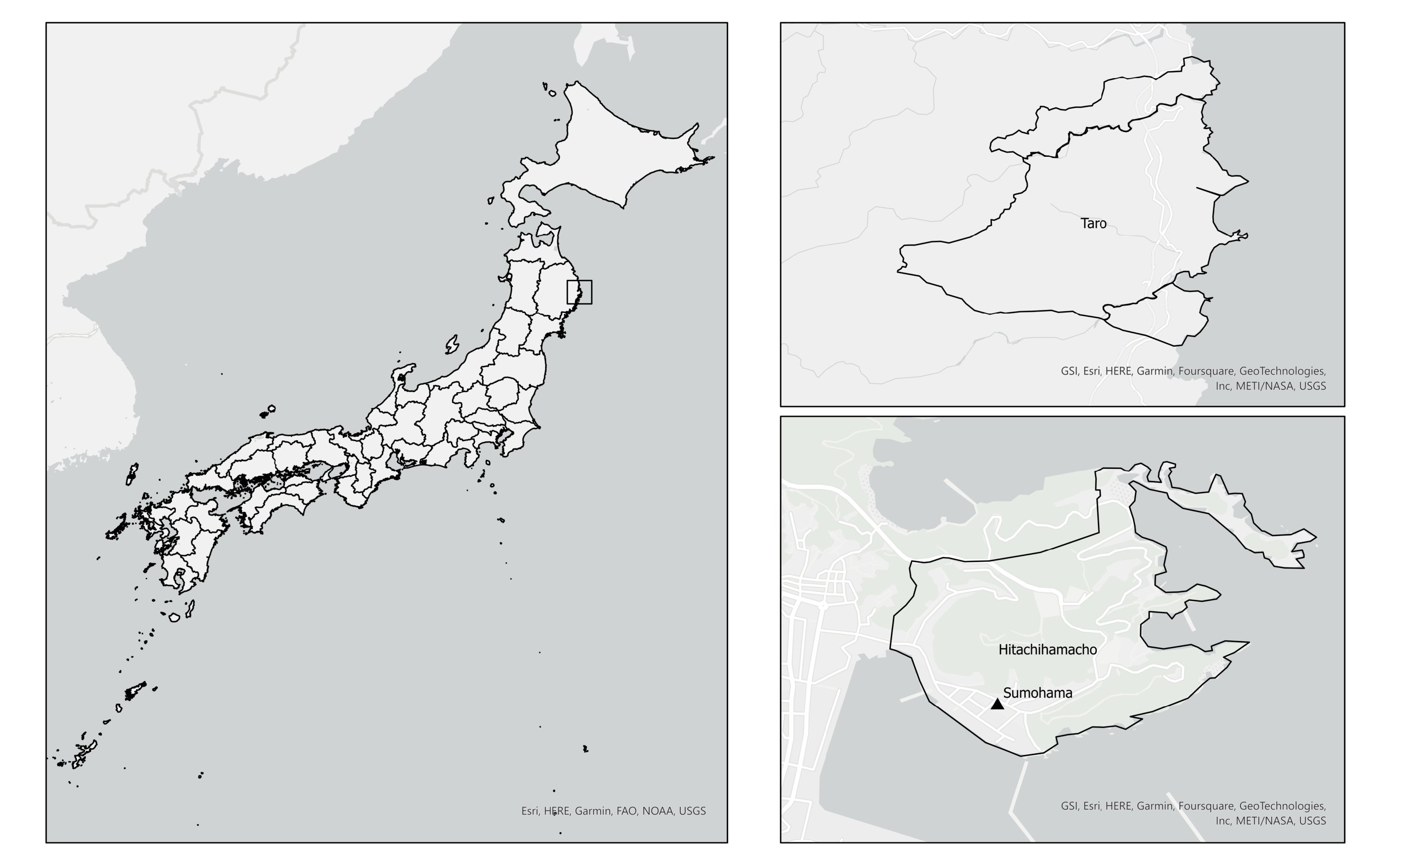

Slide 30
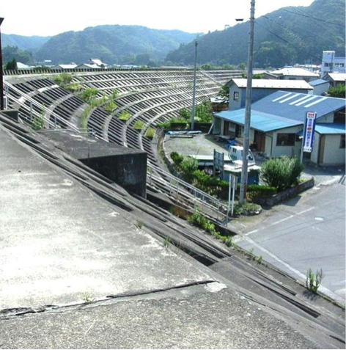
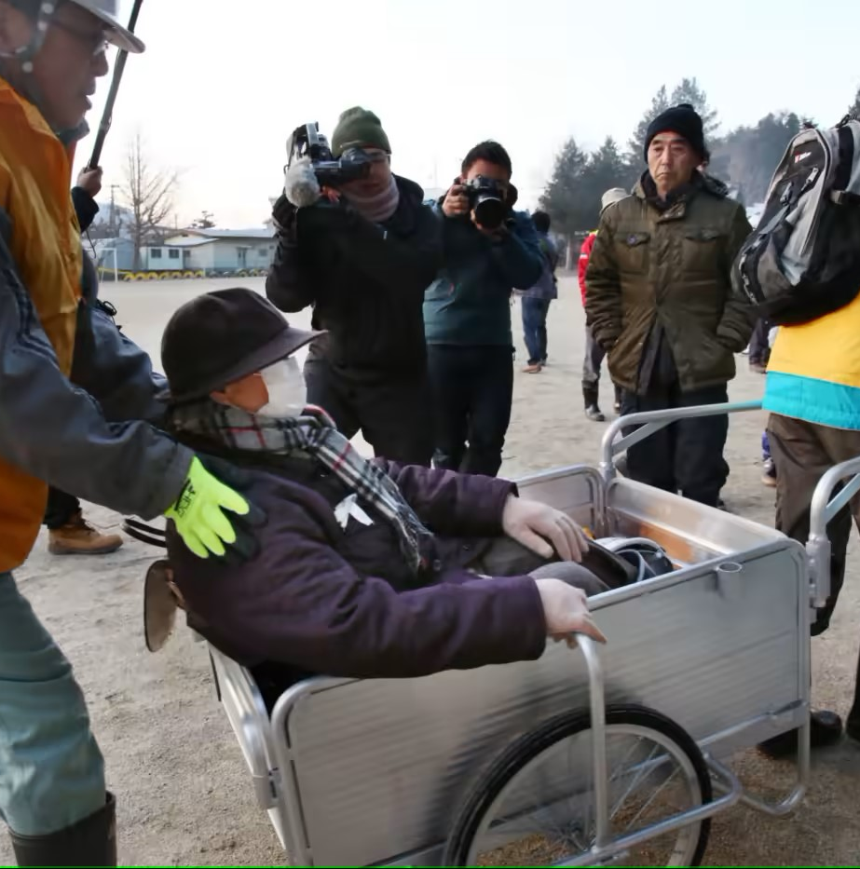

Slide 31
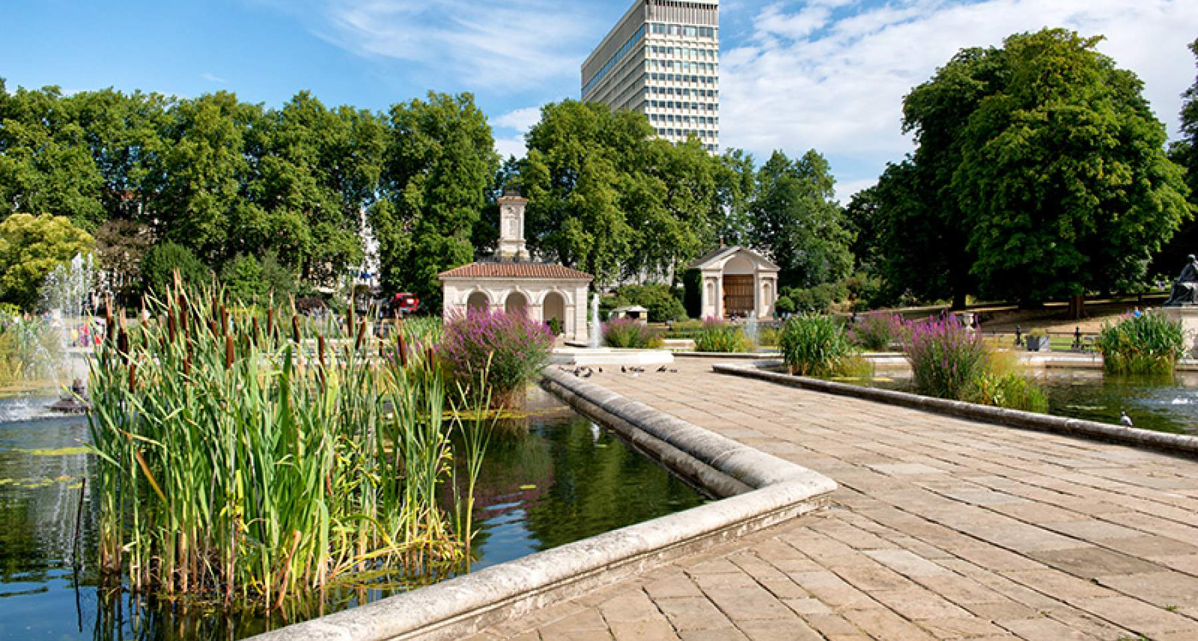
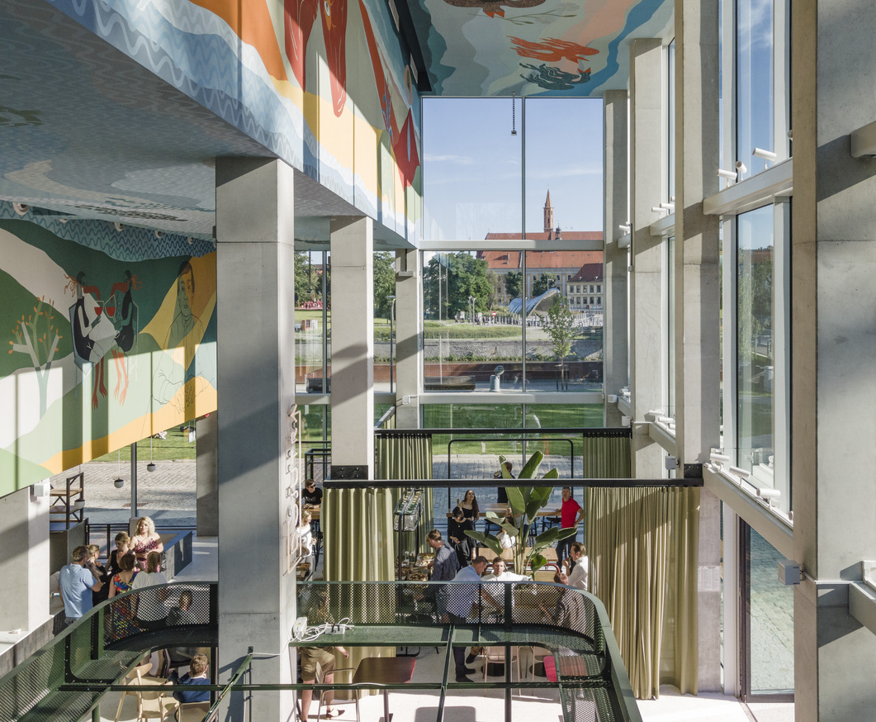
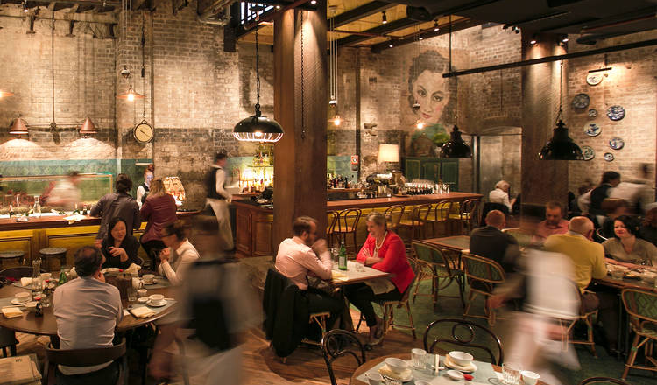
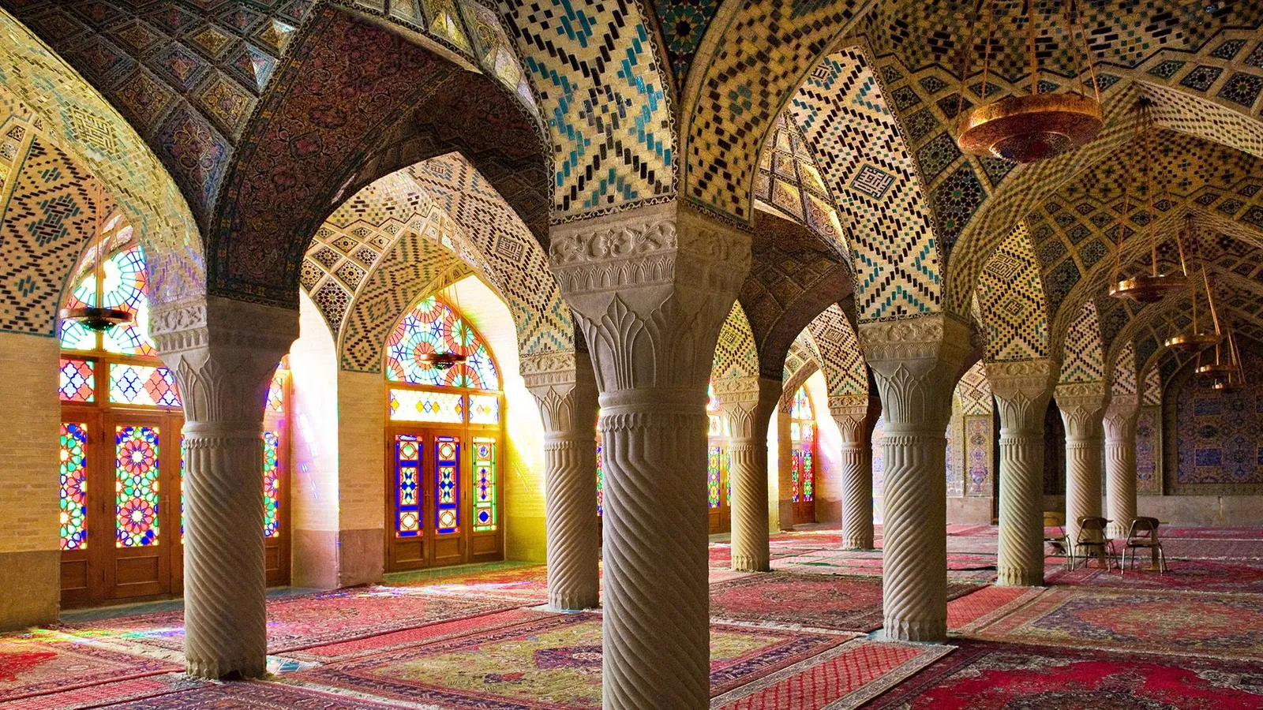

Slide 32
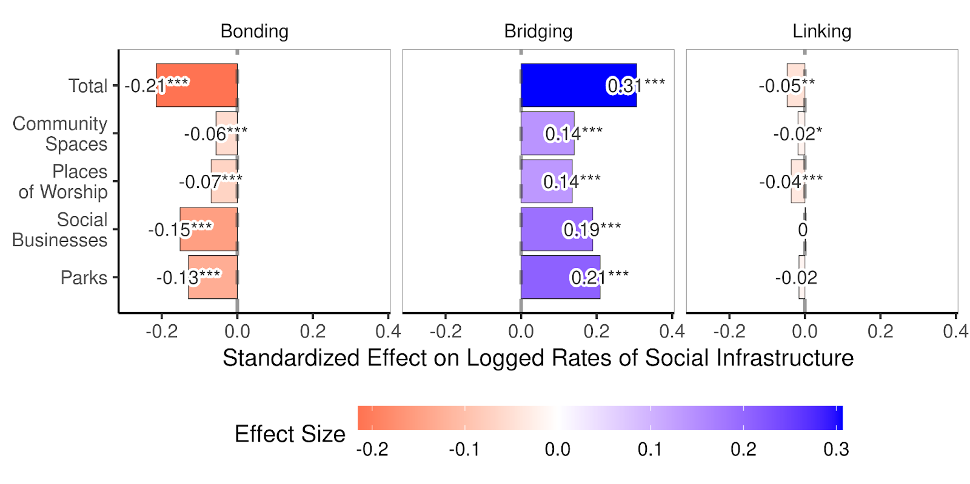
Social infrastructure builds bridging ties

Slide 33
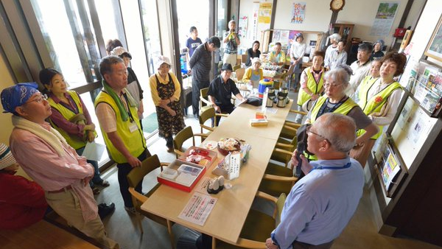
Social infrastructure in Japan, Philippines, and Nepal: Ibasho

Slide 34
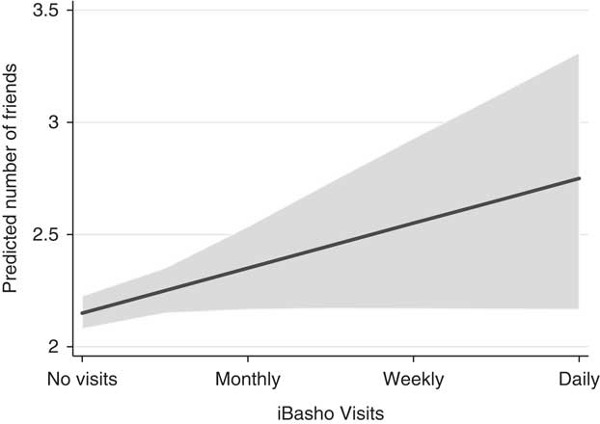
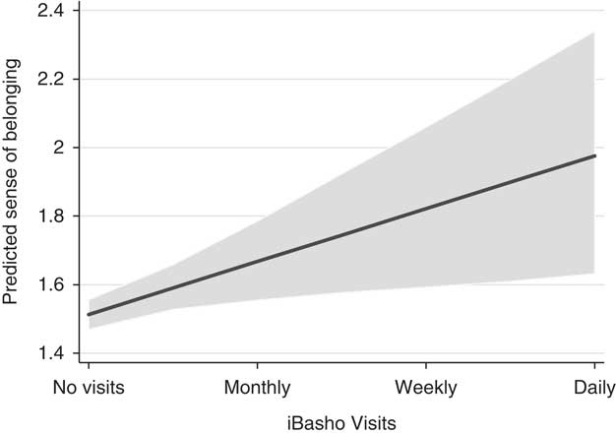
Ibasho –social infrastructure - broadens networks and deepens efficacy

Slide 35
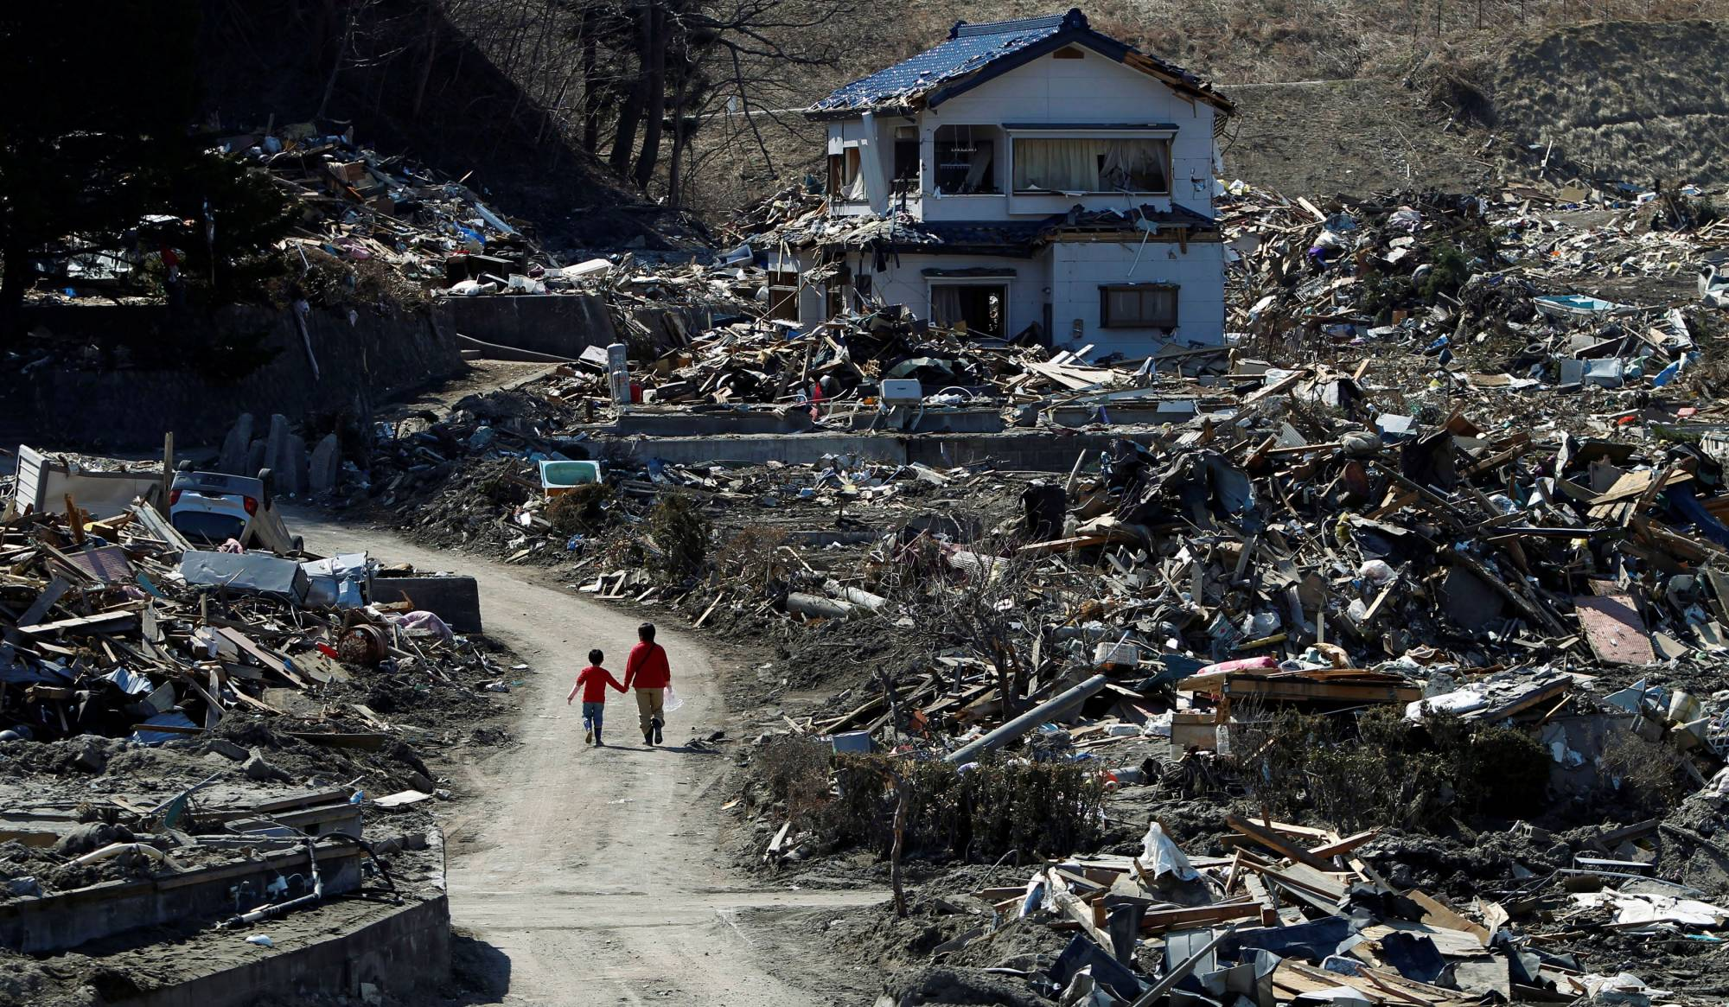

Slide 36
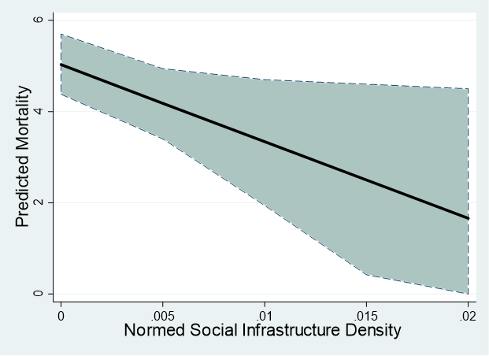
Communities with more social infrastructure saw fewer deaths

Slide 39
Social Infrastructure Drives Economic Recovery

Slide 40
Social Infrastructure Helps Population Recovery

Slide 41
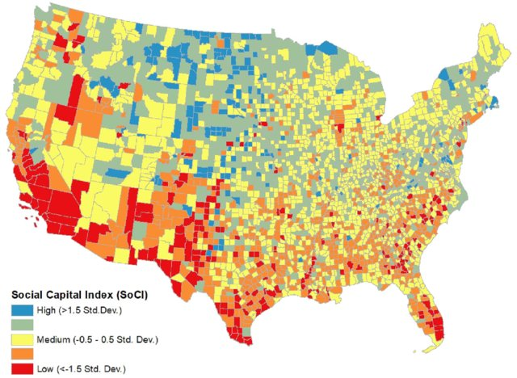
Lack of systematic data on social infrastructure

Slide 42
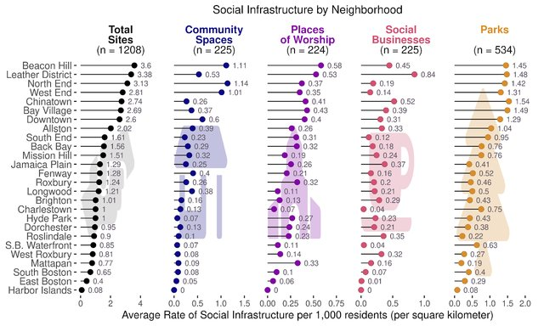
Uneven distribution of social infrastructure

Slide 43
Huge imbalance between physical and social infrastructure investment

Slide 44
Conclusions
Societies fall back on building and rebuilding physical infrastructure but overlook social infrastructure
Social businesses, community spaces, parks, and places of worship are underappreciated for their ability to build bridging social infrastructure
Communities with better access to these gathering places have more resilience to shocks
Our societies underinvest in these facilities, distribute them unequally, and cut their funding first

Slide 45
