Slide 1
2025 Regional Hazard Vulnerability Analysis (HVA)
Metro Coalition
Senior Advisory Committee Meeting
November 25, 2025

Slide 2
Regional HVA Objectives
Identify hazards or risks that are most likely to have an impact on the demand for healthcare services and our system’s ability to provide these services.
Provide information for consideration of vulnerable/at risk communities.
Focus is regional healthcare service delivery impacts. Individual site considerations (e.g. internal fire, flood, patient elopement, etc.) are not included in the regional rollup. Site considerations are included in member specific risk analysis.
Summaries based on review of existing facility/system hazard analysis, jurisdictional-based planning documents and internet research on regional hazards.

Slide 3
Highlights
76 submissions received for this year’s HVA
Hospitals, Long Term Care/Home Health/Hospice, EMS, Public Health, Emergency Management participated
Member Specific Risk Analysis for Compact and Long-Term Care
3 Year Regional Risk Analysis Trending
AI Assisted Summaries

Slide 4
Methodology
Metro HCC utilized hazard analysis submitted by coalition members from August – October 2025 as the foundation for this Regional HVA.
Hazards were reviewed and prioritized by using two metrics:
Probability of occurrence
Overall risk score
This method does factor the components of impact and preparedness, as well as severity of impact, which are incorporated into the overall risk score.
All information submitted is presented generally; individual information submitted is held in strict confidence.

Slide 5
HVA Analysis Coalition Member & Metro Region

Slide 6
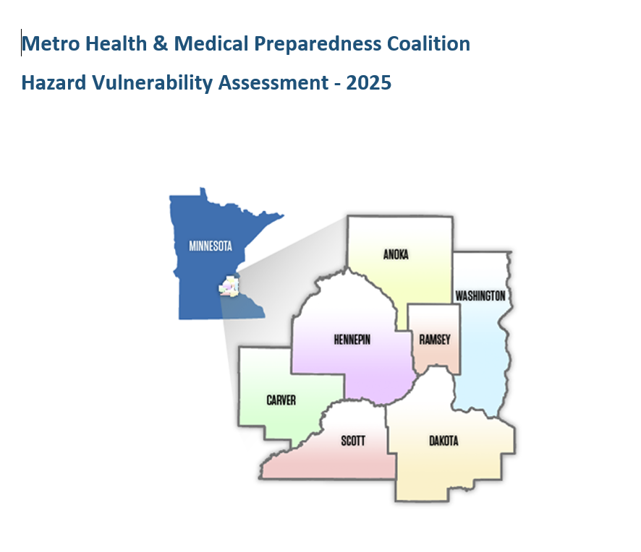
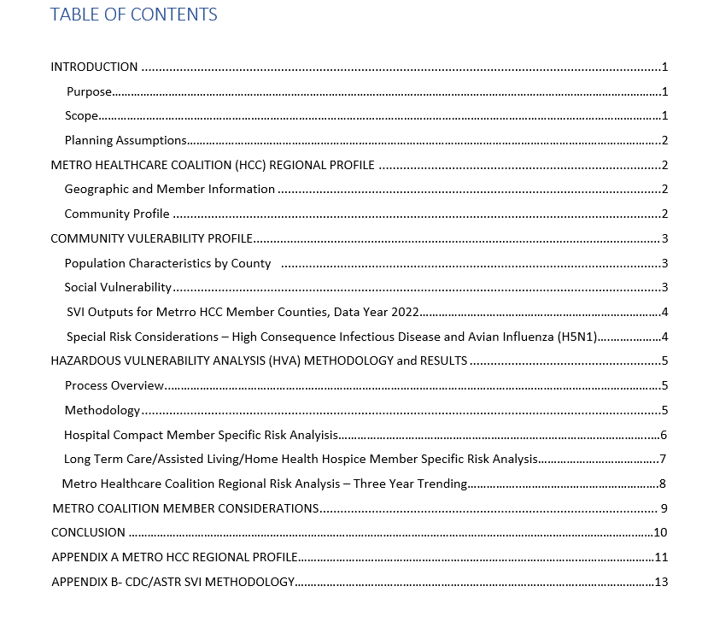

Slide 7
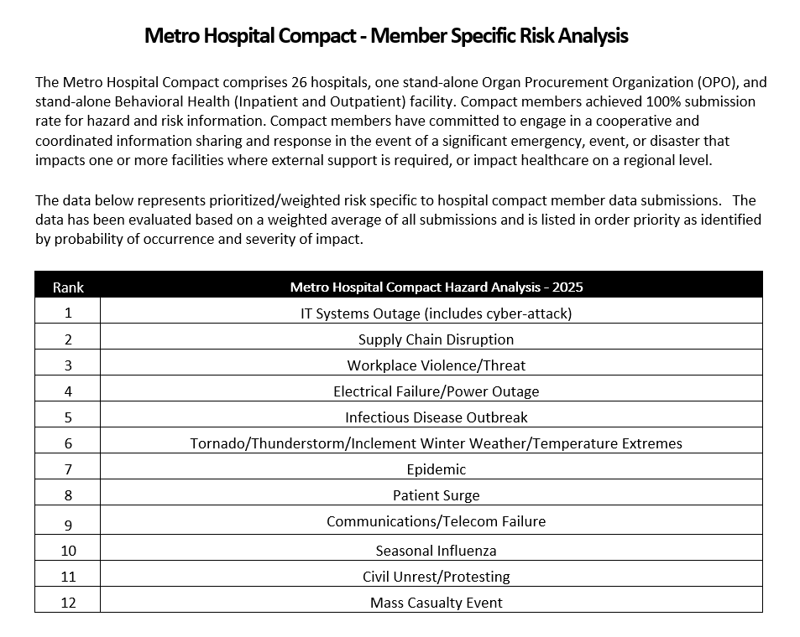

Slide 8
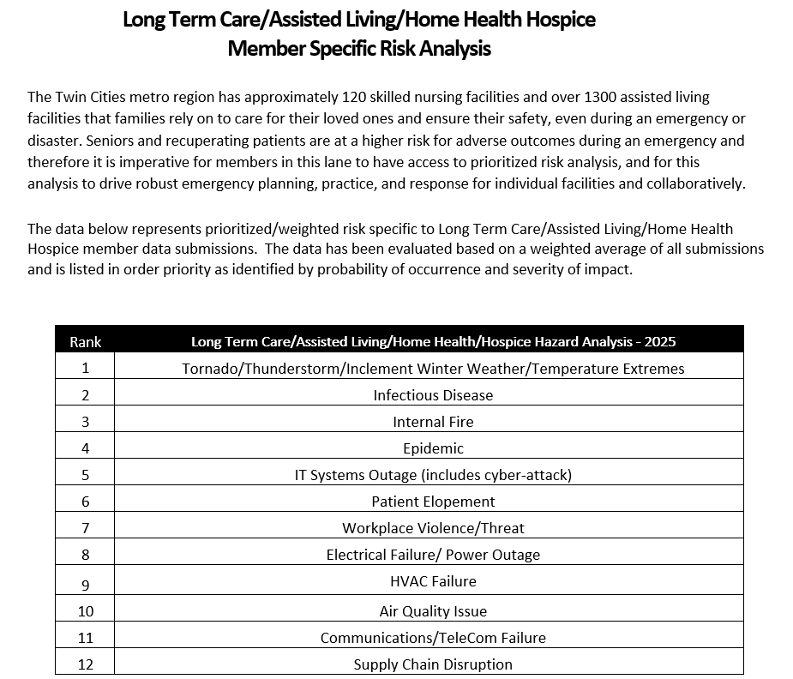

Slide 9
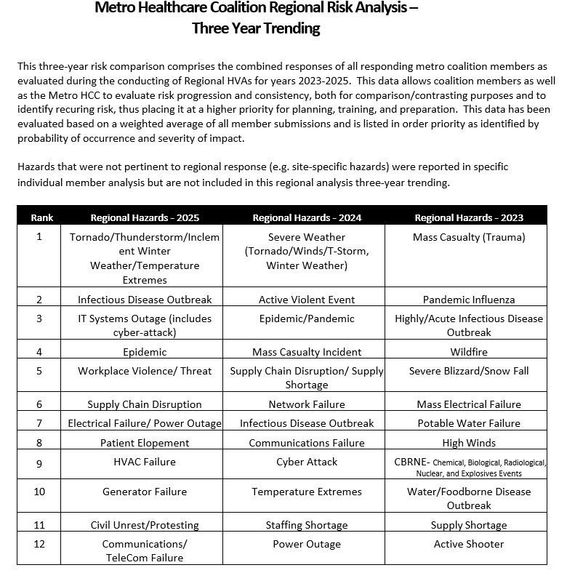

Slide 10
How Do We Utilize This Data
This Regional Healthcare Hazard Vulnerability Assessment is intended to be a broad strategic planning tool that provides linkages among hazards, risks, and vulnerabilities so that healthcare partners can better plan for emergencies and disasters.
This assessment offers a prioritized list of hazards that can serve as a baseline for future organizational and jurisdictional HVAs in planning, training, mitigation, response, and recovery activities.

Slide 11
Next Steps
The 2025 Regional HVA and Executive Summary have been reviewed and approved by MDH, pending a few minor edits.
The executive summary will be distributed to Metro Coalition members in December 2025.
Chris will submit the HVA to ASPR in December to meet the federal deliverable deadline.

Slide 12
Thank You!!
This Regional Healthcare Hazard Vulnerability Assessment would not be possible or as comprehensive without the dedication and participation of our partners.

