Slide 1

Programs & Services Overview
Notes:
Hi everybody and welcome, my name is ______________. Thank you for being here today.
Who we are- make a connection to the specific group
I'm here today to talk to you about The Arc Minnesota
History
Mission
Values
Programs
Services
Photo Description From Left to Right:
The Arc Minnesota logo.

Slide 2
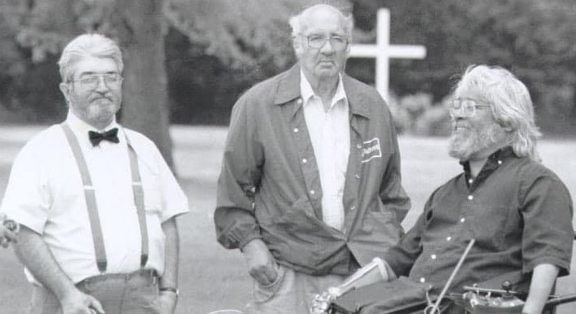

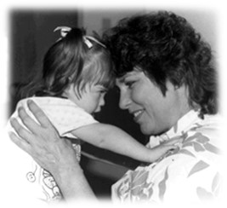
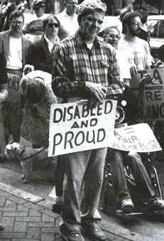
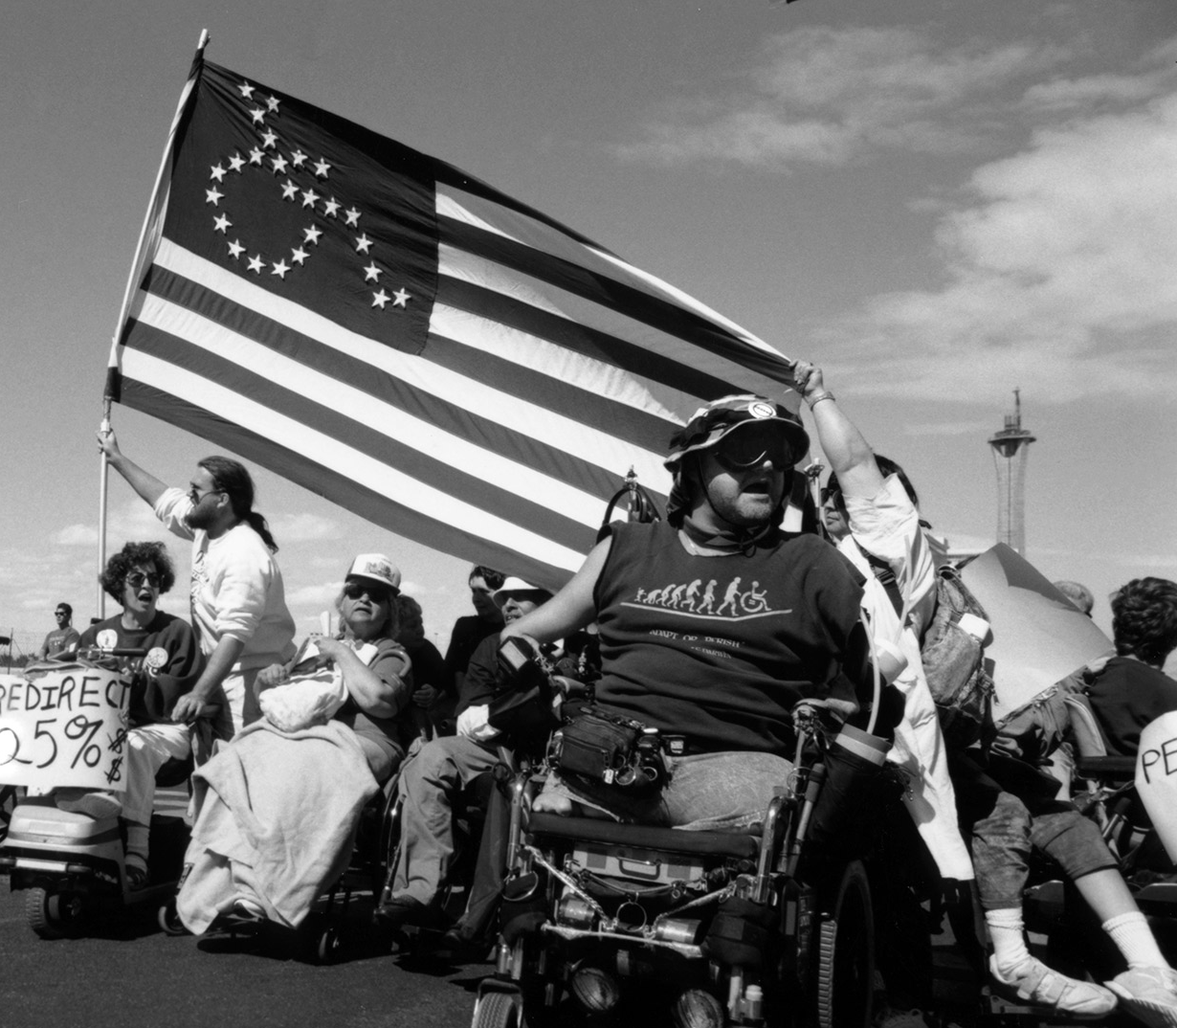
Where We've Been
Notes:
Short Version
The Arc began in 1946. It started with parents who wanted to change how their children with disabilities were treated.
In the past, many children and adults with disabilities were put in institutions, where they stayed their whole life.
Institutions treated people with disabilities inhumanely, and parents who kept their children at home didn’t have support systems in place to help them. These families and individuals were ignored by society.
The Arc has been there for many important parts of disability history, from the President's Committee for People with Intellectual Disabilities in 1961 to the Americans with Disabilities Act in 1990.
Our name is NOT an acronym. We like to think of it as an "Arc to the future"
You may have heard of different names of Arc Chapters across the state. In 2018, we merged many of our Minnesota Chapters together into one Nonprofit called The Arc Minnesota to unify the support we provide across Minnesota.
We are affiliated with other Arc chapters across the country.
Although we are a statewide organization, we still have regional staff, groups and offices in 5 geographical regions.
Long Version
Here is a brief History of the Disability Rights Movement and how The Arc played a role:
Babies and toddlers with disabilities were put in institutions, where they stayed their whole life
Institutions
were overcrowded
had poor sanitary conditions
had inedible food
and used unneeded restraints
Parents who kept their children didn’t have support systems in place to help them
These families and individuals were ignored by society
The Arc began in 1946. Originally called the Minneapolis Association of Retarded Children (ARC)
The name is no longer an acronym because the word retarded is offensive
It started with parents who wanted to change how their children with disabilities were treated
These are other important dates in disability history:
President's Committee for People with Intellectual Disabilities –1961 address the needs of people with intellectual disabilities and their rights to be part of everyday life.
Civil Rights Act – 1964. This was the first Act that outlawed discrimination and segregation based on race, color, religion, or sex. It wasn't until 1988 that people with disabilities were included
Voting Rights Act – 1965. People with disabilities are able to have assistance in voting in elections.
Fair Housing Act – 1968. Discrimination in housing. It wasn't until 1988 people with disabilities were included.
Independent Living Movement – 1972. Advocacy and services for people with disabilities to live free and independent lives.
Individuals with Disabilities Act (IDEA) - 1975. This act required all public schools accepting federal funds to provide a "free, appropriate public education" to all children with disabilities in the "least restrictive environment.
504 Sit-in – 1977. People with disabilities fought to have rules in Section 504 more concisely defined and known. Section 504 is a federal law to protect the rights of individuals with disabilities in programs and activities. In schools, 504 is related to aids and services designed to meet the student's individual educational needs.
Capitol Crawl – 1990. 60 activists with disabilities climbed out of their wheelchairs and up the 83 steps of the Capitol to protest to their rights not being protected.
ADA – 1990. This law guarantees Americans with Disabilities unrestricted access to public buildings, equal opportunity in employment, equal access to government services and employment opportunities.
Photo description from left to right:
A white woman with curly brown hair holding a toddler who has light brown hair and ribbons in pigtails. The toddler has Down Syndrome. A drawing of a fist, with the wheelchair symbol and the phrase support disability rights inside of it. Three people outside, one is in a wheelchair (Cliff Poetz, John Daggy, and Rick Cardenas - who is in a wheelchair , 3 strong Minnesota advocates for people with disabilities). A person holding a sign saying Disabled and Proud. People in wheelchairs at protest. One person is holding an American flag, where the stars form the symbol of a person in a wheelchair.

Slide 3
The Arc Minnesota
The Arc Minnesota is a statewide organization and an affiliate of The Arc of The United States.
We have staff in 5 regional areas:
Greater Twin Cities
Midstate
Southeast
Southwest
West Central
For more information go to:
Where We Work - The Arc Minnesota

Slide 4

Arc’s Value Village Thrift Stores and Donation Centers generate significant funding for The Arc’s programs and services. Shop, donate, or volunteer!
arcsvaluevillage.org/
www.instagram.com/arcsvaluevillage
Notes:
Want to swap out logo

Slide 5

Mission
Promote and protect the human rights of people with intellectual and developmental disabilities
Support full inclusion and participation in communities
Notes:
For over 75 years, The Arc Minnesota has worked across the state to provide advocacy and information for people with IDD, and their trusted supporters.
We believe people who have disabilities are strong, powerful, capable, and resilient.
People with disabilities and their lived experiences are truly the driving force of the mission of The Arc.
OPTIONAL:
What sets us apart is our:
Diverse range of support options
Work to develop future leaders
Focus on disability and racial justice and the Disability Justice Framework
Work to transform systems and promote natural solutions
Emphasis on building self-efficacy
Intentionality around informed decision making
Determination to reframe the narrative around people with disabilities to end ableism and racism
Photo description: Three people standing outside together smiling.

Slide 6
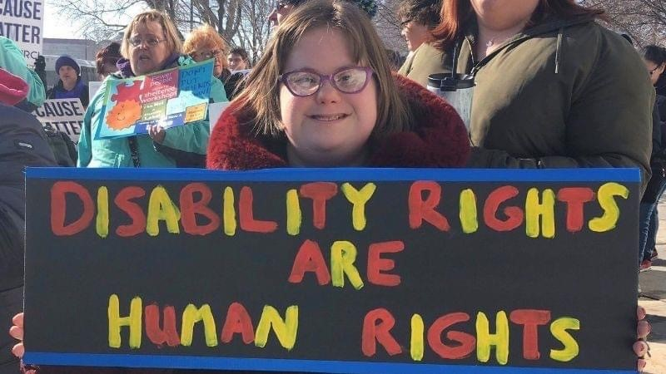
Values
Human & Civil Rights
Self-Advocacy & Self Direction
Equity & Belonging
Disability & Racial Justice
The Arc Minnesota Strategic Plan and Values Framework
Notes:
At The Arc Minnesota and Arc’s Value Village, our values guide our shared work to change systems and build an inclusive society in Minnesota and beyond.
One of the ways we have been working towards that future is by following a values framework. We aim to have all of our work founded in the values of:
Human and civil rights
Self-advocacy and self-direction
Equity and belonging
Disability & Racial Justice
Photo description: A young woman with chin-length brown hair and bangs, wearing a fuzzy red coat and red glasses. She has Down Syndrome. She is standing outside the Minnesota state Capitol holding a sign that says "Disability Rights are Human Rights" in red and yellow letters.

Slide 7
Programs and Services
Individual Advocacy
Housing Services
Advocacy & Community Engagement
Notes:
The Arc has several overarching categories for our services. We support people in the areas of:
Individual Advocacy – Includes our Help Desk where people can call in with disability related questions
Housing Services – Housing Access and Stabilization Services, and the Crisis Housing Assistance Program
The Advocacy & Community Engagement Team- Has staff in 5 regions across the state who give presentations, do outreach, and address regional issues.
Photo Description Left to Right There are icons next to each topic.

Slide 8
Programs and Services Contd.
Self Advocacy
Public Policy
Statewide Grants and Initiatives
Notes:
We also work in the areas of:
Self Advocacy & Systems Change - These groups offer social events (such as Calling All Self-Advocates and Happy Hour), training on self-advocacy skills, and they advise work at The Arc Minnesota.
Public Policy – Regional Capital Connector groups, Statewide Public Policy Committee, Advocacy Day at the Capitol, and public comments on policies
Statewide Initiatives – Various grants, such as a MicroGrants, Quality Assurance, Regional Quality Councils, and Peer-to-Peer Mentorship.
Photo Description Left to Right There are icons next to each topic.

Slide 9

Emergency Preparedness for People with Disabilities

Slide 10
Resources
Preparedness for All: Emergency Planning for People with Disabilities
https://www.youtube.com/watch?v=phzNF4wwLs0
Minnesota Council on Disabilities
https://www.disability.state.mn.us/technical-assistance/emergency-preparedness/emergency-plan/
Centers for Disease Control and Prevention (CDC)
https://www.cdc.gov/disability-emergency-preparedness/people-with-disabilities/index.html
Rachel Garaghty, MN Department of Health, Health Equity Strategist/Emergency Preparedness Response
651-201-4153, Rachel.Garaghty@state.mn.us
Kody Olson, Emergency Management Coordinator, olsonda@mgmc.com

Slide 11
Functional and Access Needs
Access Needs
Physical
Communication
Sensory
Functional Needs
Independence
Transportation
Medical care
Supervision
Safety
Health maintenance

Slide 12
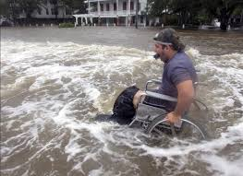
Access and Functional Needs Resource - FEMA
https://www.fema.gov/sites/default/files/documents/fema_access-and-functional-needs-support_fact-sheet.pdf

Slide 13
Connect with us!
General Information
arcminnesota.org
833-450-1494
Info@arcminnesota.org
P.O. Box 64007 St. Paul, Minnesota 55164
Facebook: www.facebook.com/thearcminnesota
Twitter: twitter.com/thearcminnesota

Slide 14

We are not experts at this – We Want To Connect with You!!
Connect with The Arc!
How do we partner together?
Mai Thor, Chief Program Officer
The Arc Minnesota
maithor@arcminnesota.org

Slide 15
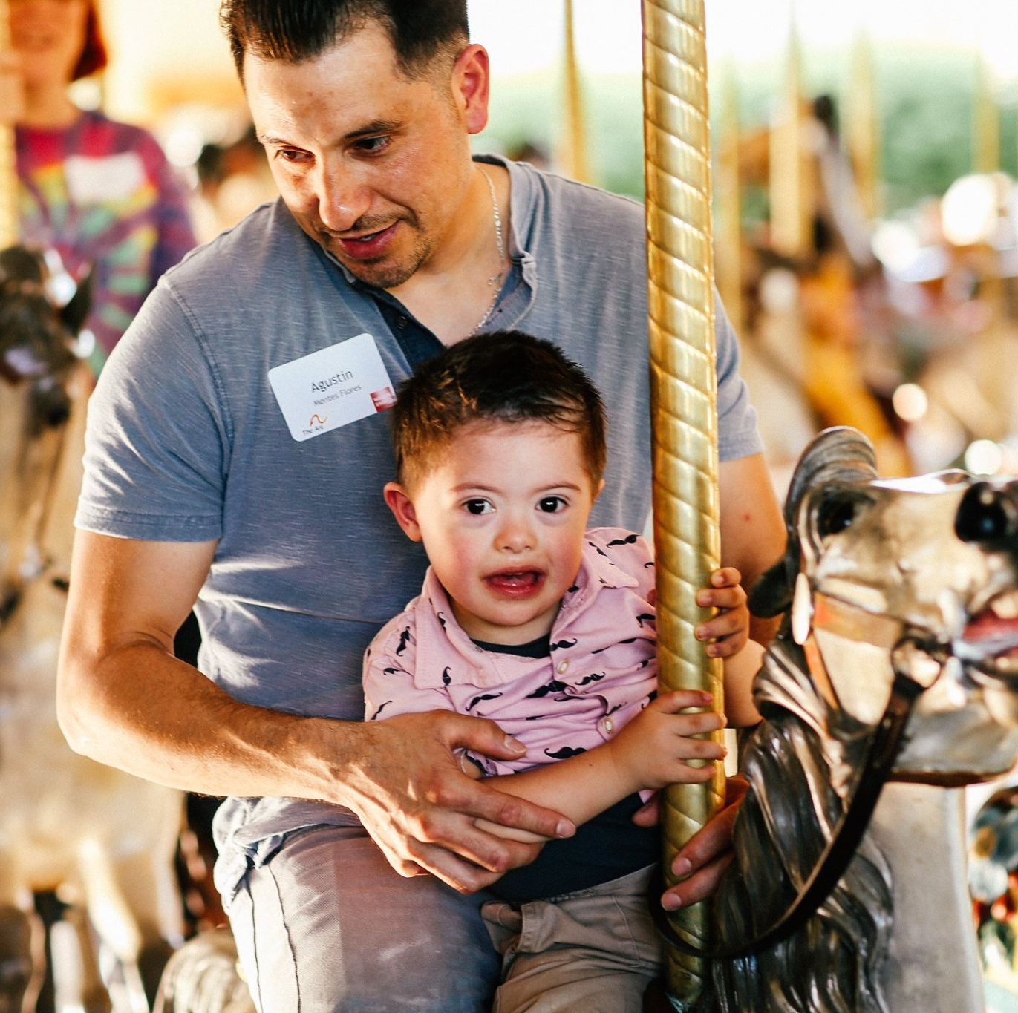
Questions?
Thank you!!
Notes:
Answer any questions the audience might have about the information presented

