Slide 1


Slide 2


Mission
To enrich, empower, and elevate people through life’s journey.
Values

Slide 3


Promoting Team Resiliency in Times of Heightened Stress
Erin Hurley Robinson, M.A., M.Div.
Team Chaplain Manager | Mental Health First Aid Instructor

Slide 4
Reflections
What are you noticing:
In your team members as individuals?
In your team as a whole?
In yourself?
Consider challenges, strengths, and gaps.
Please share your reflections in the chat.

Slide 5
Special Considerations
Individuals:
Personal stressors
Barriers
Values & beliefs
Teams:
Internal resources
Equity
Accessibility

Slide 6
Promoting resiliency with individuals
Maintain safe, trusting relationships
Recognize strengths and contributions
Acknowledge challenges and limitations
Encourage awareness and use of internal resources
Check in regularly
Support reasonable, sustainable self-care at work
Remember: being clear is kind

Slide 7
Promoting resiliency within a team
Incorporate wellness practices into team meetings
Create opportunities for growth and connection
Offer or sponsor continuing education
Respond as needs arise
Be creative in care – support doesn’t have to be somber
Bring mission, vision, and values to life → purpose matters!
Address conflict with kindness and curiosity

Slide 8
Being a resilient leader
Practice what you preach
Continue growing in attunement, active listening, and empathy
Learn to recognize early signs of burnout and mental health challenges
Develop mental health and wellness literacy
Invest in your own holistic wellbeing
Embrace your humanity

Slide 9
During high stress seasons…
…leadership often looks like adaptation
Increase check-ins
Increase reminders of resources
Increase flexibility: adjust responsibilities, timelines, expectations as able
Communicate clear action plans for potential crises
Make space for shared humanity
Remember to care for yourself while caring for your team – resources exist for your use, too!

Slide 10
Remember…
Modeled behavior is promoted behavior
What you do matters more than what you say
Some things can’t be fixed – that’s normal and okay
Presence and validation matter deeply

Slide 11
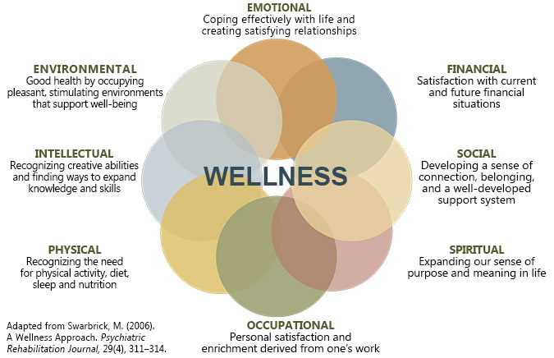
A couple favorite resources…
Notes:
The 8 Dimensions of Wellness - Workplace Wellness Lab

Slide 12
A couple favorite resources…
NAMI Minnesota Crisis Resources
988 - National Suicide and Crisis Lifeline
SAMHSA
Trauma Stewardship by Laura van Dernoot Lipsky

