Slide 1
Long Term Care Emergency Preparedness Call
Metro Health & Medical Preparedness Coalition
August 2026

Slide 2




Put in the chat your name, facility name, and favorite summer activity!

Slide 3
Agenda
Topic | Description | Speaker
Welcome & Introductions | Please put your facility name and type in chat | All
Coalition Updates | Education and training updates from the Metro Coalition | Emily Moilanen
Special Topic: Evacuation Transportation | Group discussion on gaps, best practices, resources | All
Group Report-out: Recent Survey or Event | Have you had a recent survey or emergency event? Please share any insights or questions with the group. | All
Next meeting: November 5, 2026 @ 10:00am | Topic: TBD | Emily Moilanen
Adjourn |  | All
Notes:
EM

Slide 4
Training Updates
Coalition Orientation (Virtual)
  August 25, 1:00-1:45
  Register: email Christine.chell@hcmed.org
MNTrac Training for New Users (Virtual)
  September 17, 1:30-2:30
  Register: MNTrac Training for New Users (Virtual) Tickets, Thursday, September 17 • 1:30 PM - 2:30 PM CDT | Eventbrite
Introduction to Healthcare Incident Command System (In Person)
  October 6, 8:00am-4:00pm
  Register: Introduction to Healthcare Incident Command System (HICS) Tickets, Tuesday, October 6 • 8 AM - 3:30 PM | Eventbrite
Quarterly Coalition Meeting (In Person)
  October 14, 9:00am-3:00pm
  Register: Metro Health & Medical Preparedness Coalition Meeting Tickets, Wednesday, October 14 • 9 AM - 3 PM | Eventbrite

Slide 5
Exercise Opportunity
Annual Community-Based Exercise
Audience: long term care, home care, hospice, clinics
When: September 22, 2026
  Two time options: 9:00am & 1:00pm
Location: Virtual
Registration: Community Based Exercise Opportunity for LTC, HC/H, and Clinics - 9/22/2026 Tickets, Multiple dates | Eventbrite
Scenario: Evacuation
*No residents will be moved during the exercise*

Slide 6
Meet your Senior Advisory Committee (SAC) Representatives
Did you know that you have LTC representatives that sit on the Coalition Senior Advisory Committee?
  Lindsay Schmidt, Paruan, lschmidt@paruan.com
  Pam Hayle, Cassia, Pam.Hayle@cassialife.org

Slide 7
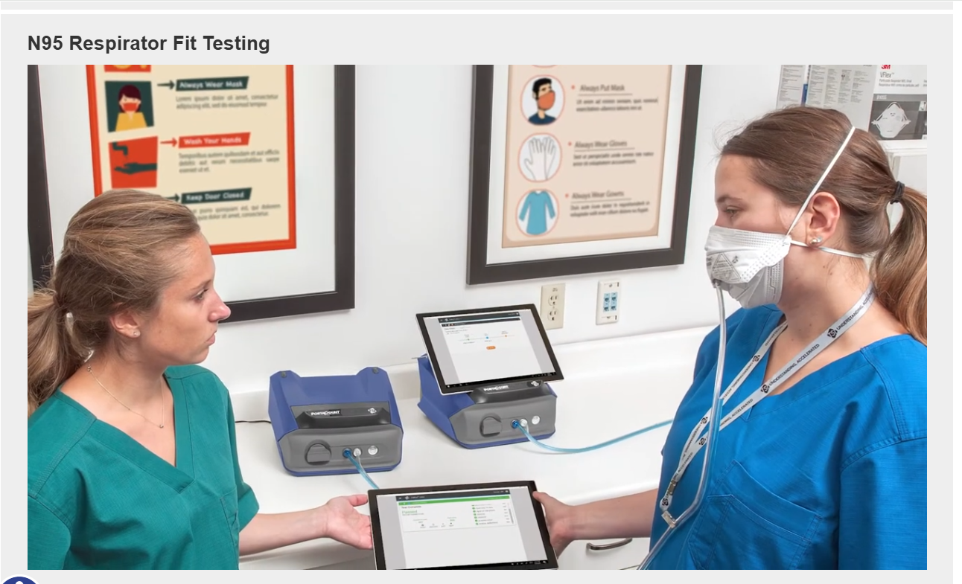
Resource Available:
PortaCount for Quantitative Fit-testing
Contact the Coalition if interested in borrowing a PortaCount:
Emily.Moilanen@hcmed.org
Carol.christians@hcmed.org

Slide 8
Group Discussion: Evacuation Transportation

Slide 9
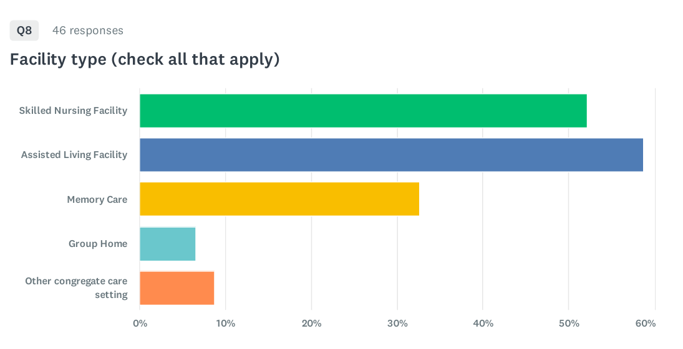
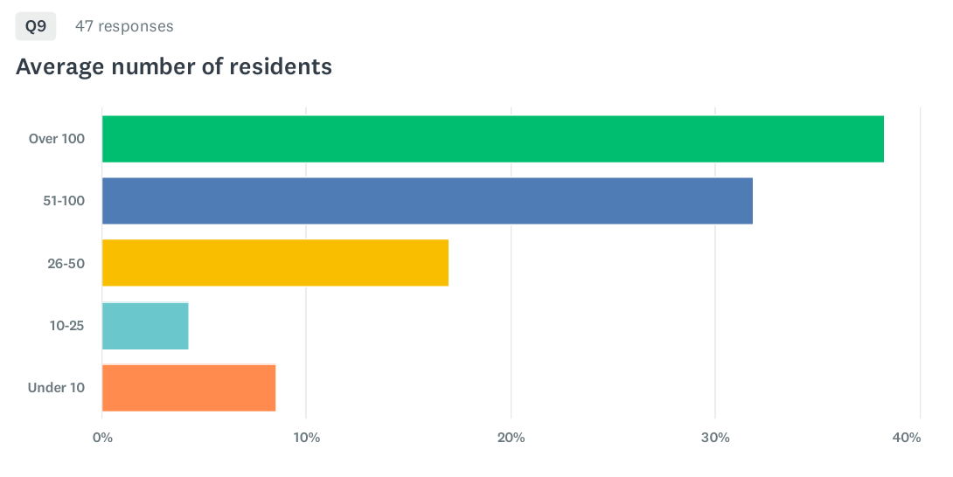
Survey Results-Evacuation Transportation

Slide 10
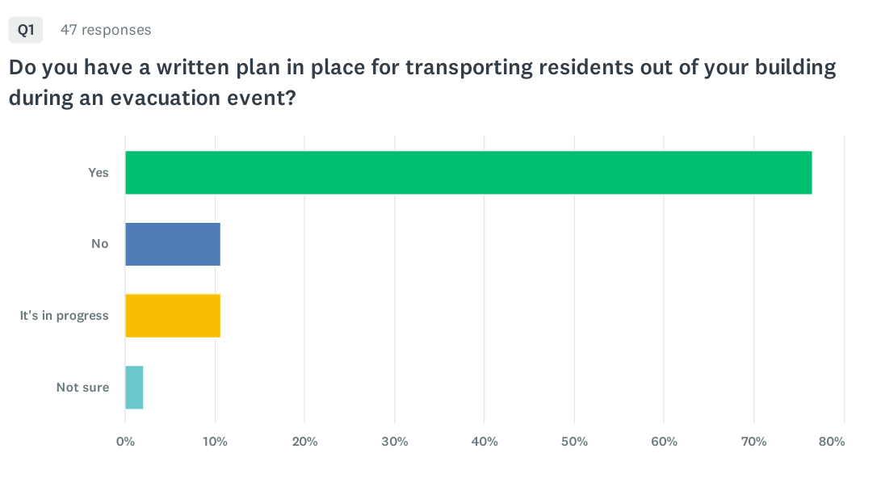
Survey Results

Slide 11
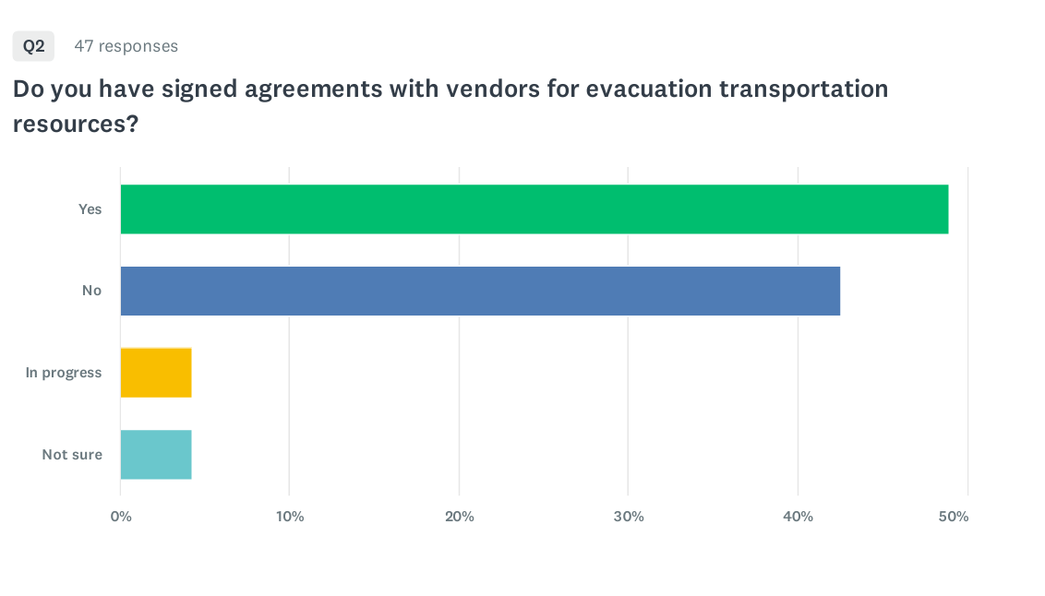
Survey Results
Notes:
No, why? Because you have agreements with other entities? Sister facilities? Your own resources?

Slide 12
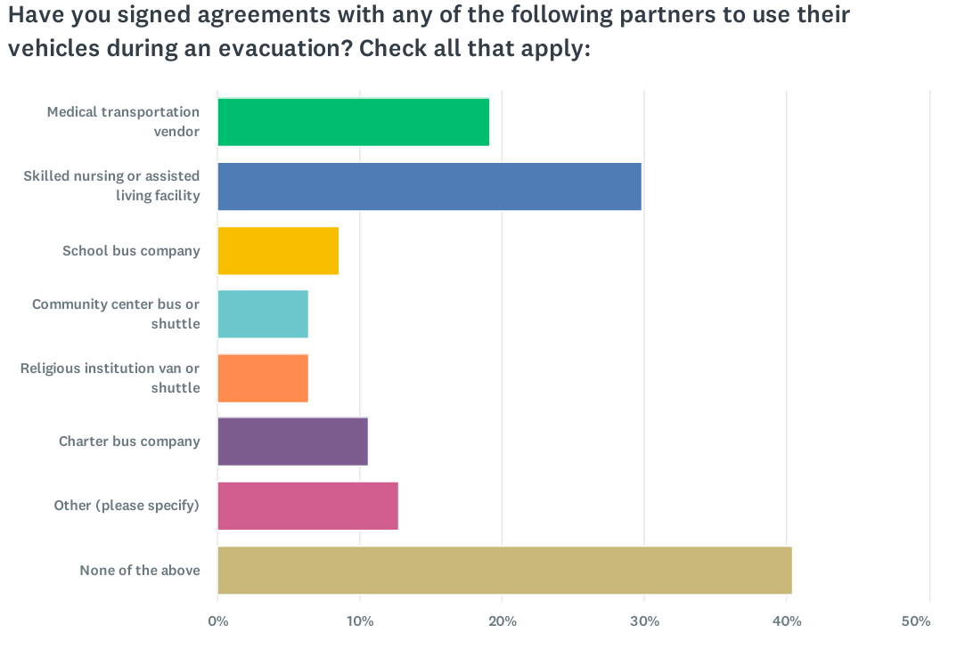
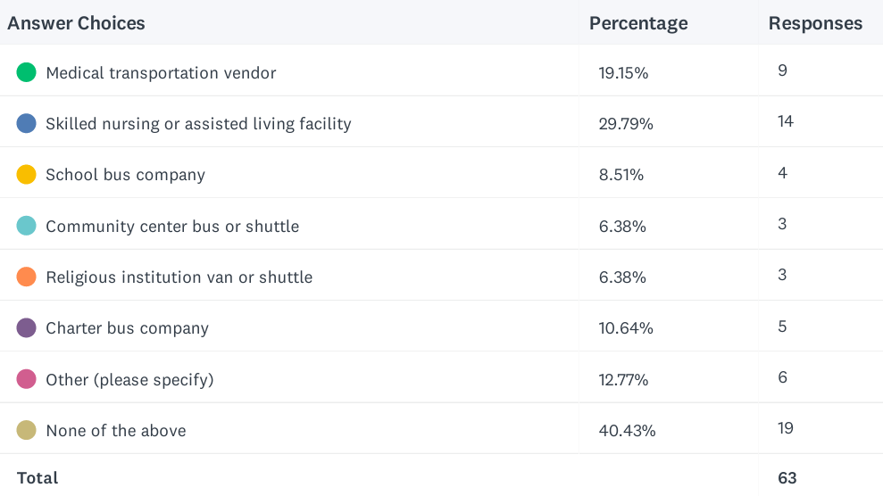
Survey Results

Slide 13
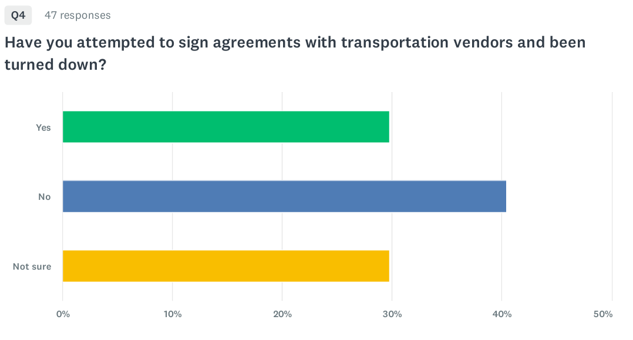
Survey Results
Notes:
No, haven’t been turned down or no haven’t attempted to sign agreements?

Slide 14
Q5 If you were turned down, what was their reason?
Hard to get ahold of/no answer
Driver availability
  Can’t guarantee transportation would be available
  Vendors are not 24/7 agencies
Cost to sign contract
Won’t risk drivers in an emergency

Slide 15
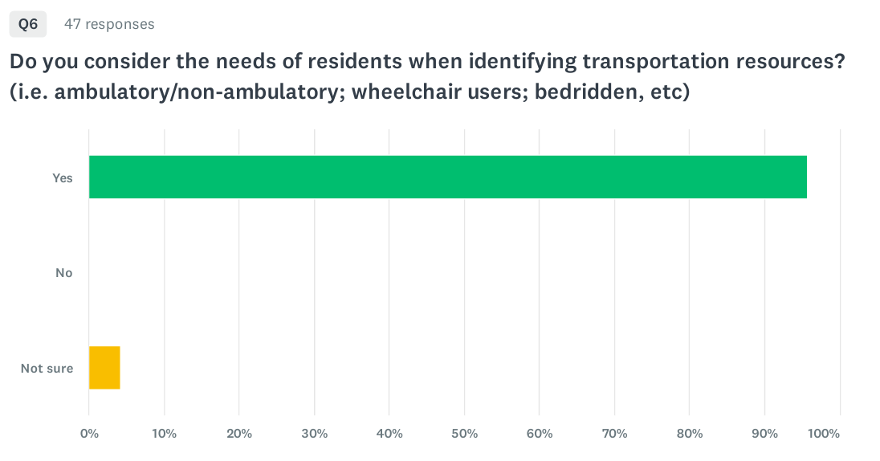
Survey Results

Slide 16
Q7 Please share any alternative strategies you have for obtaining emergency evacuation transportation:
Utilize vehicles at sister facilities
MOUs with facilities in the area
Facility vans/shuttles
Staff vehicles
Call-down list of transportation vendors
Family members picking up
911/ambulances
Notes:
Most plan on using sister facility resources or resource within company. But what if you aren’t part of a larger corporate entity?

Slide 17
Group Discussion
What are you finding most challenging about locating evacuation transportation resources?
Have you taken a creative/alternative approach to planning for evacuation transportation?
Are there ways the Coalition can support on a regional level?
  List of regional resources
  List of medical vendors
  Assistance connecting you to other facilities in the area
  Review of available partner resources
Notes:
Queue Angie up to describe her approach

Slide 18
Next Steps
Emily & Carol are meeting with various response partners to gather more info on available resources
  Emergency management
  Law enforcement
  EMS
  Other Coalitions
November LTC meeting
  Review findings
  Guest speaker?
Explore whether the Coalition can offer a regional approach/support in this area.

Slide 19
Group Report-Out: Recent Survey or Event
If you have had a recent survey or response, please share insights, lessons learned, or aha’s with the group!

Slide 20


Slide 21
Next Meeting: November 5, 10:00-11:00am
Topic: TBD
Emily Moilanen
Emily.Moilanen@hcmed.org
763.286.5839

