Slide 1

Pre-exercise Training
Operation Safe Haven Exercise
September 22nd, 2026
9:00am or 1:00pm
Notes:
Hello and welcome to the pre-exercise training for the September 22nd Exercise Operation Safe Haven hosted by the Metro Health & Medical Preparedness Coalition
My name is Emily Moilanen. Today, I will be orienting you to important Exercise information. I will also be you Exercise Facilitator on September 22nd.

Slide 2
Training Objectives
Orient you to the exercise scenario, layout, and logistics
Assign roles for the exercise
Review exercise materials
Overview of day-of logistics
Notes:
The purpose of this training is to orient you to the exercise scenario and logistics; to assist you with assigning important roles for the exercise; to review exercise materials, and to give you an overview of day-of logistics.

Slide 3
Exercise Overview
Exercise name: Operation Safe Haven
Date/Time: September 22, 2026; 9:00am-11:30am or 1:00pm-3:30pm
Type: Community-based, Functional
Length: 2 hours and 30 minutes
Scenario: Evacuation
Location: Virtual
Sponsor: The Metro Health & Medical Preparedness Coalition
Notes:
The Exercise Operation Safe Haven takes place on September 22nd, 2026. There are two options to participate: 9:00am or 1:00pm. The exercise will last for 2 ½ hours. This exercise will meet the Centers for Medicare and Medicaid Community-based exercise requirement. Participants from nursing homes, assisted living facilities, home care and hospice agencies, as well as clinics in Minnesota are welcome to participate.
The exercise will take place virtually through Microsoft Teams. Participants should gather a team at their physical location and log-on to the virtual meeting to participate. The Metro Coalition will facilitate the exercise and lead participants through exercise play.

Slide 4
Exercise Preparation
Invite your team to participate on Exercise Day
Download exercise materials from Coalition website on Sept 15th.
  https://www.metrohealthready.org/exercises/
  An email will be sent on Sept 15th once materials are on website
  The email will also include the exercise log-in link.
  Do not share exercise materials with your team until Exercise Day
    You may share the Participant Guide ahead of time
Think about which staff would be on your response team. Invite them to participate with you.
Notes:
There are a few things that you can do to prepare for exercise day.
First, be sure that you are inviting your team to participate and make sure the date/time are reserved on their calendars. Who you invite is up to you, but CMS surveyors like to see both staff and leadership participating in exercises. The scenario for this exercise is Evacuation. Think about which staff would be involved in an evacuation scenario and invite them to participate with you.
Please note, there will be no actual movement of residents or patients during this exercise. All evacuation processes will be simulated.
Next, keep an eye on your inbox for an email from the Coalition team that will be sent on September 15th. This email will contain a link to download the necessary exercise materials. It will also include your log-in link for exercise day. Prior to the exercise, download the exercise materials, print them out, and have them ready for exercise day.
We will go over the exercise materials a little bit later in this training.

Slide 5
Exercise Roles and Responsibilities
Roles to Assign
Other Roles
Observer: visit or view selected segments of the exercise. Observers do not play in the exercise, nor do they perform any control or evaluation functions. *Optional
Note-takers: Note-takers observe, taking notes on notable events, decisions and observations during exercise play. *Optional
Site Facilitator: responsible for setting up and operating the exercise location. Facilitates exercise at site level.
Evaluator: responsible for observing exercise activity and collecting observations and data.
Participants: have an active role in discussing or performing their regular roles and responsibilities during the exercise.
Notes:
The next thing you can do to prepare for exercise day is to assign important exercise roles. We recommend assigning three roles for this exercise: a Site Faciltator, an Evaluator, and Participants. We will review each of these roles in the next few slides.
Beyond these three roles, there are a couple of other roles you may consider assigning but these are optional. On occasion, we may have Observers join our exercise. For example, you may have a new staff member who is observing the exercise as part of their training. Or maybe you invite an external partner (like a Fire Marshal or Law Enforcement) to observe so that they can learn more about how your facility will respond in an emergency. The observers are there simply to watch and observe but do not participate in exercise play. Again, this is an optional role.
The other optional role is a note-taker. The Evaluator role will be taking notes on their observations during the exercise. However, sometimes it is helpful to have an additional person observing and taking notes on notable events, decisions, or observations during the exercise. This information can then be incorporated, along with the Evaluator’s notes, into the post-exercise report. You may consider adding a notetaker to your exercise, but again, this role is optional.
Let’s review the three recommended roles in further detail.

Slide 6

Site Facilitator Responsibilities
Facilitates discussion questions using the Exercise Manual
Keeps time
Redirects if players get off track
Provides prompts if players get stuck
Communicates with Exercise Director if questions/concerns
Conducts post-exercise hotwash
Exercise Day!!
Notes:
While the Metro Coalition will facilitate the overall exercise, it is also important to designate a site facilitator for your team. The Site Facilitator is responsible for setting up and operating your exercise location. They keep the team on time and on track when working through the scenario and discussion questions. The site facilitator also helps with redirecting staff if discussions go off topic as well as prompting staff if they get stuck. The Site Facilitator will use the provided Exercise Manual to guide the team through the exercise. They are also responsible for facilitating the debrief, called a hotwash, that takes place after the exercise.

Slide 7

Evaluator Responsibilities
Observe and evaluate exercise using the Exercise Evaluation Guide
Understand the exercise objectives and scenario
Ask for clarification if needed
Attend hotwash
Hand-off completed evaluation to the Site Facilitator
Notes:
The second role you should assign is the role of Evaluator. The Evaluator is responsible for observing exercise activity and collecting observations and data. The reason we exercise is to test our plans for gaps. The Evaluator’s job is to take note of gaps, areas for improvements, as well as what went well during the exercise. We are providing an Evaluation Guide in the exercise materials to assist your evaluator with knowing what to look for and take note of. The Evaluator should take notes on the Evaluator Guide and turn in the completed Evaluation to the Site Facilitator at the end of the Exercise.

Slide 8

Participants
Sign-in using provided Sign-in Sheet.
Review the Participant Guide at the start of the exercise.
Respond to the scenario as written, accepting any artificialities.
Use current knowledge and training to respond to the scenario.
Ask questions and for clarification if needed.
Participate in post-exercise Hotwash.
Notes:
Finally, you will want to make sure that you have staff participating in the exercise. Again, think of which roles would need to respond in the event of an emergency evacuation. Invite those staff to the exercise. Your participants’ job is to react to the scenario as it is presented during the exercise and use their current training and knowledge to respond. Although the exercise starts at 9:00am or 1:00p respectively, we recommend inviting your team to the exercise room 10-15 minutes prior to the exercise start time so they have time to settle in. Surveyors may ask to see documentation of which staff participated in the exercise so be sure to have all participating staff sign in using the provided Sign-in sheet, or your own documentation. Each staff member may receive a copy of the Participant Guide to review prior to the start of the exercise. This document gives staff members necessary information about the exercise without giving away the scenario ahead of time as well want them to all receive and react to the scenario information at the same time.
Participants will also participate in the post-exercise hotwash.

Slide 9
Exercise Materials
Download the exercise materials here on or after Sept 15th
Exercises | The Metro Health & Medical Preparedness Coalition
Notes:
You’ve already heard me reference several exercise materials while discussing staff roles. Let’s do a more thorough review of the materials you will need to participate. Remember, all registrants will receive an email on September 25th that contains a link where you can go to download exercise materials. If you do not see the email come through on September 15th, please check your junk or spam folder.

Slide 10
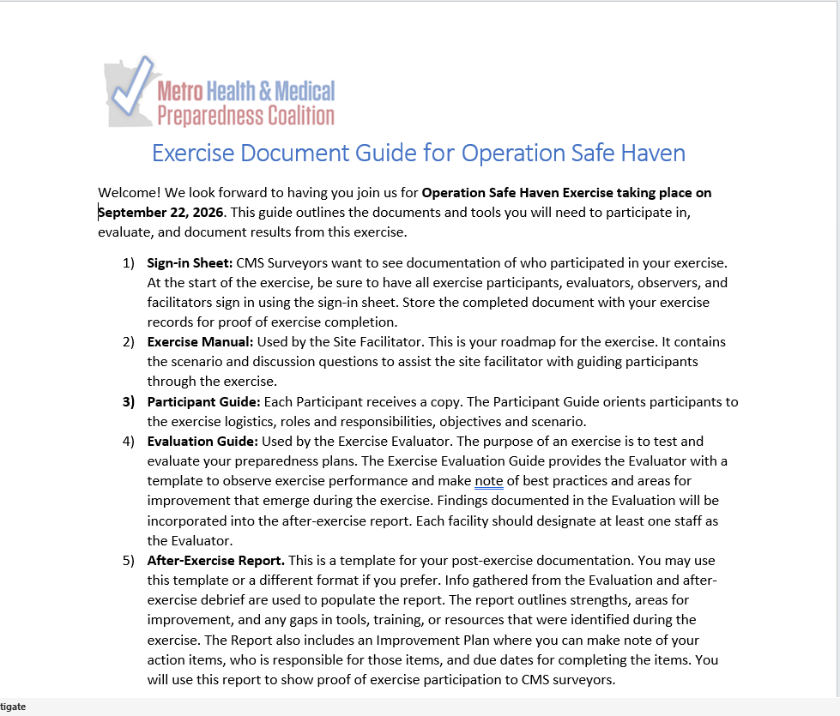
Exercise Document Guide
Notes:
As part of the exercise packet, you will receive an Exercise Document Guide. This guide describes what materials are included in your exercise packet as well as how to use each document.

Slide 11
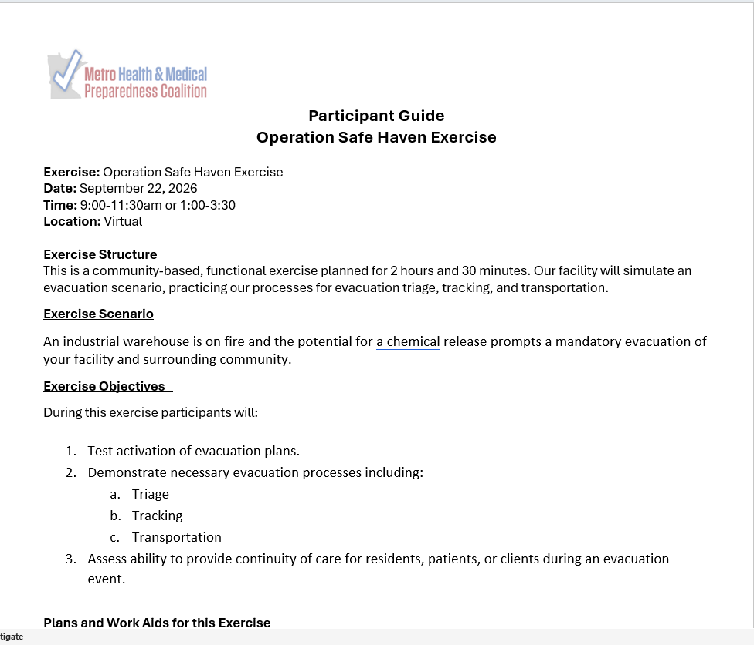
Participant Guide & Sign-in Sheet
Notes:
As mentioned earlier, we are providing you with a sign-in sheet to document who participated in your exercise. You may use the one provided or your own. We are also providing you with a Participant Guide. This guide can be shared with participants prior to the exercise or at the start of the exercise. This is a two page brief overview of what to expect on September 22nd. It helps orient staff to expectations, roles, and the scenario. Please note, there are a few fields on the Participant Guide that you need to fill in before sharing with participants. First, under the Heading “Plans and Work Aids For this Exercise”, you should fill in the facility plans or tools that you will be testing during the exercises. Next, under Participant Roles and Guidelines, you will see spaces to fill in the names of your Site Facilitator and Evaluator.

Slide 12
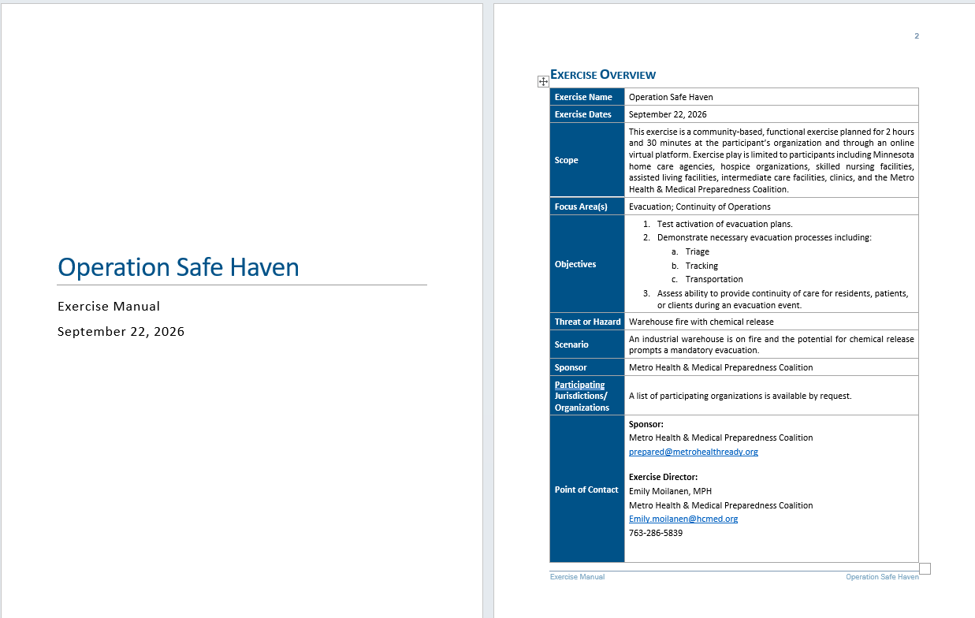
Exercise Manual
Notes:
The next document in the packet is the Exercise Manual. The Exercise manual is used by the Site Facilitator to guide participants through the exercise. It contains important exercise information as well as the scenario and discussion questions. Participants may also be provided a copy of the Exercise Manual if you like. However, they should be encouraged to avoid reading ahead in the scenario as we want them to respond to the information at the time it is presented.
Please pay attention to the headings in the discussion questions. Some questions are designated for all participants. Other questions are labeled for long term care, clinics, or home care specifically. Keep an eye on the section headers to make sure you are answering the correct questions with your team.

Slide 13
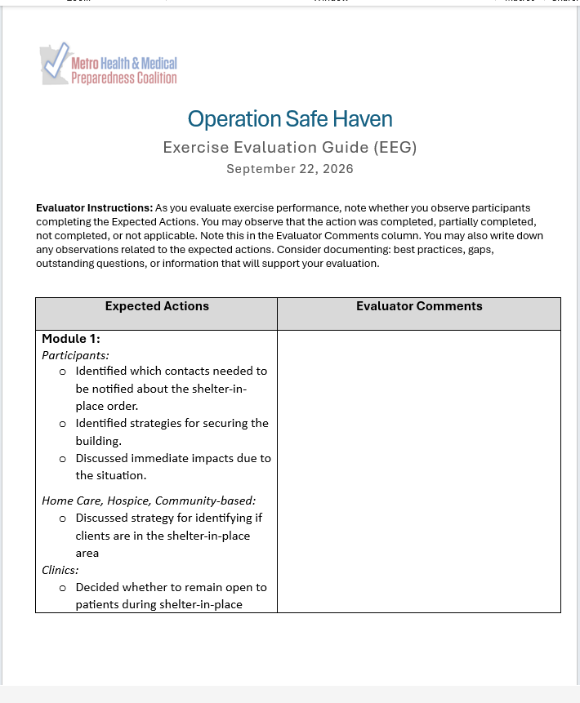
Exercise Evaluation Guide
Notes:
The Exercise Evaluation Guide will be used by your Evaluator. The Evaluation Guide is broken down by module. In the left hand column you will see Expected Actions. These are the things we expect staff to do, discuss, or perform based on the scenario. These are what you will be evaluating staff performance against. The right-hand column gives you space to take notes, document observations, or list items which need clarification. The Evaluator will submit this completed Guide to the Site Facilitator at the end of the exercise.

Slide 14
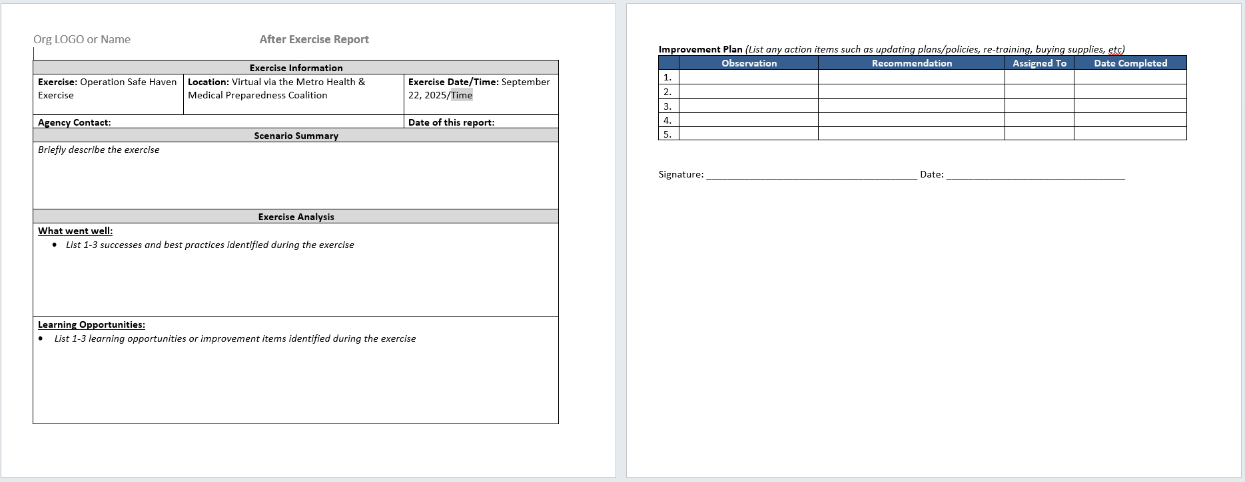
After Exercise Report/Improvement Plan
Notes:
The last document in the exercise materials packet is an After Exercise Report and Improvement Plan template. Whenever we exercise, we want to document our findings and do a brief analysis to identify strengths, areas for improvement, as well as corrective actions. The After Exercise Report gives you a space to document these findings. It is also is a great way to document your exercise participation for regulatory purposes.
You may use the template we provide, or you may use your own. Either way, be sure to document what went well during the exercise, any areas for improvement or learning opportunities, as well as action items. To populate this report you will use the completed Evaluator Guide, feedback provided during the post-exercise hotwash, and any notes taken by a notetaker, participants, or the site facilitator.

Slide 15
Exercise Day Logistics
Notes:
Now that we’ve talked about what needs to happen prior to the exercise, let’s talk about what to expect on Exercise Day.

Slide 16
Exercise Logistics
On Exercise Day, gather your team in a central location.
Have a sign-in sheet available to track who participates
Log-in to virtual exercise and follow along as the Coalition facilitates.
Exercise Tip:
Have these materials available:
Computer & internet access
Printed Participant Guide & Exercise Manual for each participant
Access to your emergency plans
Evaluation Guide for evaluator
Pens, notepaper
Notes:
On September 22nd, gather your team into a central location. This may be a meeting space, conference room, or perhaps if your staff are remote a separate virtual platform. Make sure that you have access to a computer and an internet connection. Be sure to have staff sign-in and/or document who is participating in the exercise. Each participant may receive a copy of the Participant Guide and the Exercise Manual. It may also be helpful to have copies of your emergency plans and any other resource documents staff may need to respond to the exercise scenario.
Once your team is gathered in the room, log-on to the exercise using the link provided to you in the informational email that will be sent out on September 15th. We encourage you to log-on a few minutes ahead of to the 9:00am or 1:00pm start time as we will be prompt with our start times. Once logged on, the Coalition will lead you through the exercise.

Slide 17

BEGIN EXERCISE
Notes:
The exercise will begin with some housekeeping information and a review of logistics for the day followed by the introduction of the first module.

Slide 18
Facilitator introduces Module
Discussion ?s with your team
Logistics
Logistics
Large group report-out
Introduce next module
Notes:
The exercise will consist of 4 modules. Each module will have a scenario update and a set of discussion questions. Once the module is introduced, you will be instructed to work through provided set of discussion questions with your team. Scenario updates and discussion questions can be found in the provided Exercise Manual. They will also be displayed on the screen. The Coalition facilitator will let you know how much time you have to discuss the questions with your team. Once time is up, the Coalition facilitator will call you back to the large group where they will lead you through a large group report-out with other attendees. Following the large group report out, the next module will be introduced. We will repeat this process for each of the four modules

Slide 19
Large Group Report-Out
Purpose: To encourage inter-facility discussion, peer-to-peer learning, and sharing of best practices
Logistics:
  After each module, participants will rejoin the main room.
  The Facilitator will use virtual polls, live discussion, and the chat function to facilitate sharing.
  Discussion prompts will be shared on the screen.
Reminders:
  Please stay muted unless reporting out.
  Use the chat function to respond to discussion prompts
Notes:
The purpose of the large group report out is to share information with and learn from peers at other facilities and organizations across the state. You are not required to report out but it is highly encouraged. You may either report out live by using the Raise Hand function in Microsoft Teams and waiting to be called on or by putting information into the chat. There will be discussion prompts on the screen and the Coalition facilitator will guide the large group through the report out.
Please remember to stay muted throughout the exercise unless you are reporting out. This will help to cut down on unnecessary background noise.

Slide 20

End of Exercise
Notes:
After the four modules and four group report-outs, exercise play will end. However, please stay logged on to complete your hotwash.

Slide 21

After Exercise Hotwash
What is a Hotwash?
A Hotwash is a short check-in with exercise participants immediately after the exercise to highlight.
A chance to debrief on exercise performance
Opportunity to collect information for After Exercise Report.
Questions to ask during a hotwash:
  What went well today? What are our strengths?
  Where might our plans need extra attention? What are the areas for improvement?
  Did we identify any gaps or needs during this exercise (i.e. missing plans, policies or procedures that need to be written or updated, staff training that’s needed, equipment or supplies that should be purchased, etc)?
Notes:
A hotwash is short check-in after the exercise. It gives your staff a chance to debrief on the exercise, share lessons learned, identify gaps and best practices, as well as ask any outstanding questions. Discussion prompts for completing your hotwash will be provided on the screen. Please be sure you have someone designated to take notes during this time. The information gathered during the hotwash, as well as observations collected from your Evaluator, will inform you after exercise report and action items.
Once you complete your hotwash, you will come back to the large gropu for one final report-out and wrap-up instructions.

Slide 22
Final Exercise Reminders
Know your role, the exercise scenario, and logistics for the day.
Test communications before the exercise starts.
Have all your exercise documents prepped and ready prior to the start of the exercise.
Ensure you have a space reserved for the exercise.
Follow along with the virtual platform on Exercise Day
Contact the Coalition team through Chat with any problems or questions.
Safety Comes First – real world events take precedent.
Notes:
And that’s it! The exercise will run for a full 2 ½ hours. Please plan to attend for the entire session.
Finally, some reminders to send you on your way.
Know your role, the exercise scenario, and logistics for the day. This information can be found in this training and in your exercise materials.
Test communications before the exercise starts. Make sure you have internet access and a computer.
Have all your exercise documents prepped and ready prior to the start of the exercise. You may provide the Participant Guide to staff prior to Exercise Day. All other materials should be shared with staff on September 22nd.
Ensure you have a space reserved for the exercise.
Follow along with the virtual platform on Exercise Day as the Coalition guides you through the exercise.
Contact the Coalition team through Chat with any problems or questions.
And finally, Safety Comes First – real world events always take precedent.

Slide 23
Thank you & see you on Exercise Day!
Metro Health & Medical Preparedness Coalition
Emily Moilanen
Emily.Moilanen@hcmed.org
Notes:
Thank you for attending this pre-exercise training for the Operation Safe Haven Exercise taken place on September 22nd at 9:00am and 1:00pm. We look forward to seeing you on Exercise Day!

